Slide 1
Sel Tumbuhan dan Sel Hewan
Kelompok 8 THP A
Rifqi Fawas Ulloh Yazie 2114051061
Salsabila Khalisa Tsuraya 2114051063
Puteri Syalaisya F 2114051065
Partiwi Eka Ningsih 2114051067
Nurmalinda Nisrina Partiwi 2154051001
Julianro Ragil VP 2154051003

Slide 2
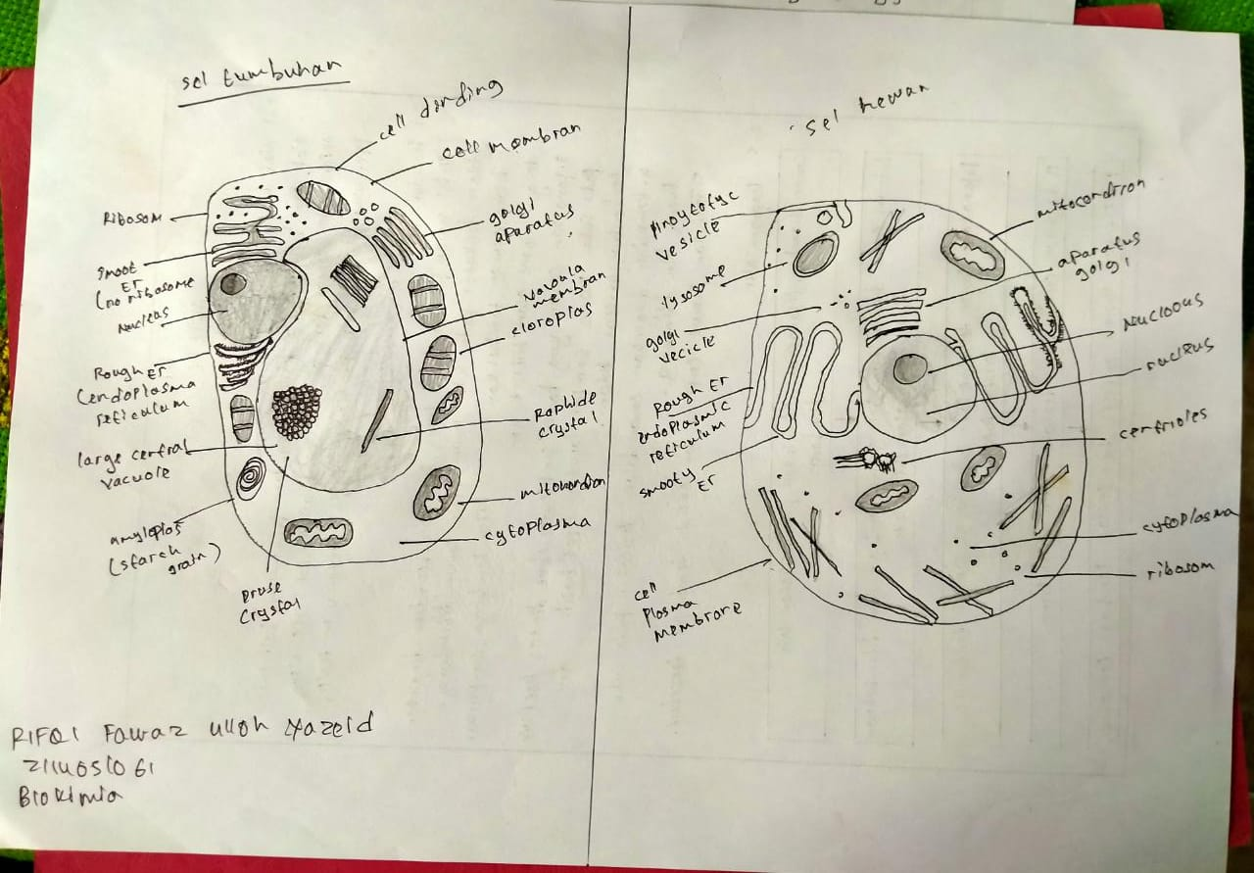
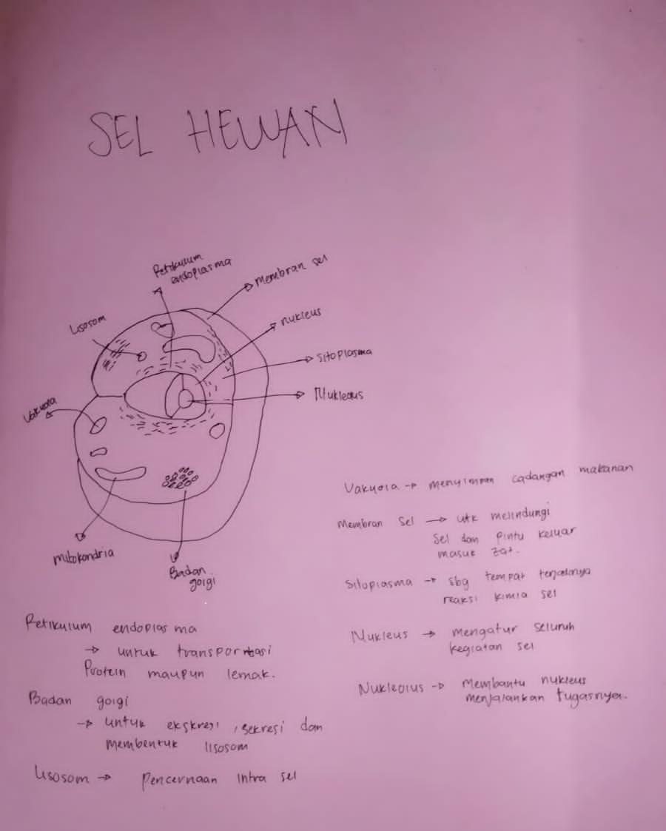
Rifqi Fawaz Ulloh Yazied

Slide 3
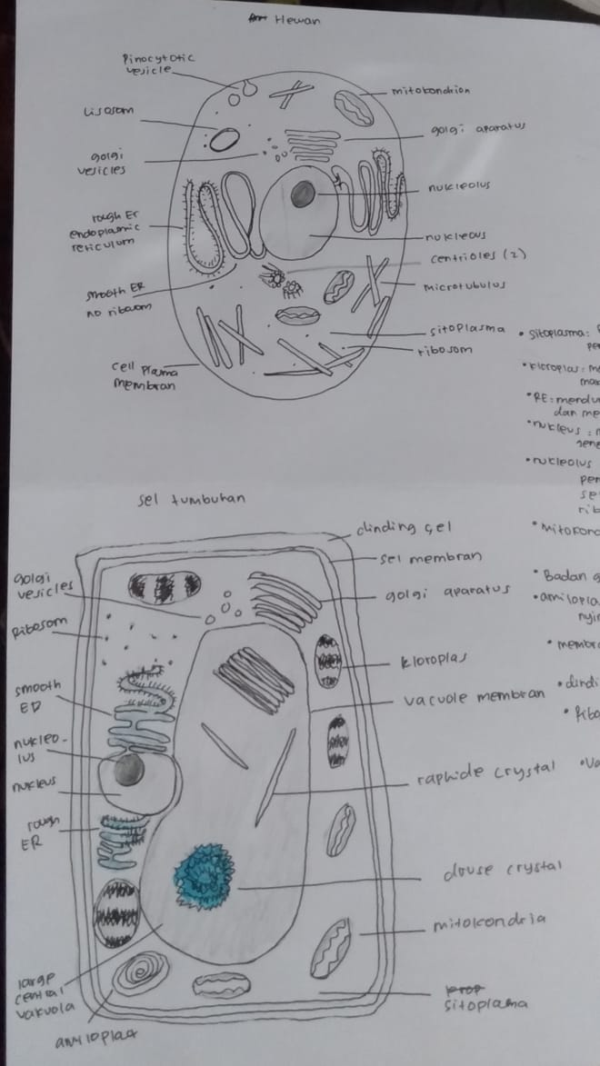
Salsabila Khalisa Tsuraya

Slide 4
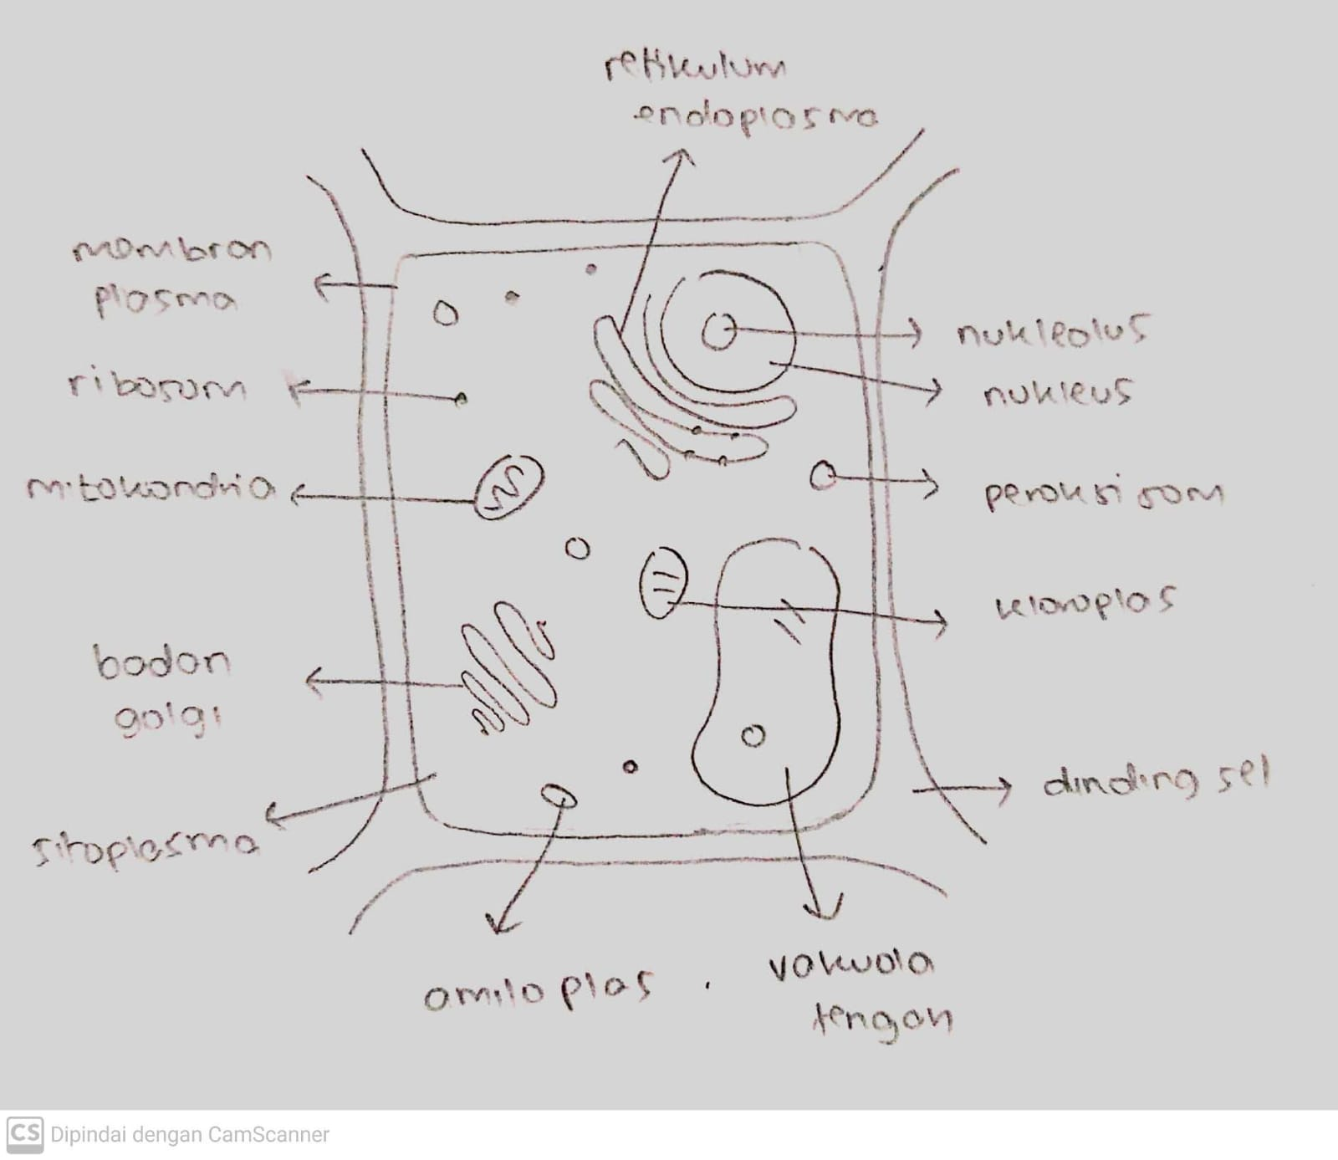
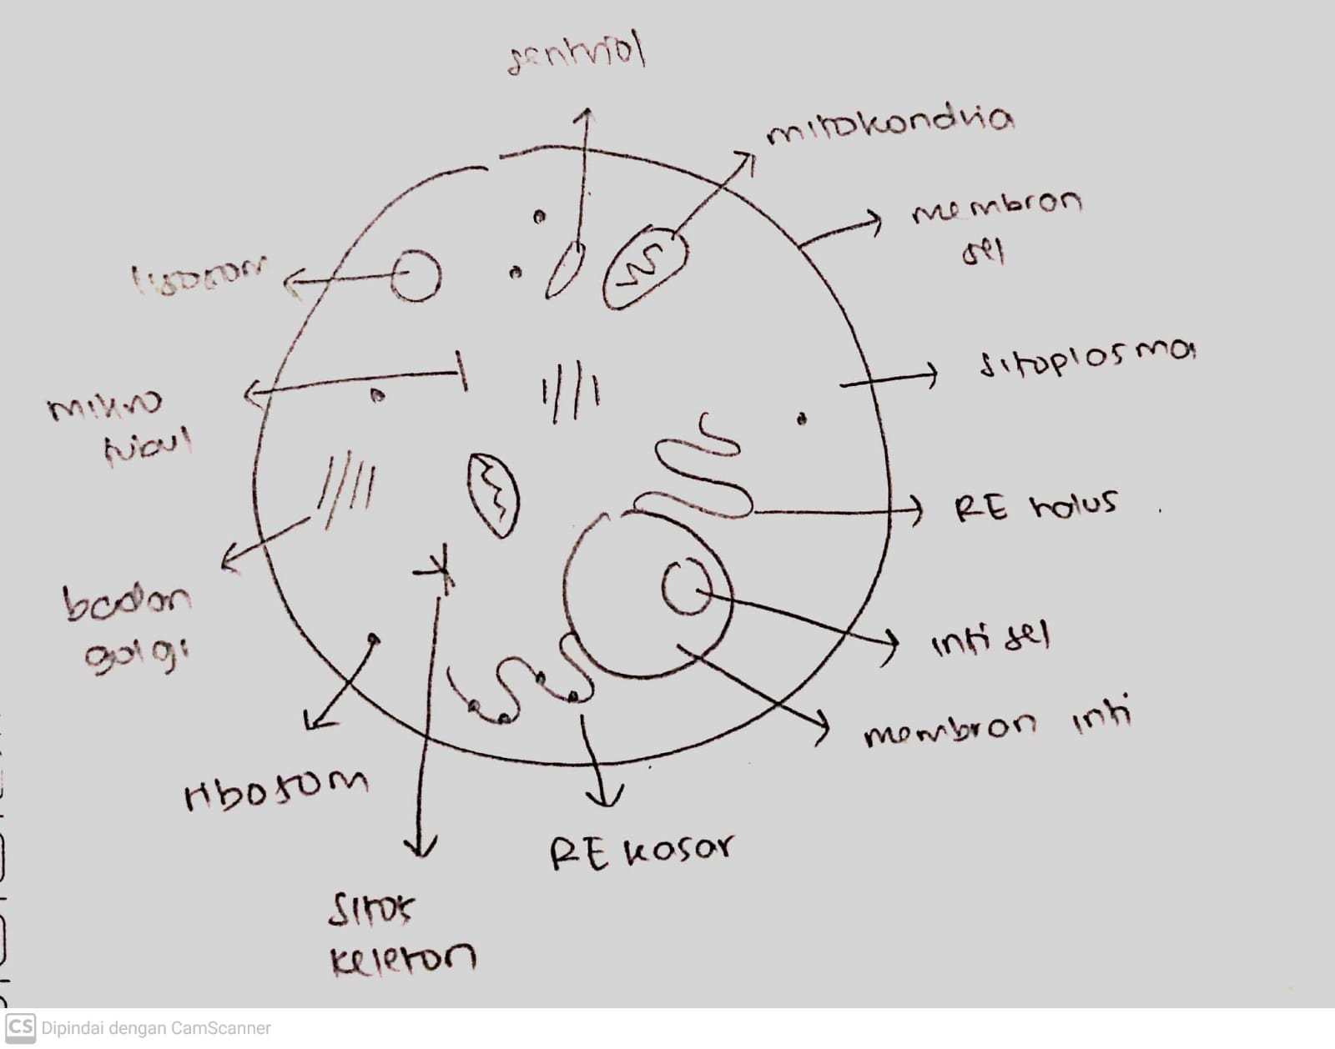
Puteri Syalaisya

Slide 5
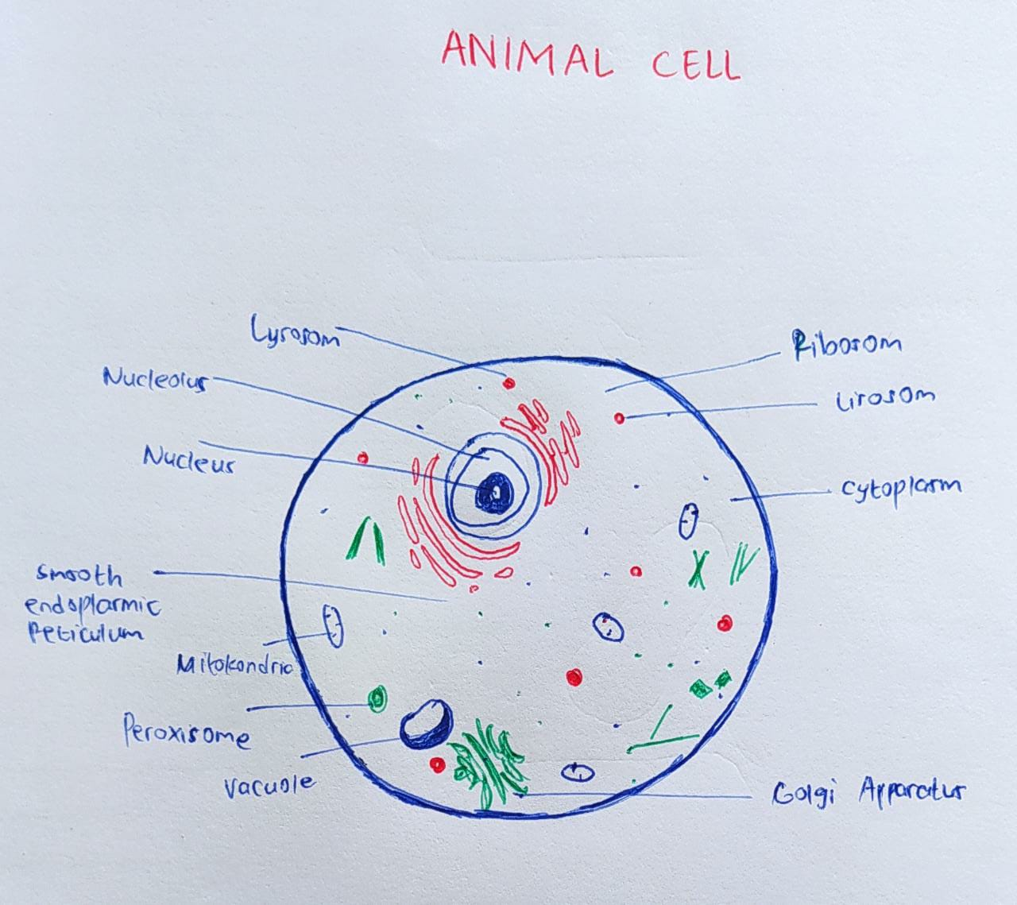
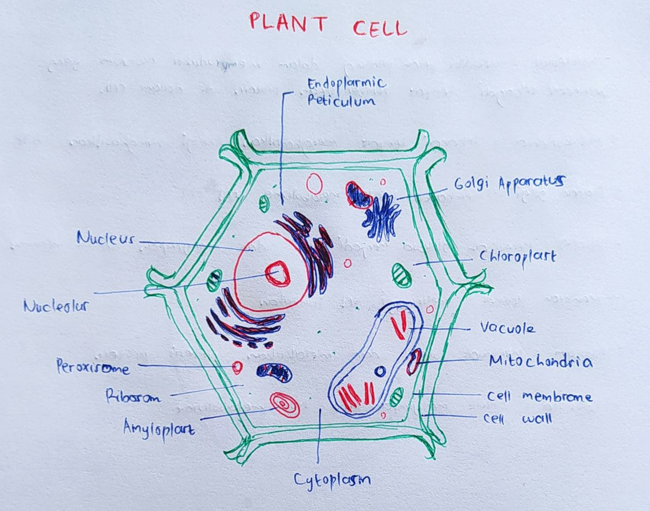
Partiwi Eka Ningsih

Slide 6
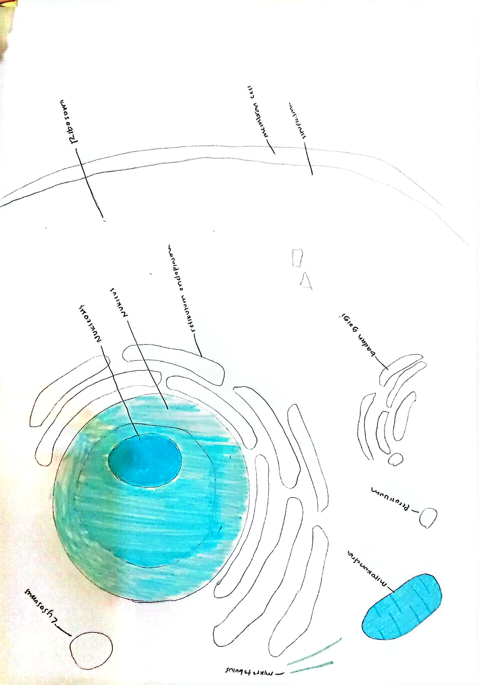
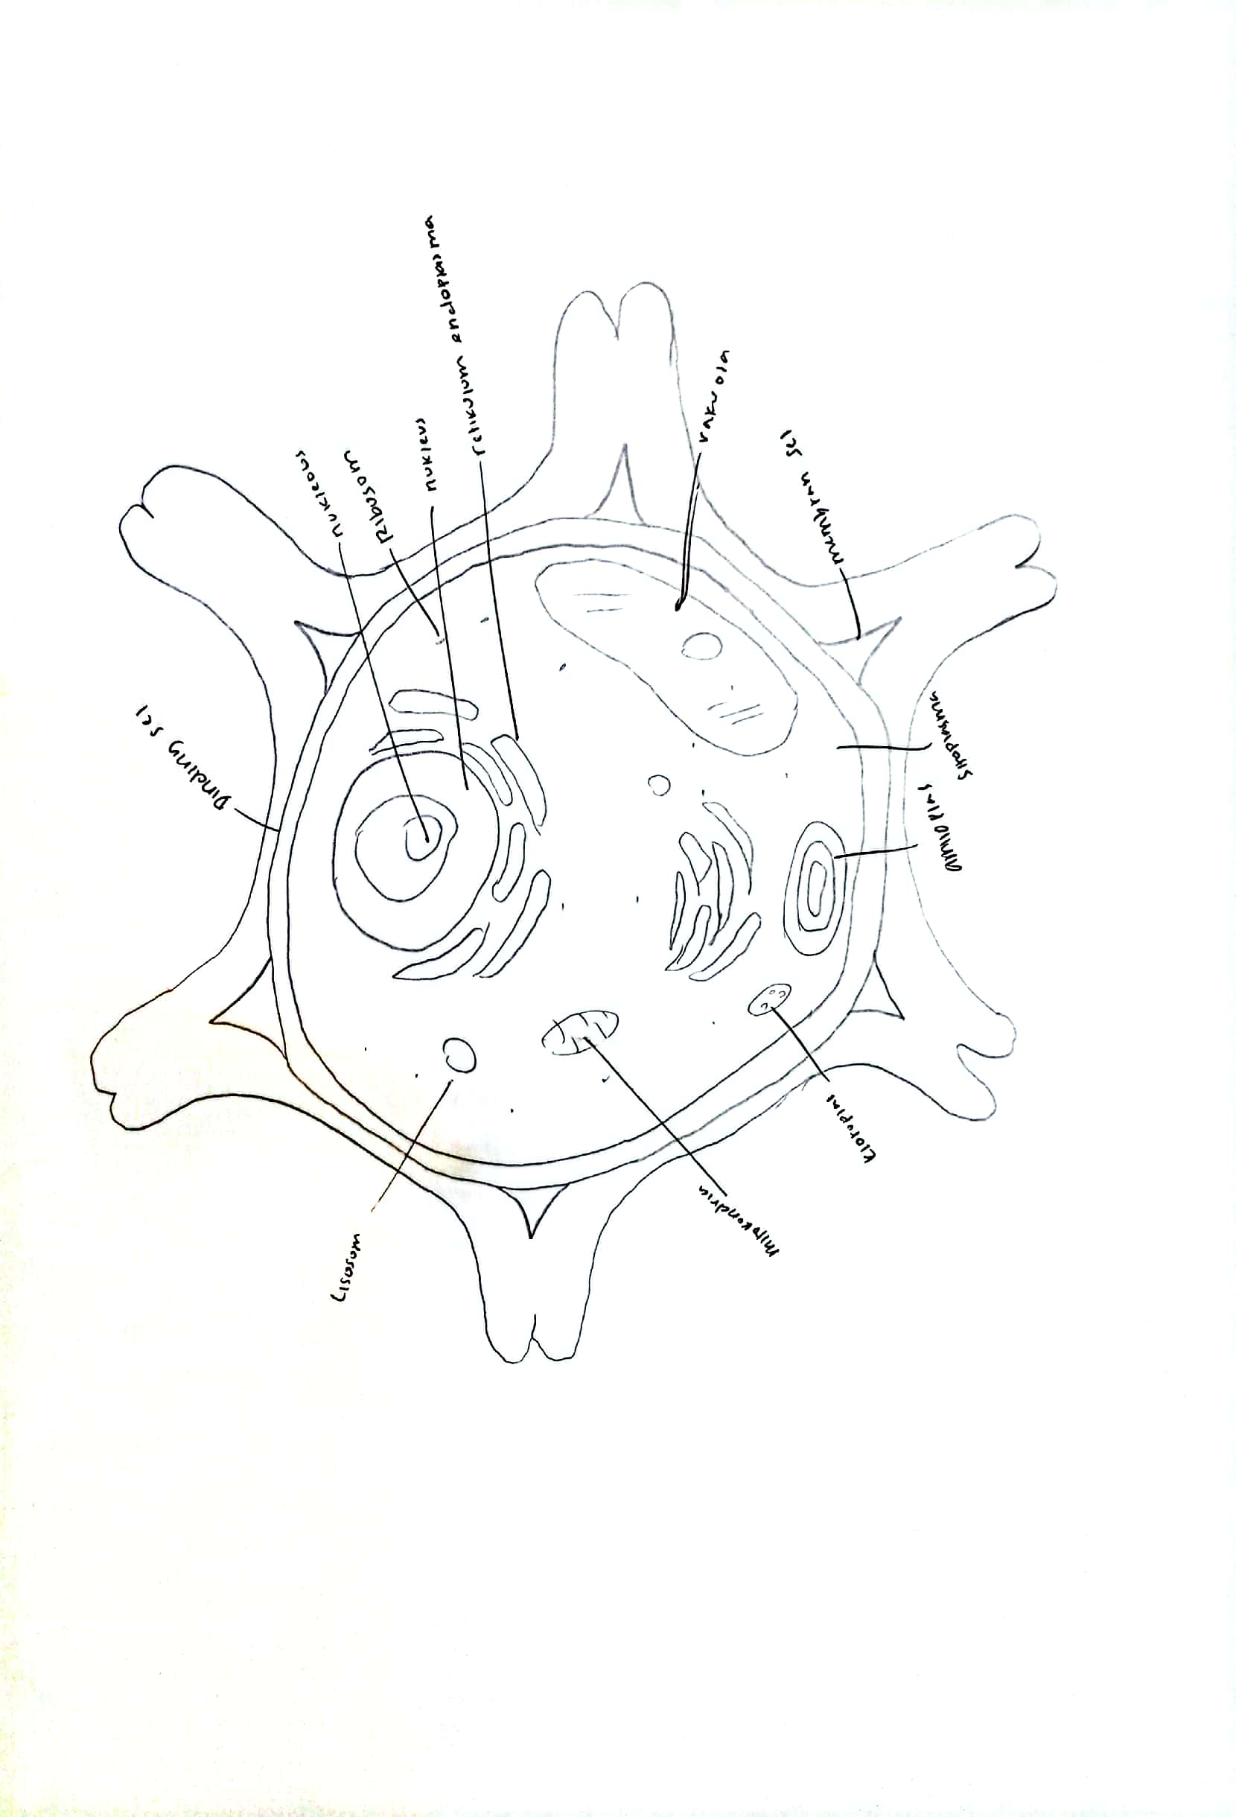
Nurmalinda Nisrina Partiwi

Slide 7
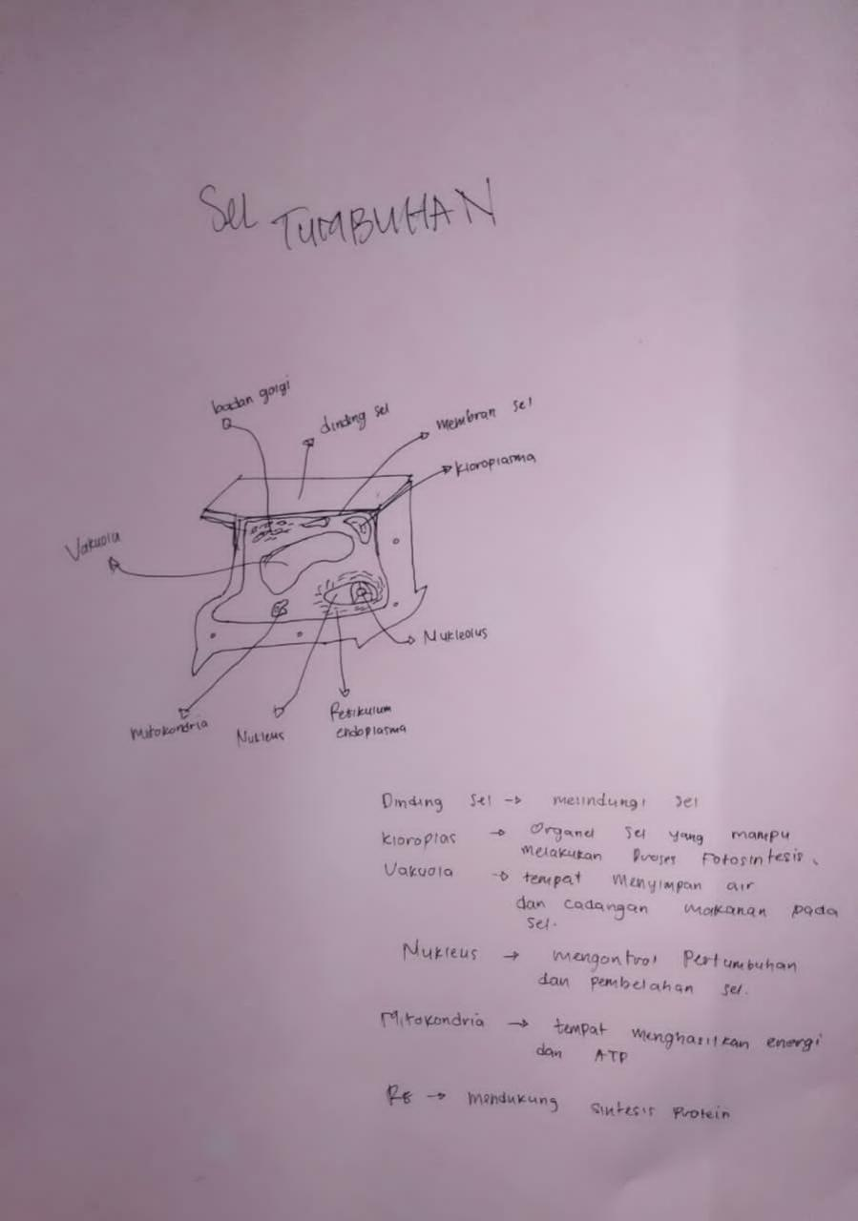
Juliandro Ragil VP

