Slide 1
Kelompok 4 THP A :
Annisa Faras Nabilah Arrijal Firdaus
Diaswara Satria Dirgantara Devi Paramita
Mutia Rahmah

Slide 2
Sel Hewan
Sel Tumbuhan
Annisa Farras Nabila

Slide 3
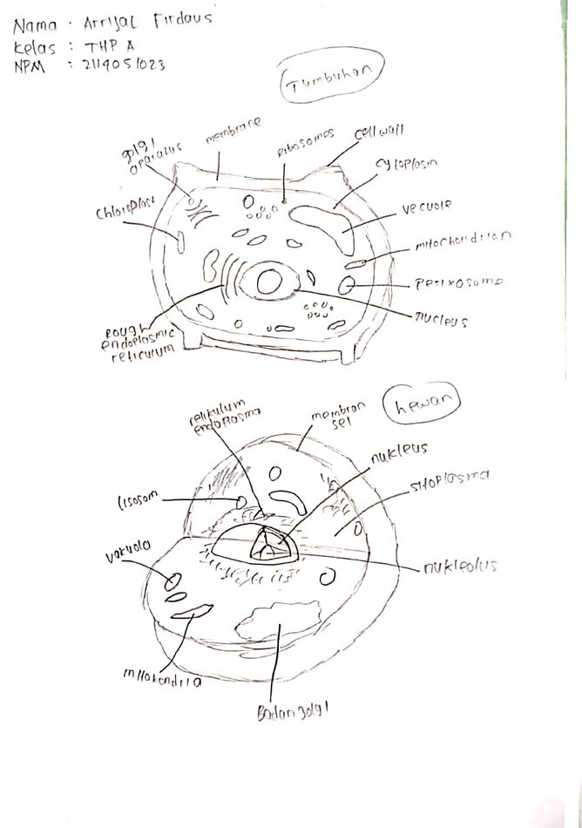
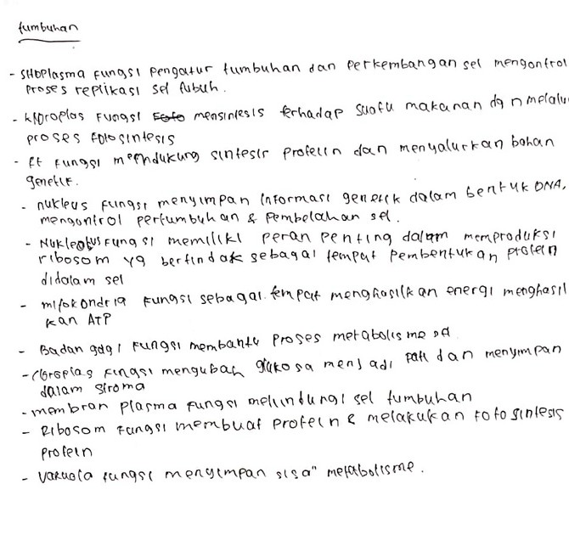
Arrijal Firdaus

Slide 4
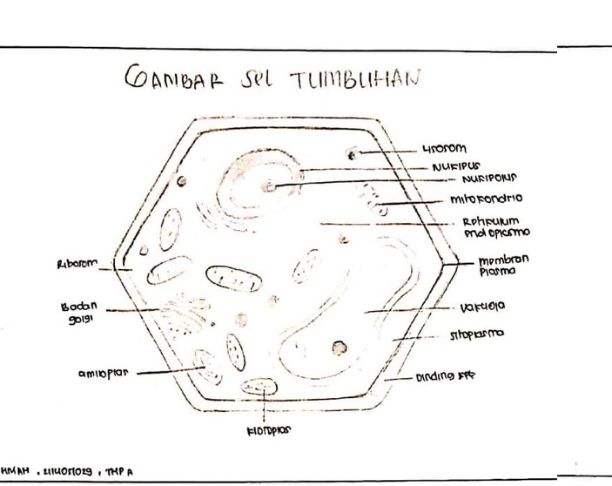
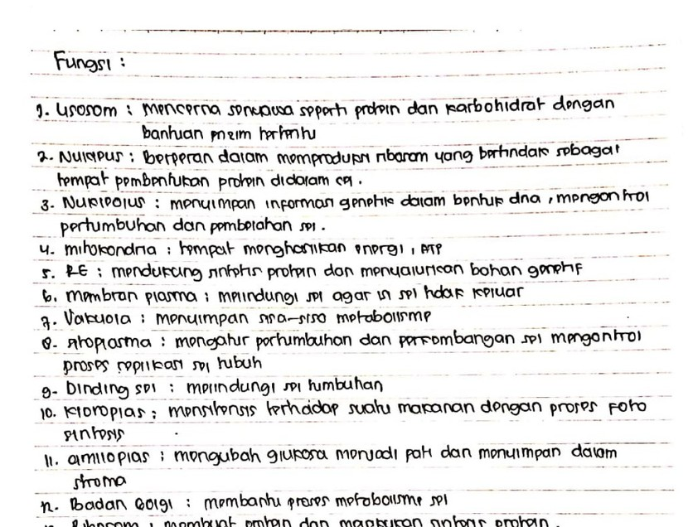
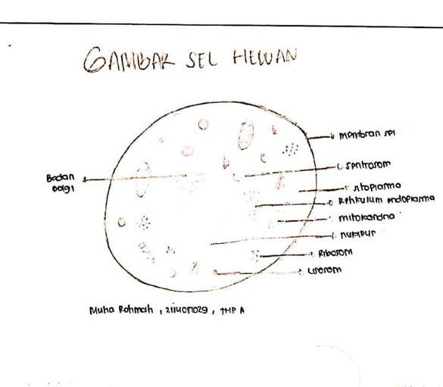
Mutia Rahmah

Slide 5
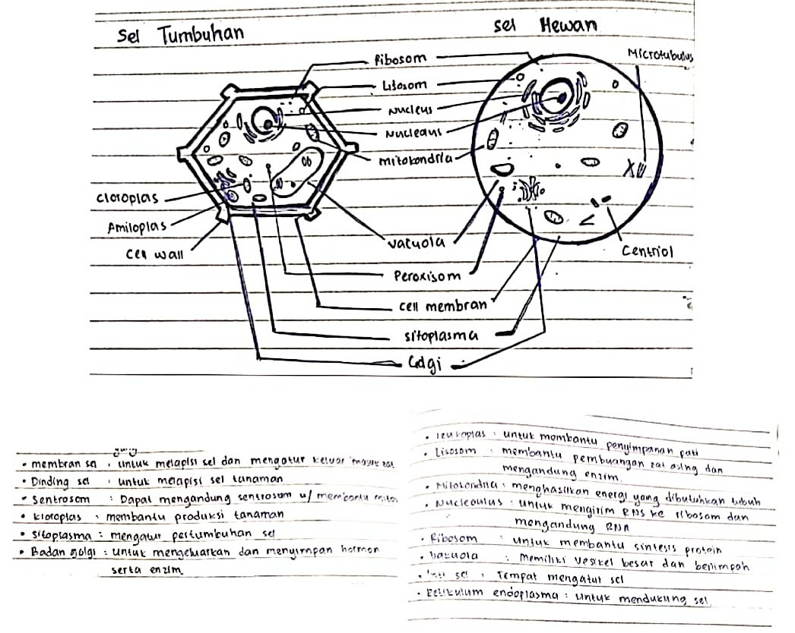
Diaswara Satria Dirgantara

Slide 6
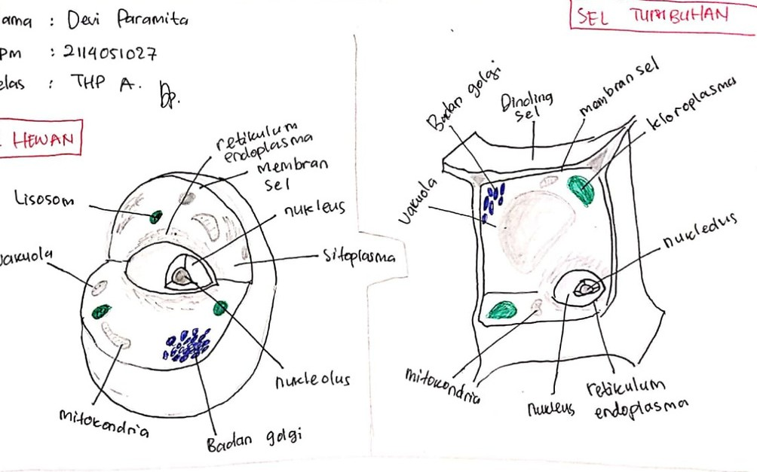
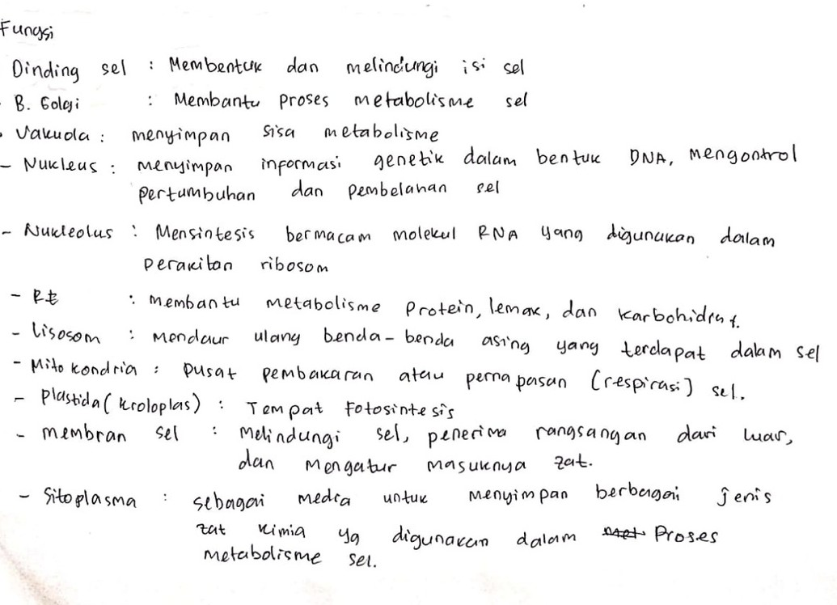
Devi Paramita

