Slide 1


Kelompok 3
Alyaa Khoirunnisa Yulian 2114051030
Glory Agnes Simarmata 2114051026
Hanifah Septiana Putri 2114051032
Maftukh Zaina Luthfiyyah 2114051024
Riza Andriantha 2114051028

Slide 2


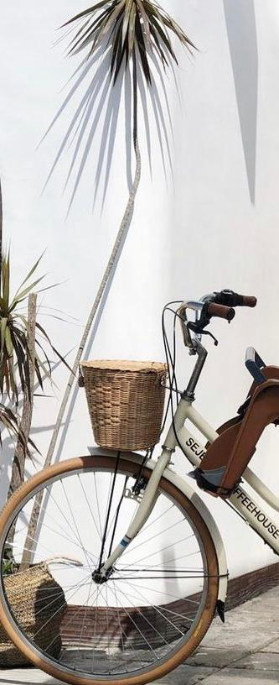
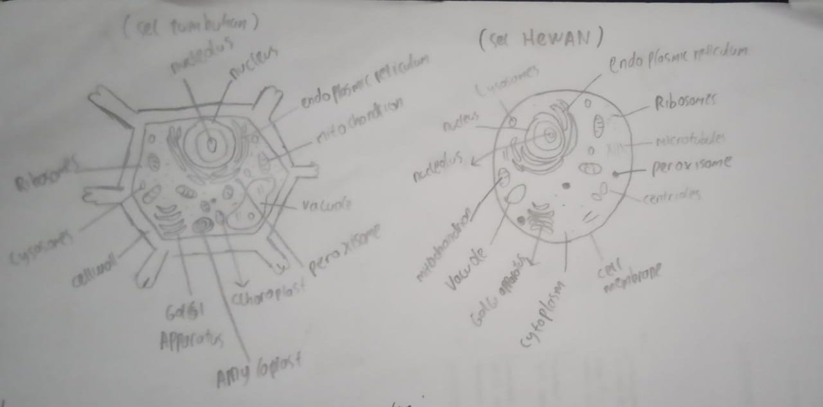
Riza Andriantha NPM 2114051028

Slide 3
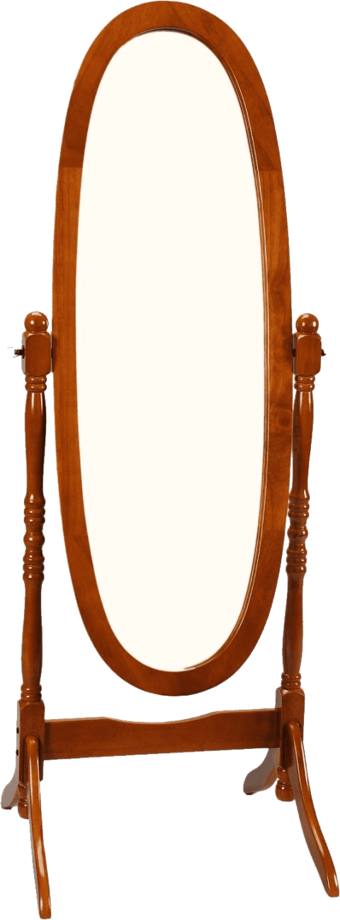
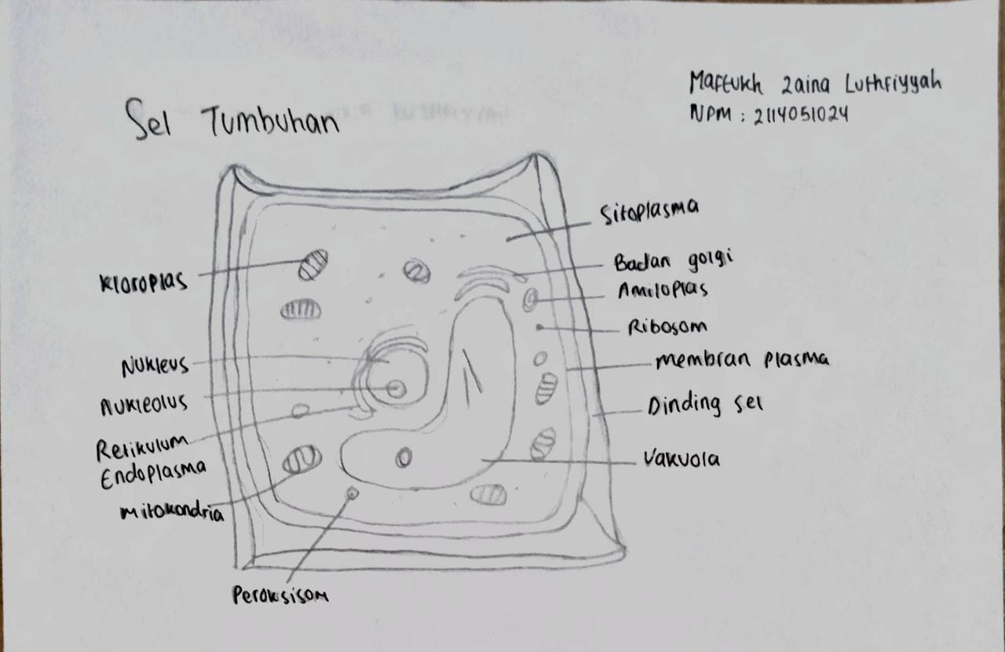
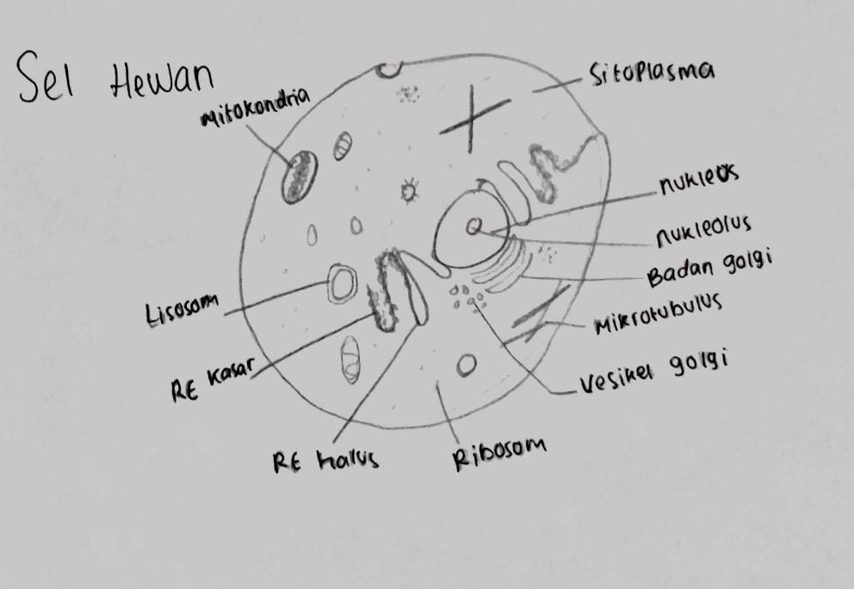

Maftukh Zaina Luthfiyyah 2114051024

Slide 4
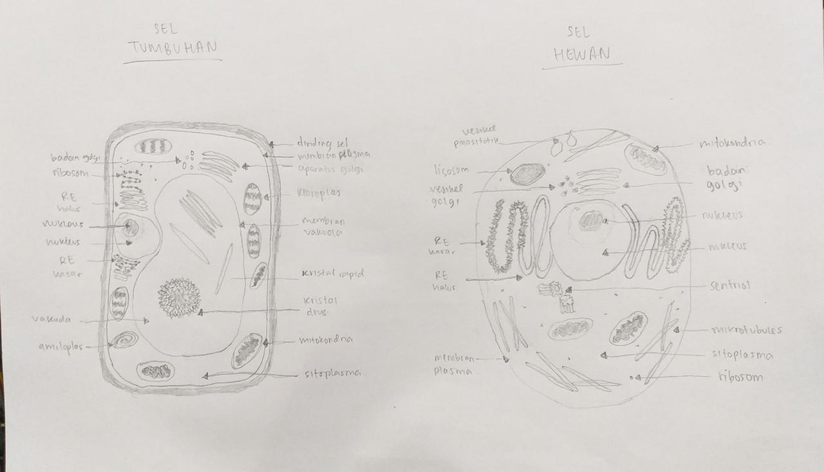
Glory Agnes Simarmata 2114051026

Slide 5
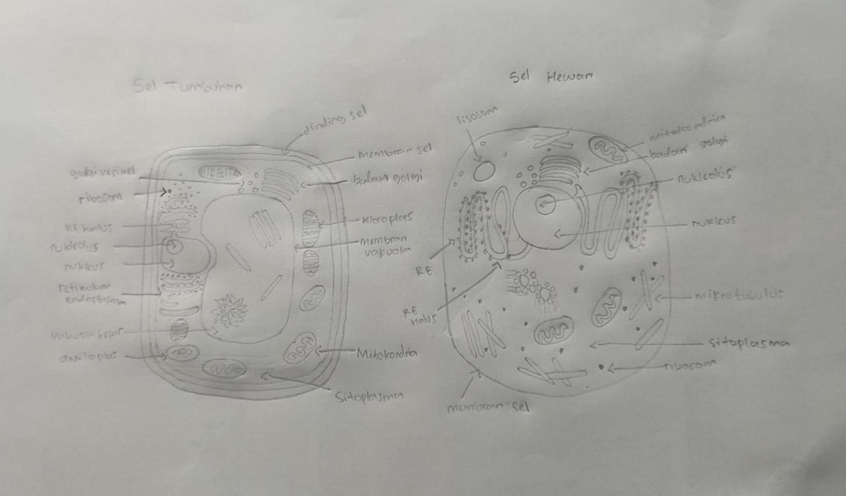
Hanifah Septiana Putri 2114051032

Slide 6
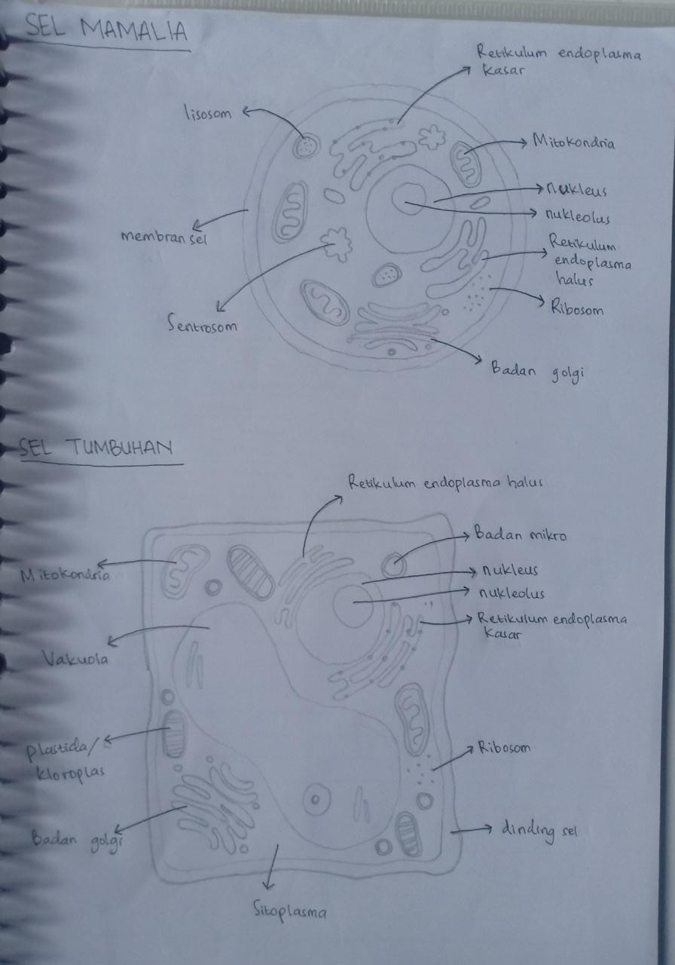
Alyaa Khoirunnisa Yulian 2114051030

