Slide 1
Kelompok 4 THP B
Hana Adilah Saputri 2114051038
Nyoman Tri Gangga Pebriana_2114051042
Tri Risma Sari_2114051034
Wanda Rahma Azzahra_2114051036
Yulia Nurainy 2114051040

Slide 2
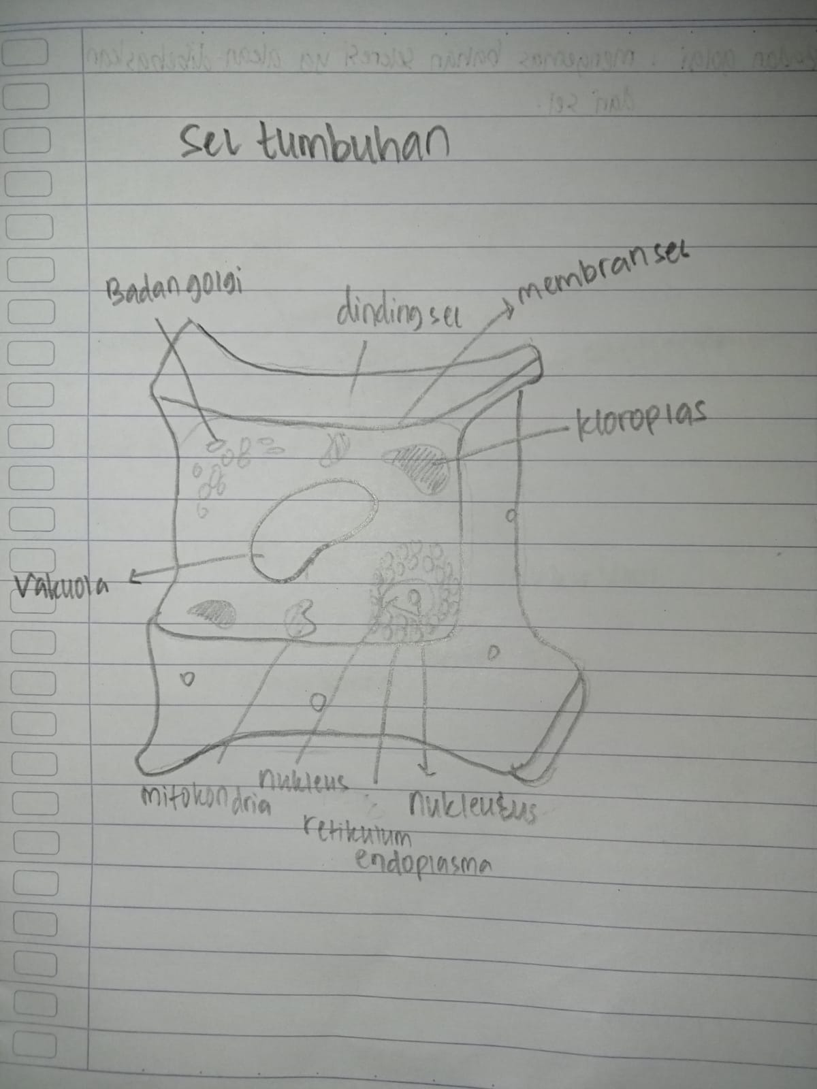
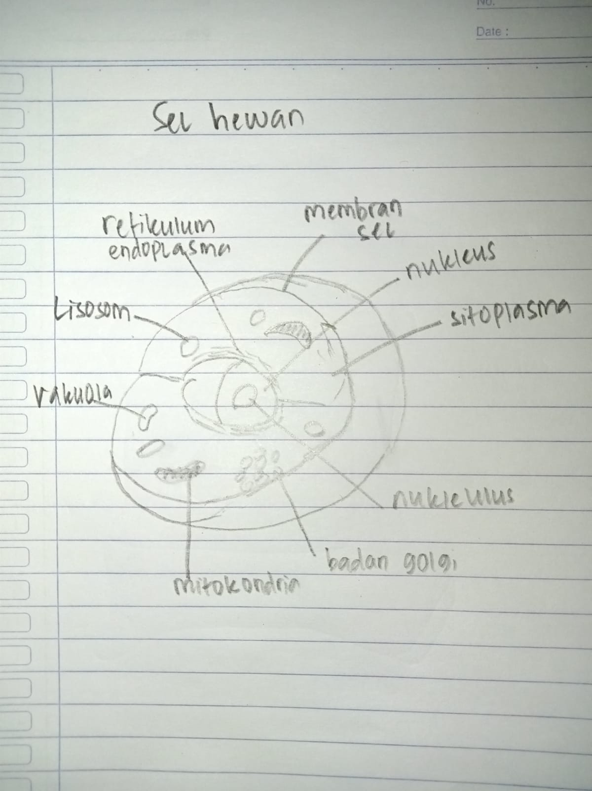
yulia

Slide 3
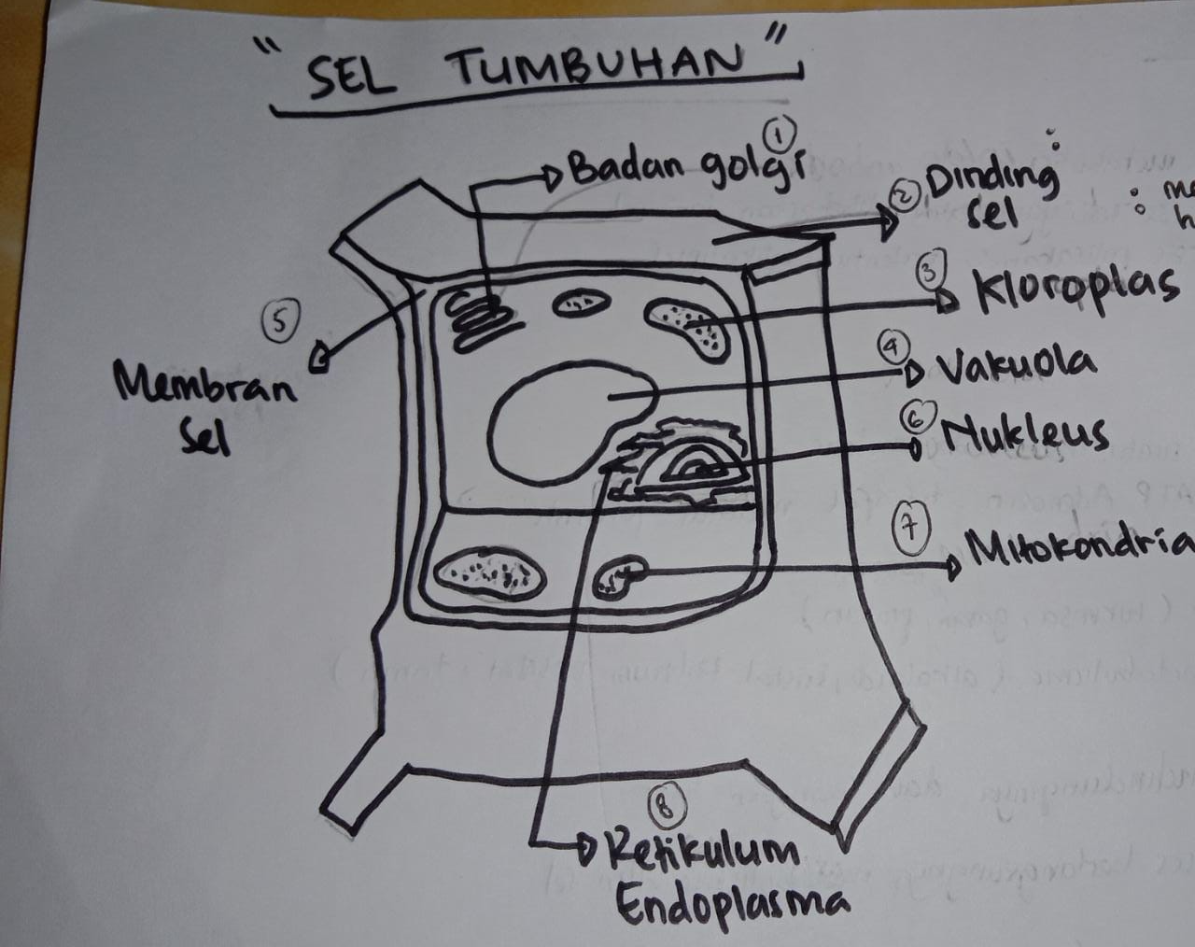
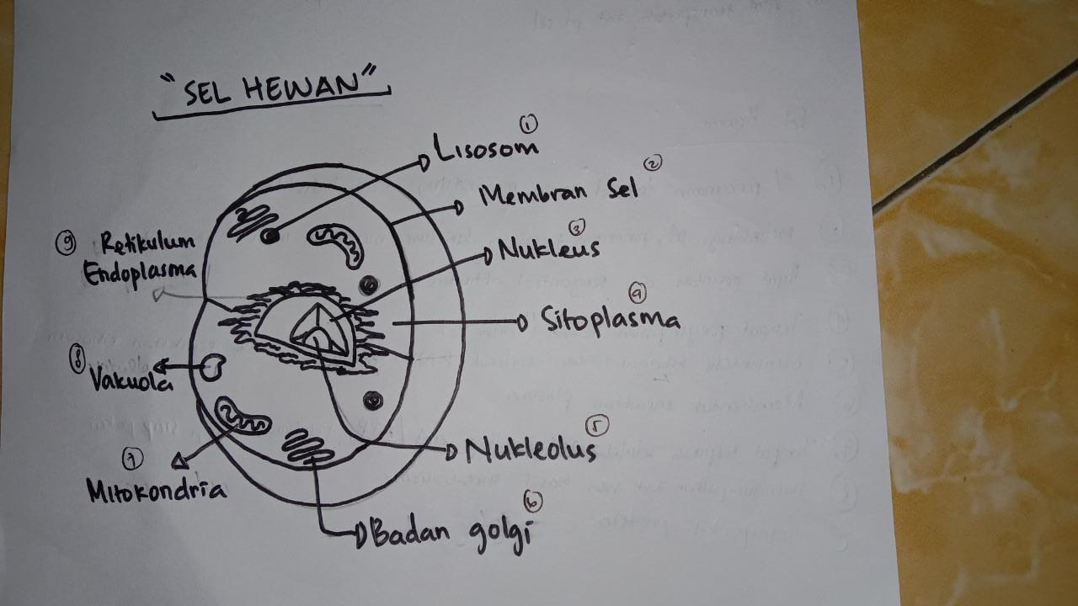
hana

Slide 4
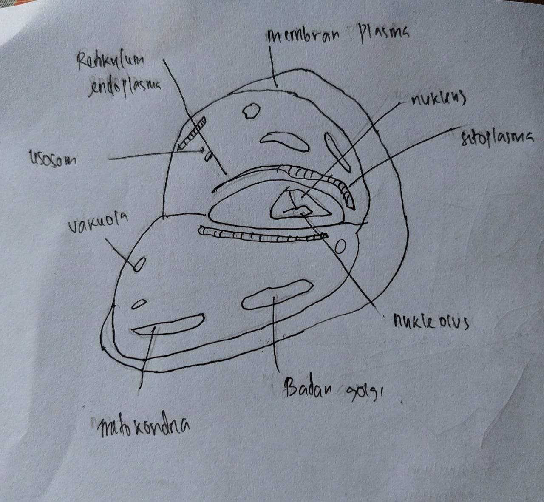
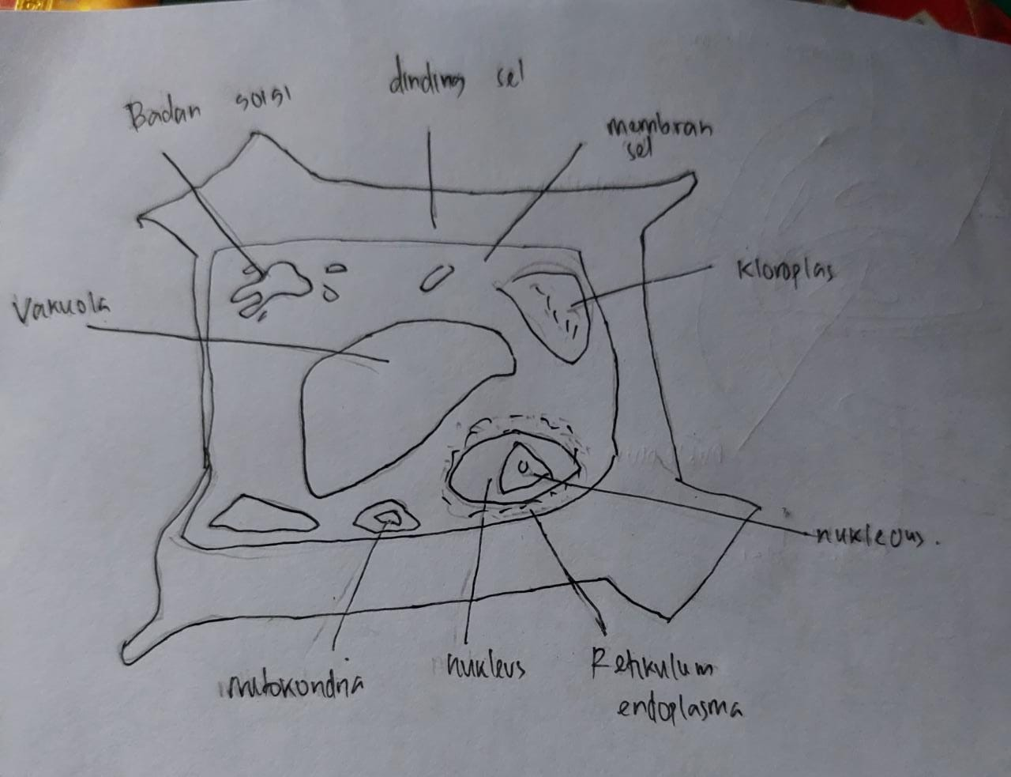
wanda

Slide 5
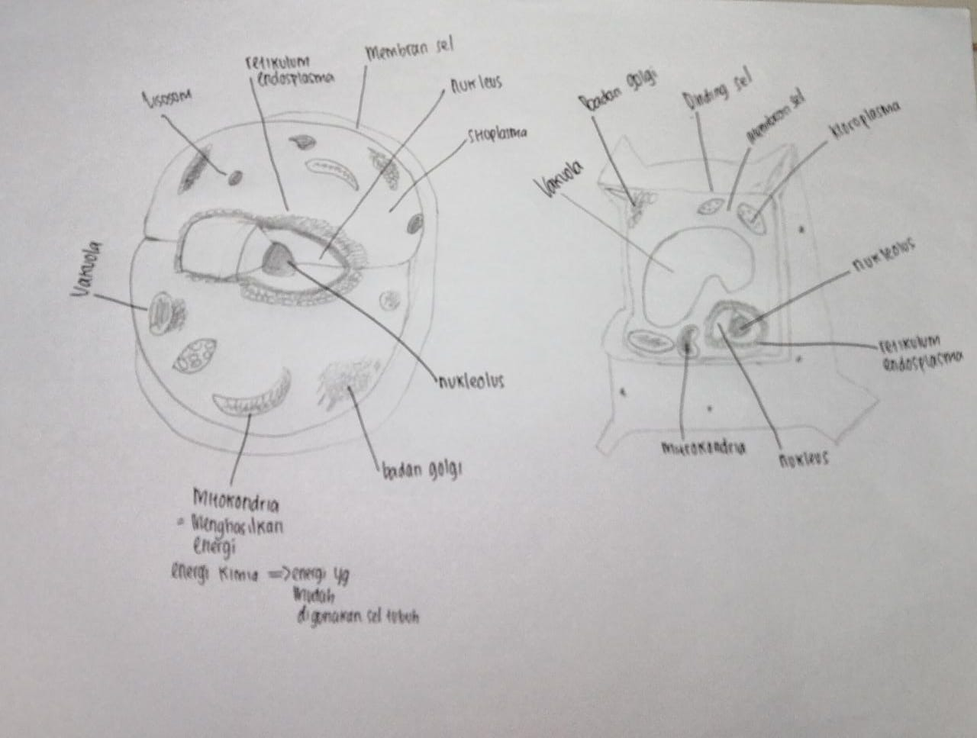
Tri risma

Slide 6
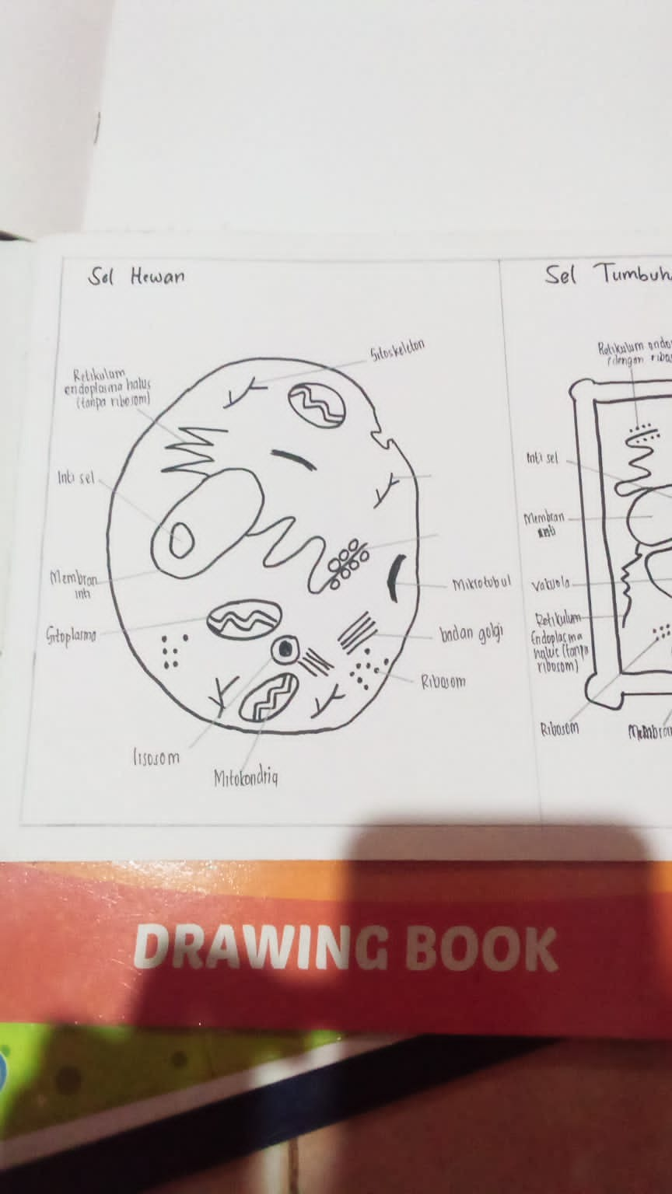
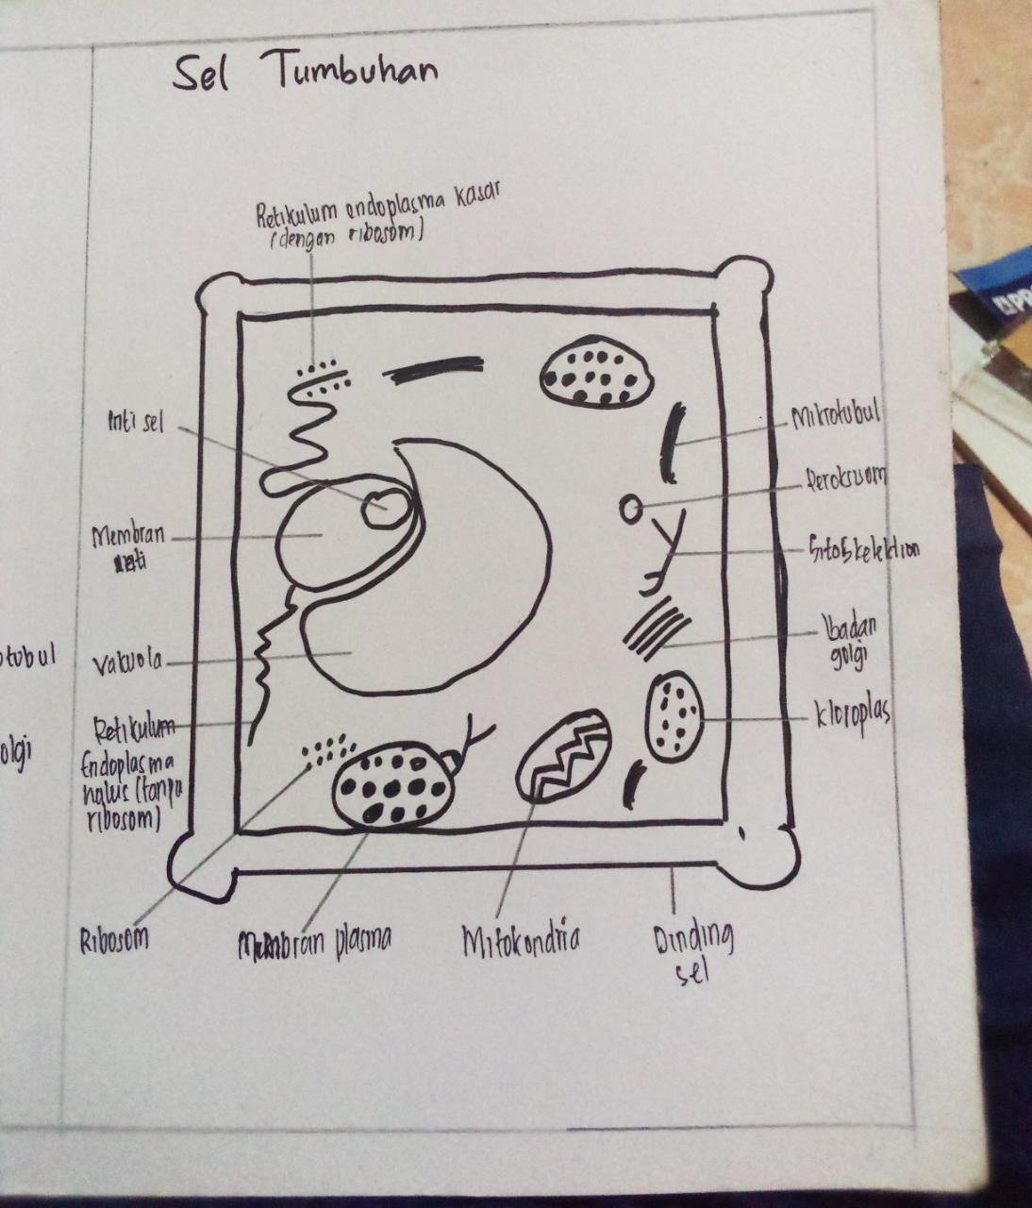
nyoman

