Slide 1

Kelompok 2
THP-B
BIOKIMIA
Yunita Rachmawati_2114051022
HANNY RANGGA_ 2114051014
Delya Etika_2114051020
Luqita Ocha Ivana_2114051016
Syifa Sabrina Hafidzah_2114051018

Slide 2
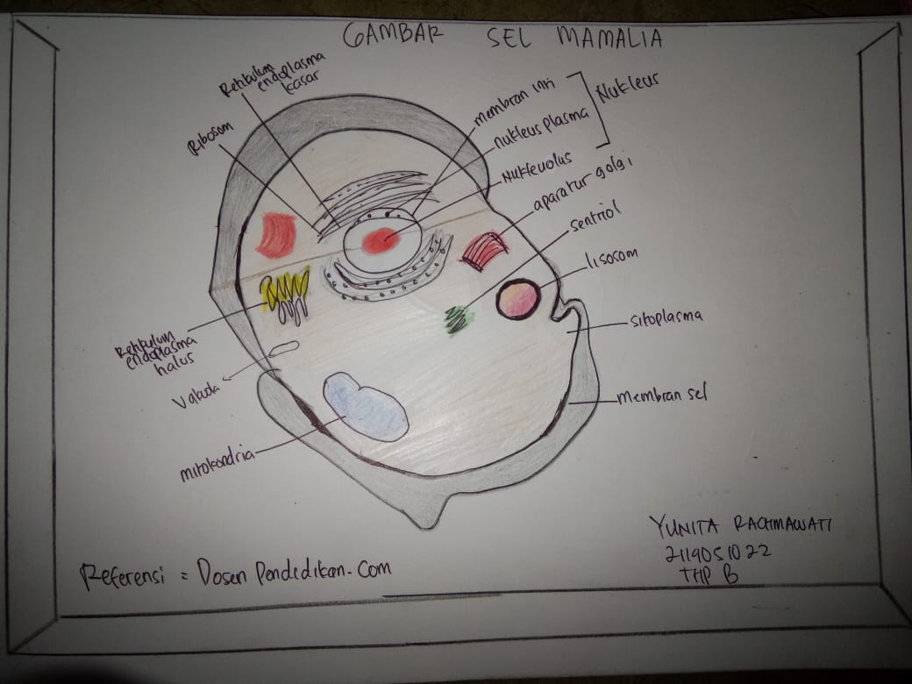
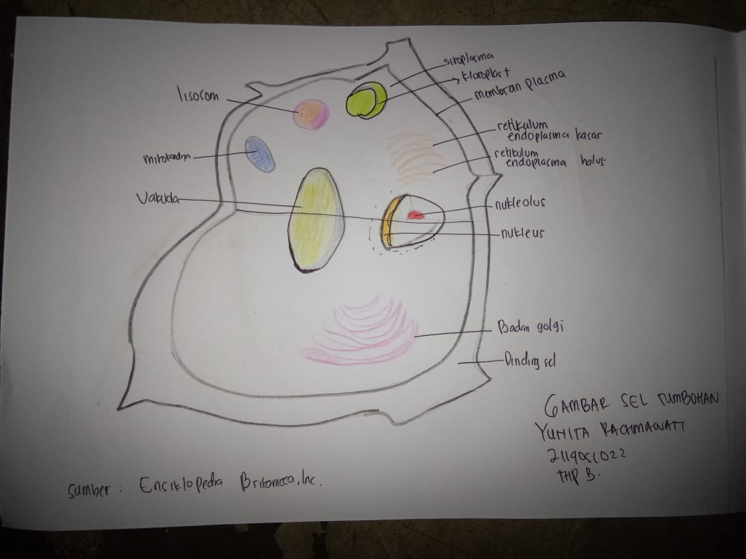
Yunita Rachmawati_2114051022

Slide 3
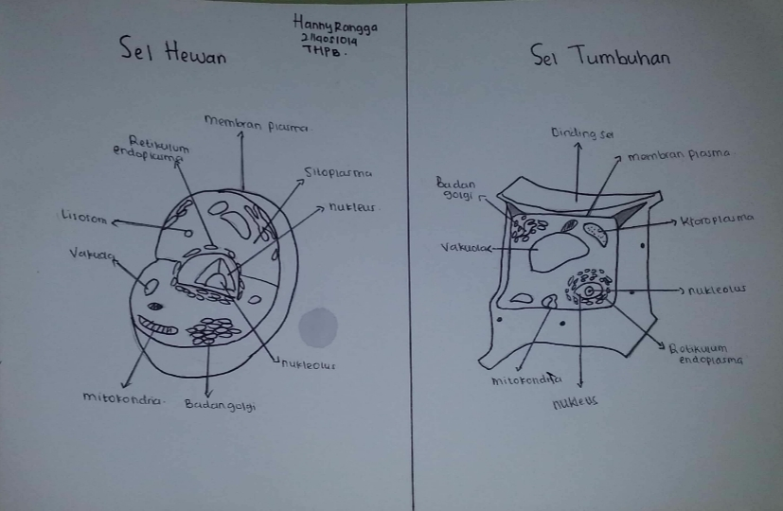
HANNY RANGGA_ 2114051014

Slide 4
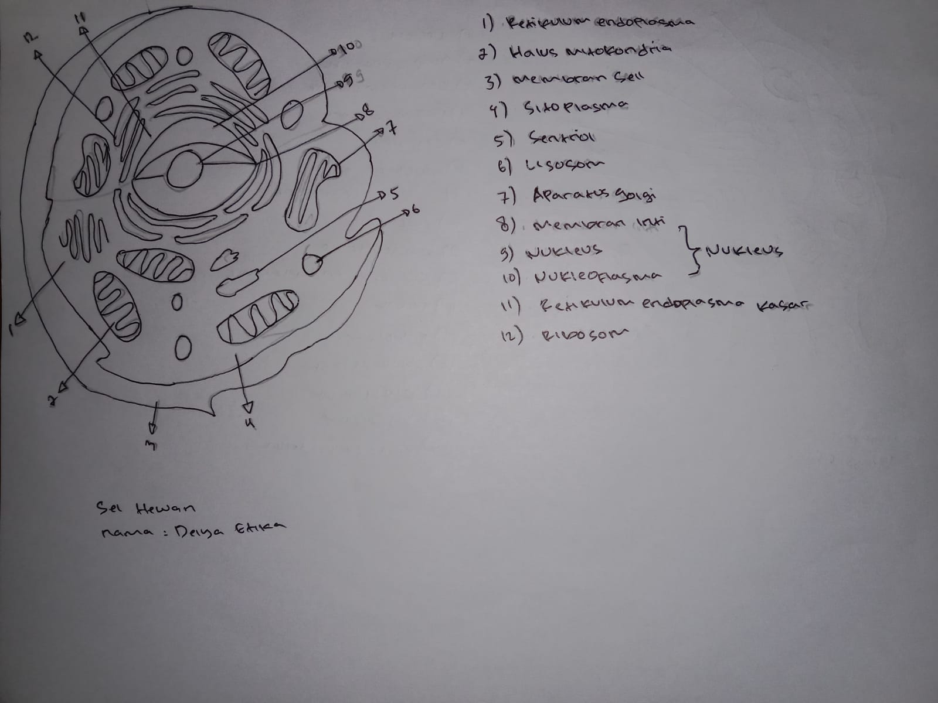
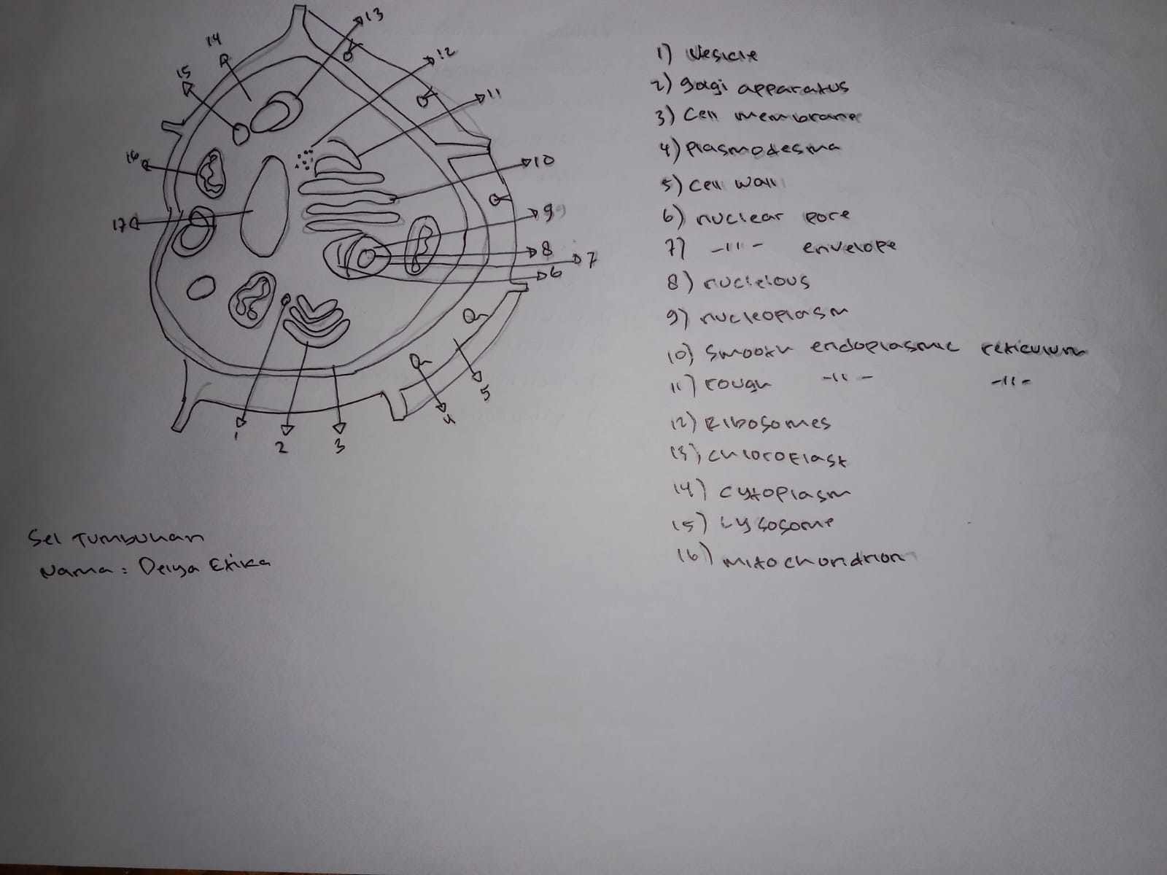
Delya Etika_2114051020

Slide 5
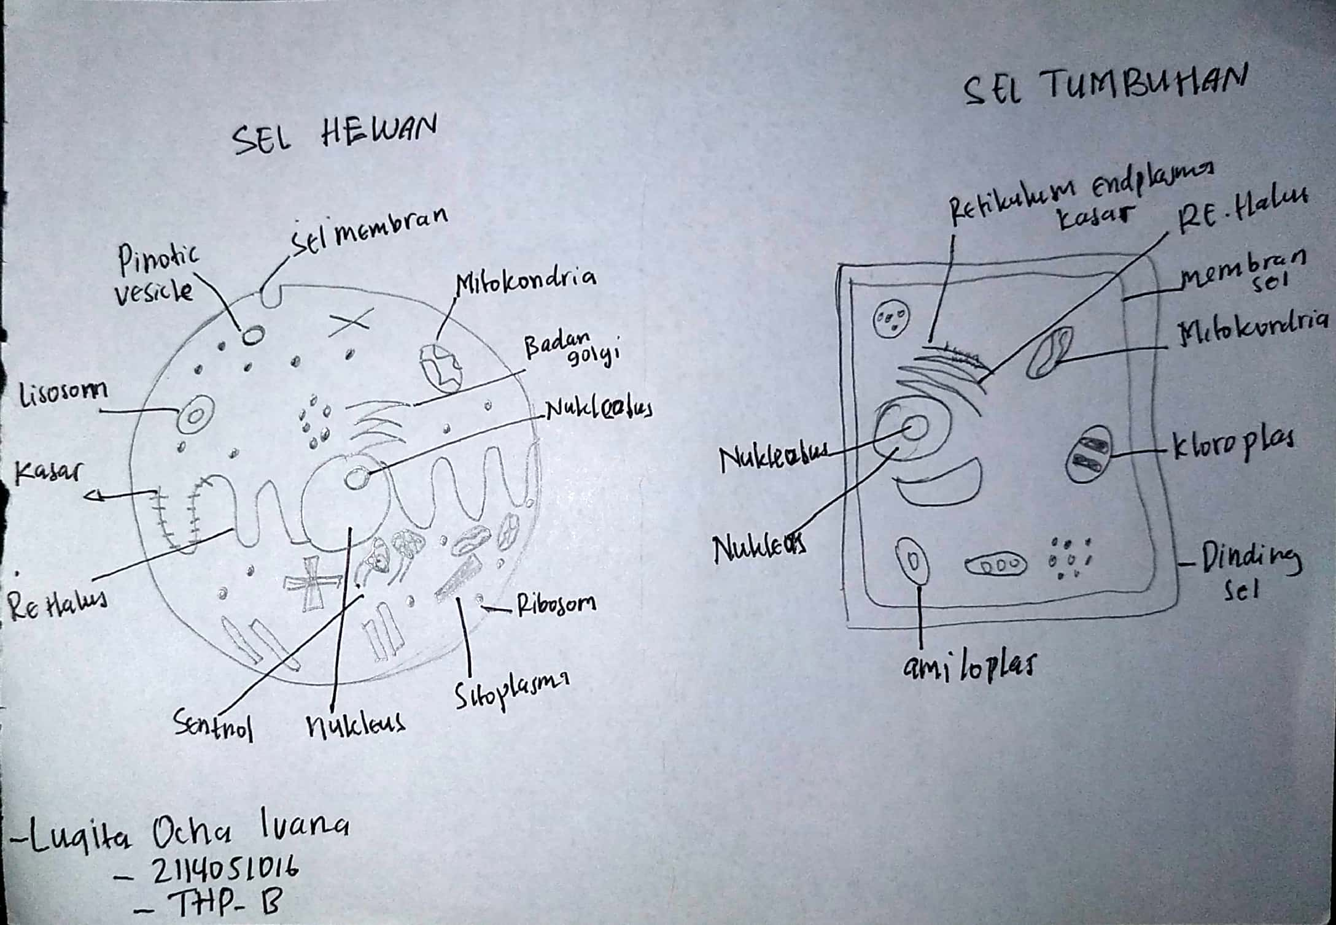
Luqita Ocha Ivana_2114051016

Slide 6
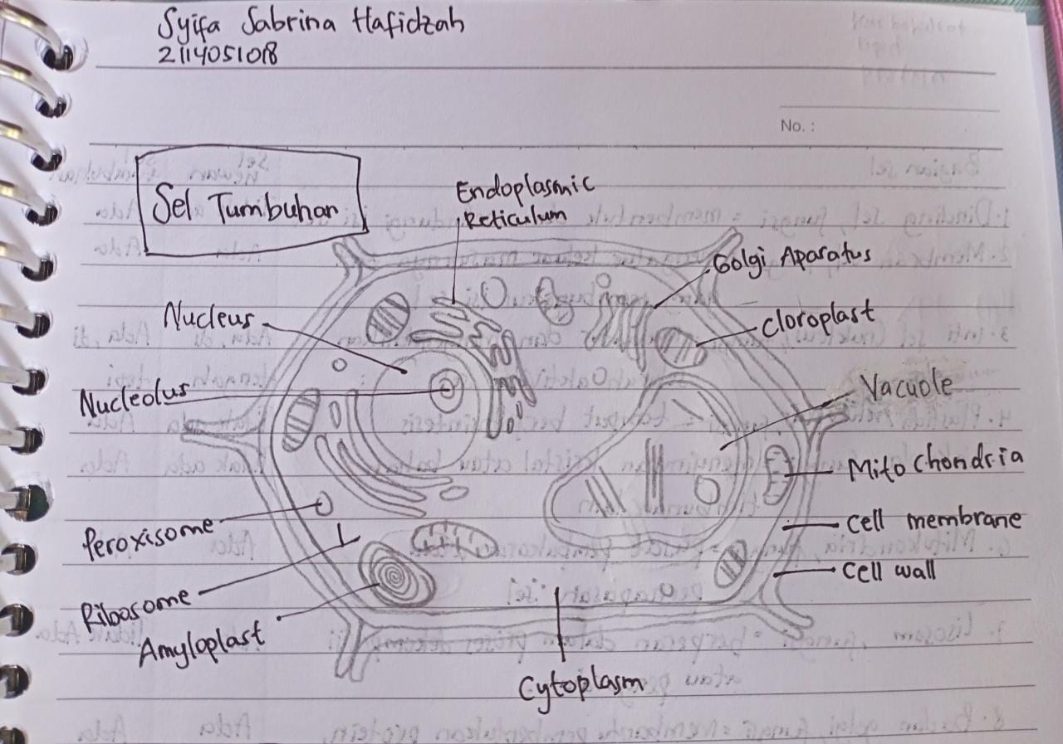
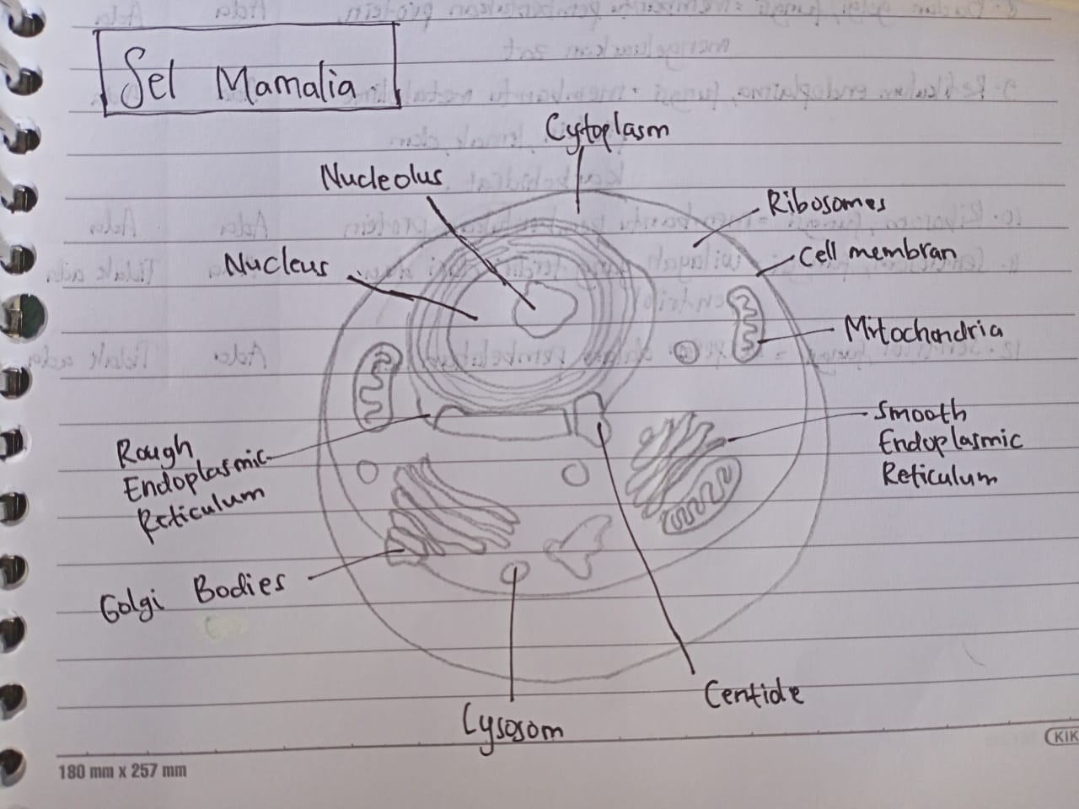
Syifa Sabrina Hafidzah_2114051018

