Slide 1
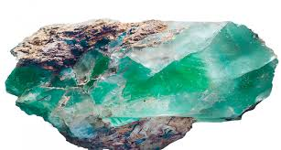
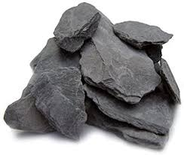
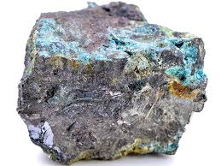
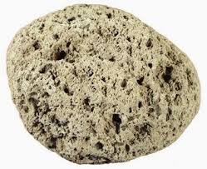
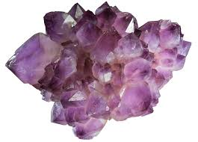
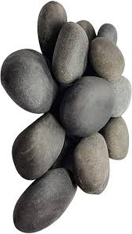
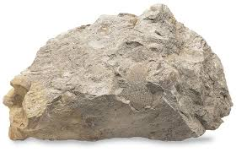
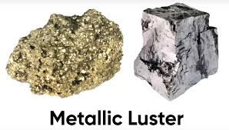
Rocks
Kelompok 12

Slide 2
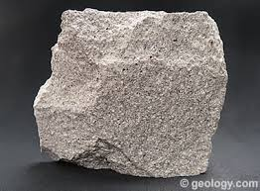
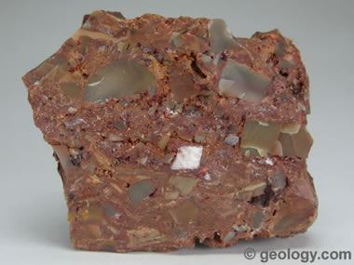
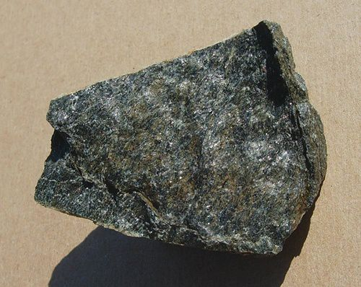
Igneous Rocks
Table
of
content
Sedimentary
Rocks
Metamorphic Rocks

Slide 3
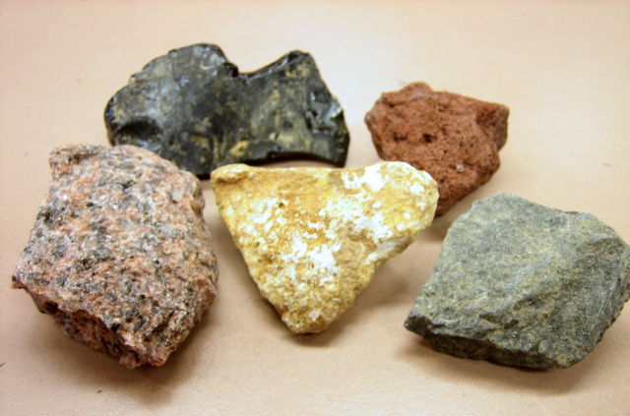
Igneous rocks

Slide 4
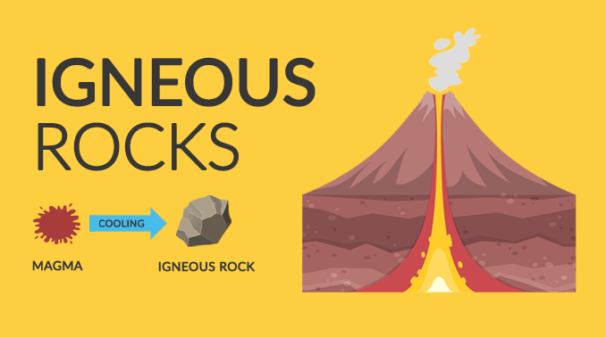
All rock originates from magma.
Magma is an incandescent hot liquid that has a temperature above 1000ºC. Magma comes out on the surface of the earth, among others, through volcanic peaks. Volcanoes are on land and some are in the oceans.
Magma that has reached the surface of the earth will freeze. Magma which then becomes igneous rock. Igneous rocks on the face of the earth for thousands of years can decompose when exposed to heat, rain, and plant and animal activities.
Origin of Igneous Rocks

Slide 5
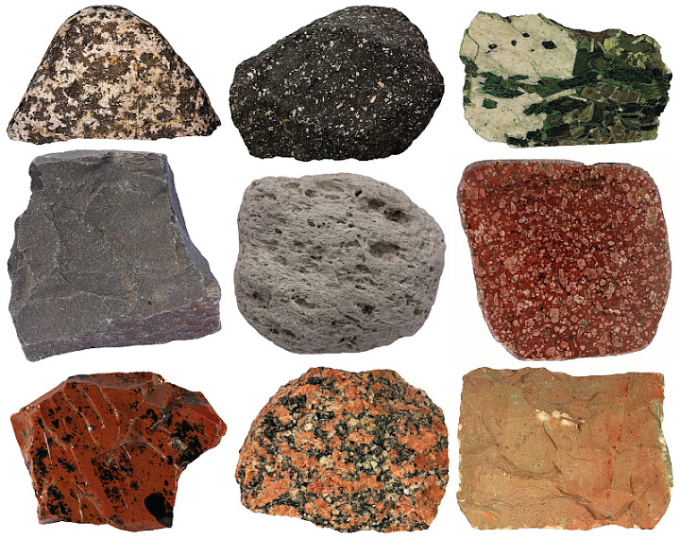
How Igneous Rocks Form :
Several types of igneous rock and their formation processes include:
Igneous rocks in or plutonic rocks are formed due to freezing that occurs in the magma chamber slowly so that the rock body consists of large crystals. Examples of these rocks are granite, peridotime, and gabbro.
Igneous rock alley or korok, the process of this rock occurs in the gaps between layers in the earth's crust. This freezing process runs faster so that in addition to large crystals there are also many small crystals. Examples of this type of rock include porphy granite
External igneous or molten rock, the process of forming this rock is when a volcano ejects molten lava. This freezing occurs not only around the volcanic crater, but also in the air. This freezing process is brief and contains almost no crystals (armorph).

Slide 6
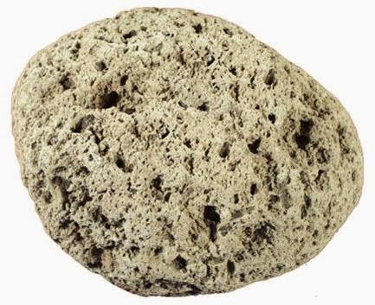
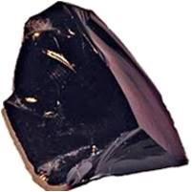
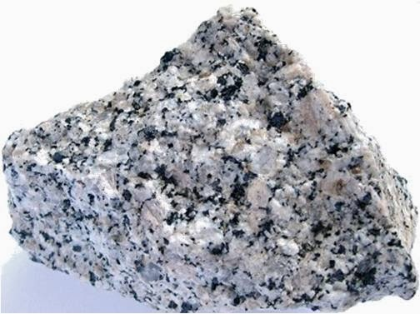
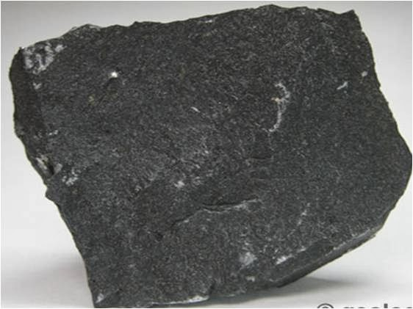
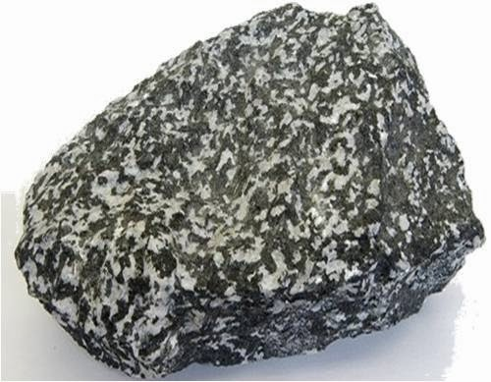
Several types of igneous rock, including:
Apung
Obsidian Stone
Granitestone
Igneous Rock Types
Basaltstone
Diroit stone

Slide 7
Sedimentary
Rocks

Slide 8
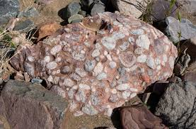
Sedimentary rocks on the face of the earth for thousands of years can be destroyed during exposure to heat, rain, plant and animal activities. Furthermore, the crushed rocks are caught by water, wind or animals to other places to be deposited. Crushed rocks are called sedimentary rocks.
Origin of Sedimentary Rocks

Slide 9
How Sedimentary Rocks Form :
Sediment will become sedimentary rocks through hardening or monitoring process involving:
a. Compaction
Compaction causes sediment granules to be depressed when boiled. the order of granules will be reasessed more densely
b. Cementation
Cementation is the process by which new minerals derived from cavity fluid will form or be immersed in the surface of the granules. The types of simen that are usually formed and main are quariza and calcite.
c. Recrystallization
Recrystallization is the process of resizing and or changing shape, without any chemical or mineralogical changes.

Slide 10
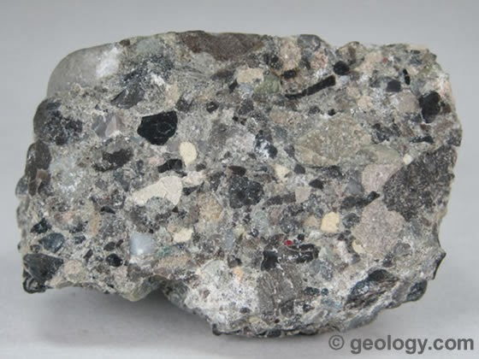
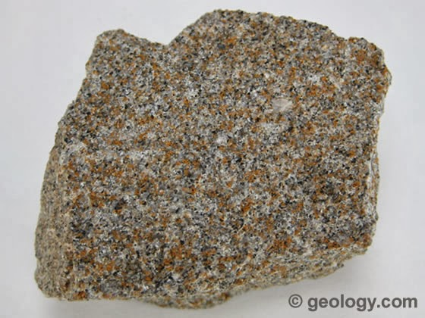
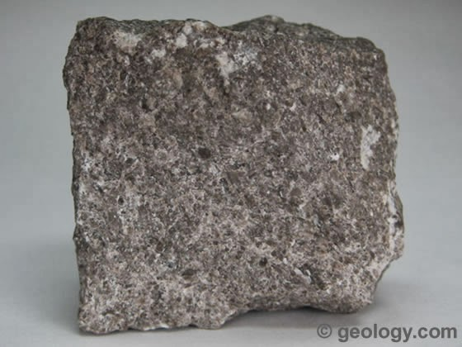
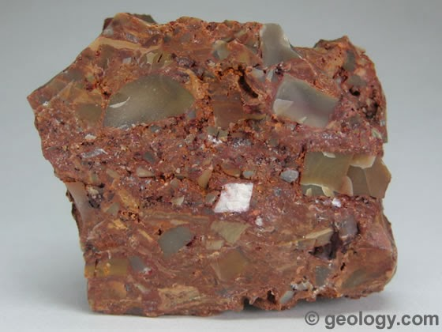
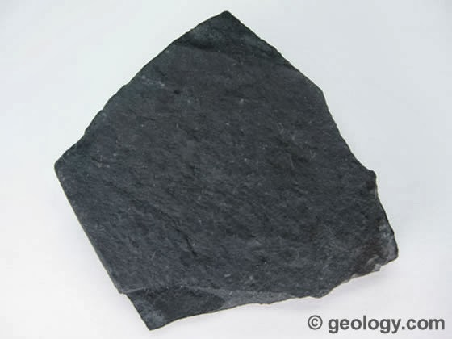
Sandstone
Sedimentary Rock Types
Several types of sedimentary rock, including:
Konglomerat
Breksi stone
Shale stone
limestone

Slide 11
Metamorphic
Rocks

Slide 12
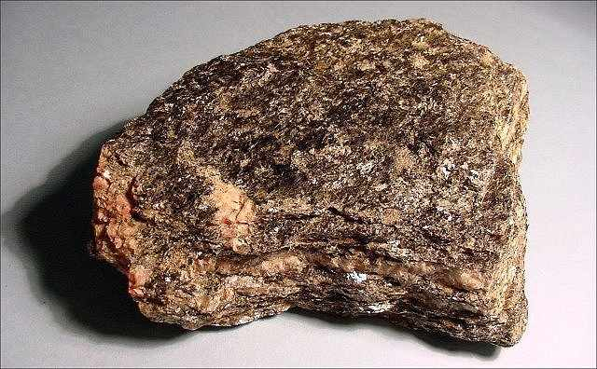
Metamorphic rocks or what are also called malihan rocks are a group of rocks which are the result of a change or transformation of a pre-existing rock type (protolith) by a process called metamorphosis or change in shape.
Origin of metamorphic Rocks

Slide 13
How to Form Metamorphic Rocks
The process that occurs when metamorphic rock formation is caused by several factors. Such as changes in pressure, chemical activity, and temperature of the parent stone.
1. Pressure Change
Pressure (pressure) is a factor that functions to control the process of forming this rock. The higher the pressure change can cause recrystallization (recrystallization) of minerals in the previous host rock content. The pressure that occurs is approximately between 1 - 10,000 bar (Jackson).

Slide 14
2. Chemical Activity
Chemical activity influences the formationmalihan rock, namely changing and recrystallizing the previous host rock that does not need to pass through the liquid phase. Combat during chemical activity lasts around 350 degrees Celsius to 1200 degrees Celsius. While the pressure formed is between 1 - 10000 bar (Jackson).
3. Changes in Temperature
Changing temperatures can be caused by changesgeothermal gradient or can be called magma intrusion. Apart from this, the friction between the rock masses causes the temperature to change easily and will culminate in the metamorphism process.
Temperature changes can occur in temperatures around 350 to 1200 degrees Celsius. Temperature or temperature functions as a controller when the rock formation process takes place so as not to enter the liquid phase first. So that the metamorphism process runs smoothly and produces perfect rocks.

Slide 15
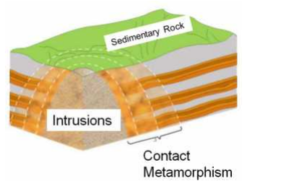
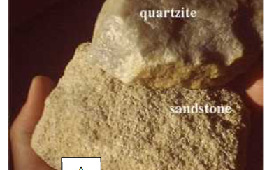
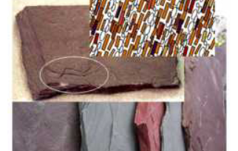
Metamorphic Rock Types
Metamorphic rock types include the following:
Contact or Thermal Metamorphism
Contact Metamorphic Rocks Pneumatolistic
Dinamo Metamorphic Rocks

Slide 16
Thank You

