Slide 1




GEOPHYSICAL METHODS
START!
By:
9th Group

Slide 2


A. Definition of Geophysics
NEXT!
Geophysics is the science that applies the principles of physics to find out and solve problems related to the earth, or it can be interpreted as studying the earth by using the principles of physics.
Geophysical methods can be applied globally to determine the earth's structure, while locally for mineral exploration and mining including petroleum and on a small scale for geotechnical applications (determination of building foundations, etc.).

Slide 3


B. Geophysical Methods
Gravity Method
Magnetic Method
Seismic Method
GPR Method
Table of Contents
Gravity Method
Geoelectric Method
Magnetic Method
Seismic Method
Electromagnetic Method
Geoelectric Method
Electromagnetoc &
GPR Method

Slide 4

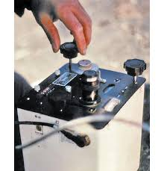
Table of Contents
Gravity Method
Magnetic Method
01.
Seismic Method
Geoelectricc Method
Gravity Method
Electromagnetoc &
GPR Method
START!

Slide 5

Table of Contents
Gravity Method
Magnetic Method
Seismic Method
Geoelectric Method
Electromagnetoc &
GPR Method
The gravity method is a method in geophysical surveys, which is included as a passive method. This method takes advantage of the difference in the value of the gravitational field on the earth's surface. The difference / variation in the value of the gravitational field is then mapped for distribution.
Gravity is greatly influenced by the density of objects, including the rocks that make up the earth's crust.

Slide 6

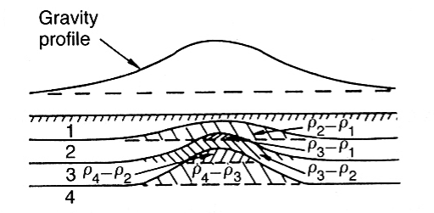
Table of Contents
Gravity Method
Magnetic Method
Seismic Method
Geoelectric Method
Electromagnetoc &
GPR Method
Variations in the gravitational field on the surface can also be influenced by the presence of subsurface geological structures, including uneven topography/ relief of the earth's surface.
Figure 1. Effect of geological structures

Slide 7

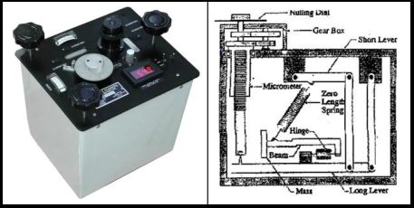
Figure 2. Gravimeter type LaCoste and Romberg

Slide 8
Table of Contents
Gravity Method
Magnetic Method
Seismic Method
Geoelectric Method
Electromagnetoc &
GPR Method
One example of a gravimeter that is widely used by geophysicists is the Lacoste and Romberg type gravimeters. The gravimeter has a reading scale from 0-7000 mGal, to an accuracy of 0.01 mGal.
This Gravimeter in use requires a constant temperature. Measurements in the field are usually carried out at measurement points along the measurement path within a measurement area.

Slide 9
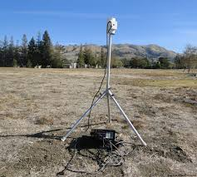
Table of Contents
Gravity Method
02.
Magnetic Method
Seismic Method
Geoelectric Method
Magnetic Method
Electromagnetoc &
GPR Method
START!

Slide 10
Table of Contents
Gravity Method
Magnetic Method
Seismic Method
Geoelectric Method
Electromagnetoc &
GPR Method
The magnetic method is a geophysical exploration method that measures the earth's magnetic field at every point on earth. The use of the magnetic method is based on the existence of the earth's magnetic field anomaly which is caused by differences in the magnetic properties of various rocks.
For more details, let's watch the magnetic method tutorial video below !

Slide 11
Table of Contents
Gravity Method
Magnetic Method
Seismic Method
Geoelectric Method
Electromagnetoc &
GPR Method
From the results of magnetic measurements, three kinds of readings were obtained, namely:
The main magnetic field that originates from within the earth and changes with time
The external field that originates from outside the earth and is the result of ionization in the atmosphere caused by ultraviolet rays from the sun
Anomalous fields are mostly sourced from rocks that contain magnetic material in them.

Slide 12
Table of Contents
Gravity Method
Seismic Method
Magnetic Method
Seismic Method
START!
Geoelectric Method
03.
Electromagnetoc &
GPR Method

Slide 13

Table of Contents
Gravity Method
Magnetic Method
Seismic Method
Geoelectric Method
Electromagnetoc &
GPR Method
The seismic method is one of the geophysical methods used to explore natural resources and minerals that exist under the earth's surface with the help of seismic waves. Seismic exploration or exploration using seismic methods is widely used by oil companies to map the subsurface structures to see possible oil traps based on the interpretation of the seismic cross section.

Slide 14
Table of Contents
Gravity Method
Magnetic Method
Seismic Method
Geoelectric Method
Electromagnetoc &
GPR Method
In the seismic method, measurements are made using a seismic source (explosion, vibroseis etc.). In seismic exploration, there are two kinds of methods, namely:
a. The seismic refractive method (refraction)
b. Reflection seismic method (reflection)

Slide 15
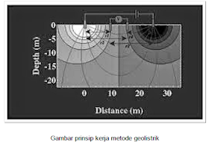
Table of Contents
Gravity Method
START!
Magnetic Method
Seismic Method
04.
Geoelectric
Method
Geoelectric Method
Electromagnetoc &
GPR Method

Slide 16

In this case, it includes the measurement of potential, currents and electromagnetic fields that occur either naturally or as a result of current injection into the earth. There are several kinds of geoelectric methods, including: self-potential, telluric,magnetoteluric,
electromagnetic, IP (Induced Polarization), resistivity (resistivity) and others.
Geoelectric is a geophysical method that studies the nature of electricity in the earth and how to detect it on the earth's surface.

Slide 17
In this discussion, the geoelectric resistivity method is specifically discussed. In this resistivity geoelectric method, an electric current is injected into the earth through two current electrodes. Then the potential difference that occurs is measured through two potential electrodes.

Slide 18


Based on the location (configuration) of the current electrodes, there are several types of resistivity resistivity methods, including:
a. Schumberger Method
b. Wenner Method
c. Dipole – dipole method

Slide 19

Table of Contents
Gravity Method
Magnetic Method
Seismic Method
Geoelectric Method
Electromagnetoc &
GPR Method
Electromagnetic
Method

Slide 20

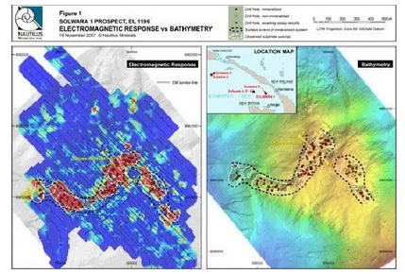
The electromagnetic method is a geophysical method that utilizes the properties of electromagnetic waves to map the subsurface conditions based on differences in the conductivity of rock objects capable of conducting electricity and able to respond to magnetic forces. This electromagnetic method is usually used for the exploration of conductive objects. Changes in field components due to variations in conductivity are used to determine subsurface structures. The electromagnetic field used can be obtained on purpose, such as by generating an electromagnetic field around the observation area, this kind of measurement is called an active measurement technique.
Examples of Appearance Results of the Electromagnetic Method

Slide 21
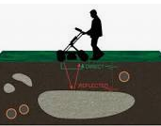
GPR Method
The ground penetrating radar or georadar method is a geophysical method that studies subsurface conditions based on electromagnetic properties using radio waves with a frequency between 1-1000 MHz. GPR can detect the parameters of electric permittivity (ε), conductivity (σ) and magnetic permeability (μ). GPR can also be called the electromagnetic reflection method because it utilizes the nature of electromagnetic radiation which shows the same reflection as the seismic wave method. GPR is used in a wide variety of applications, including soil stratigraphy, groundwater studies, fracture bedrock mapping and groundwater depth determination.

