Slide 1
Satisfaction, Engagement and Potential
Leadership
Aisyah Rizqiani Maulana
2111011041

Slide 2
Table of contents
01
02
03
Understandung and Influencing Follower Satisfaction
Understanding and Improving Employee Engagmenet
Understanding Follower Potential

Slide 3

1. Understanding and Influencing Follower Satisfaction
Satisfied workers are also more likely to engage in organizational citizenship behaviors that go beyond job descriptions and role requirements and help reduce the workload or stress of others in the organization. Dissatisfied workers are more likely to be adversarial in their relations with leadership (filing grievances, for example) and engage in diverse counterproductive behaviors.

Slide 4
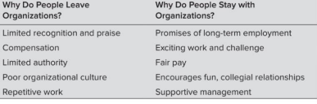
a. Some Reasons Why The Workers Stay and Leave Organization

Slide 5
Organizational Justice: Does Fairness Matter?
Organizational justice is based on the premise that people who are treated un- fairly are less productive, less satisfied, and less committed to their organizations.
b. Two Theories of Job Satisfaction

Slide 6
2. Herzberg’s Two-Factor Theory: Does Meaningful Work Make People Happy?
Herzberg developed the two-factor theory from a series of interviews he con- ducted with accountants and engineers. Specifically, he asked what satisfied them about their work and found that their answers usually could be sorted into five consistent categories.
b. Two Theories of Job Satisfaction

Slide 7
2. Understanding and Improving Employee Engagement
In engagement, people employ and express themselves physically, cognitively, and emotionally during role performances’.Alfes et al (2010: 5) saw engagement as having three core facets:
1. Intellectual engagement – thinking hard about the job and how to do it better;
2. Affective engagement – feeling positively about doing a good job;
3. Social engagement – actively taking opportunities to discuss work-related improvements with others at work

Slide 8
Job and Organizational Engagement
Job Engagement | The engaged employee is the passionate employee, the employee who is totally immersed in his or her work, energetic, co
Organizational Engagement | Organizational engagement focuses on attachment to or identification with the organization as a whole.

Slide 9
The Theory of Engagement
Saks (2006: 603) thought that a strong theoretical rationale for engagement was provided by social exchange theory. As he described it: Social exchange theory argues that obligations are generated through a series of interactions between parties who are in a state of reciprocal interdependence.

Slide 10
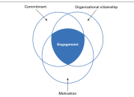
The Compenents of Engagement
There are three compenents of engageent
Engagement and Commitment
Engagement and Motivation
Engagement and Organizational Citizenship Behavior

Slide 11
Compenents of Engagement
Engagement and commitment | Robinson et al (2004) stated that while engagement contains many of the elements of commitment it is not a perfect match.
. Engagement and motivation | The motivation element in engagement is intrinsic. Macey et al (2009: 67) commented that: ‘When the work itself is meaningful it is also said to have intrinsic motivation.
Engagement and organizational citizenship behaviour | Organizational citizenship behaviour (OCB), as originally defined by Organ (1988), is employee behaviour that goes above and beyond the call of duty and contributes to organizational effectiveness.

Slide 12
Outcomes of Engagement
Stairs and Galpin (2010) claimed that high levels of engagement have been shown to relate to: | Objective 1 | Objective 2 | Goal
Lower absenteeism and higher employee retention; | Increased employee effort and productivity; | Improved quality and reduced error rates; | Increased sales;
Higher profitability, earnings per share an shareholder returns; | Enhanced customer satisfaction and loyalty; | Faster business growth; and | Higher likelihood of business success.

Slide 13
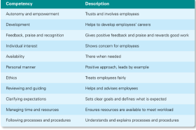
Enhancing Engagement

Slide 14
Understanding Follower Potential
Leaders are sometimes asked to share their opinions about which followers de- serve promotions.
Potential pertains to a follower’s overall capacity to assume more responsibility, move up one or more organizational levels, or become a leader.
Potential is different from readiness, which relates to estimates of how much time it will take before followers would be able to handle the demands of a promotion.
Some followers need little additional training or experience, whereas it may take another year or two before others would be effective in positions with greater responsibility.

Slide 15

Thankyou so much for your attention ^^

