Slide 1
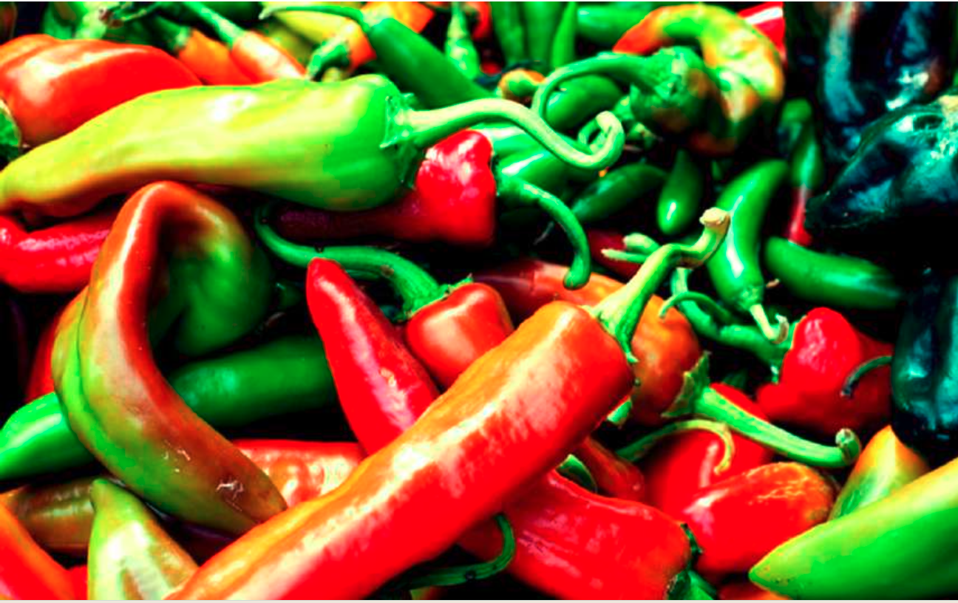
ORGANIC CHEMISTRY III
CHAPTER 20
Carboxylic Acids and Nitriles
FIGURE 20.1 The burning sensation produced by touching or eating chili peppers is due to capsaicin, a carboxylic acid derivative called an amide. (credit: modification of “Chillis” by Lucas Cobb/Flickr, CC BY 2.0)

Slide 2
CHAPTER CONTENTS
20.1 Naming Carboxylic Acids and Nitriles 20.2 Structure and Properties of Carboxylic Acids 20.3 Biological Acids and the Henderson–Hasselbalch Equation
20.4 Substituent Effects on Acidity 20.5 Preparing Carboxylic Acids 20.6 Reactions of Carboxylic Acids: An Overview 20.7 Chemistry of Nitriles 20.8 Spectroscopy of Carboxylic Acids and Nitriles

Slide 3
WHY THIS CHAPTER?
Carboxylic acids are present in many industrial processes and most biological pathways and are the starting materials from which other acyl derivatives are made. Thus, an understanding of their properties and reactions is fundamental to understanding organic chemistry. We’ll look both at acids and at their close relatives, nitriles (RC≡N), in this chapter and at carboxylic acid derivatives in the next chapter.
Carboxylic acids, RCO₂H, occupy a central place among carbonyl compounds. Not only are they valuable in themselves, they also serve as starting materials for preparing numerous carboxylic acid derivatives such as acid chlorides, esters, amides, and thioesters. In addition, carboxylic acids are present in the majority of biological pathways.

Slide 4
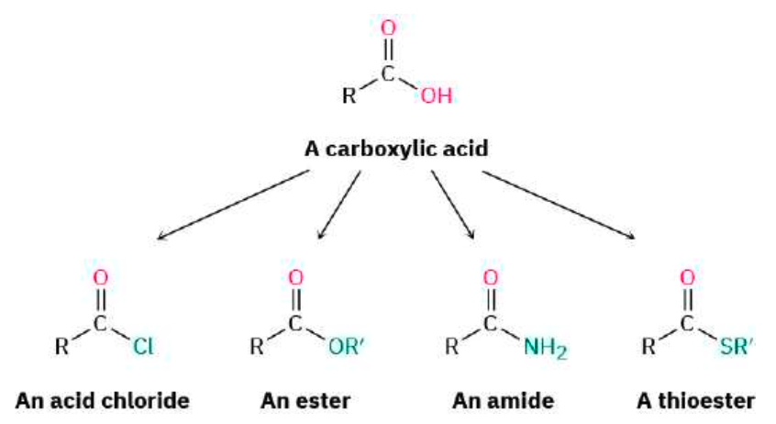

Slide 5
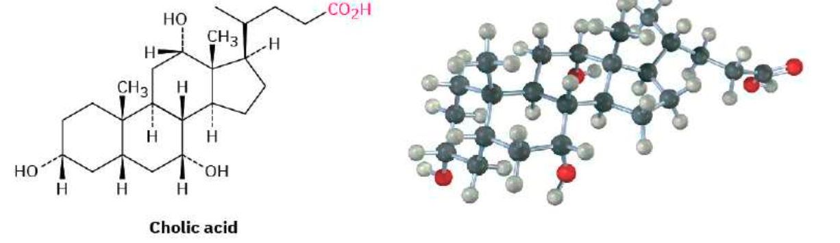
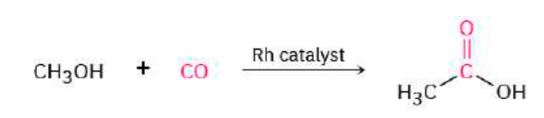
A great many carboxylic acids are found in nature: acetic acid, CH3CO2H, is the chief organic component of vinegar; Other examples are cholic acid, a major component of human bile
Approximately 20 million tons of acetic acid is produced worldwide each year for a variety of purposes. About 20% of the acetic acid synthesized industrially is obtained by oxidation of acetaldehyde. Much of the remaining 80% is prepared by the rhodium-catalyzed reaction of methanol with carbon monoxide.

Slide 6
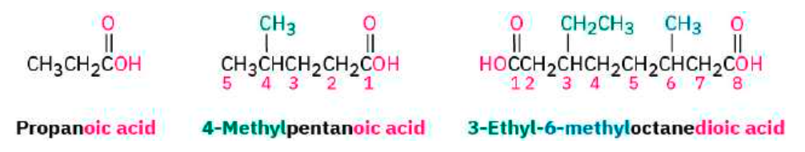
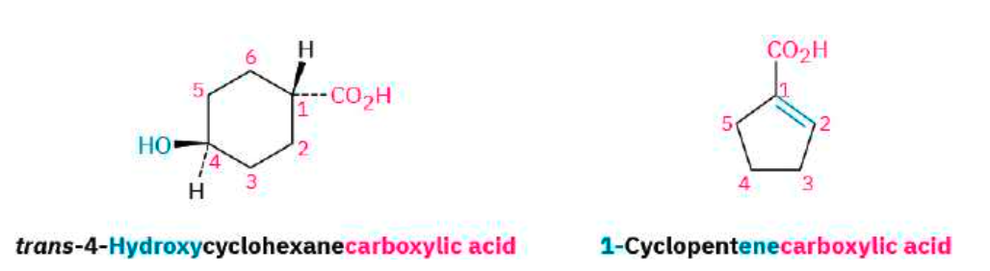
20.1 Naming Carboxylic Acids and Nitriles
Carboxylic Acids, RCO₂H

Slide 7
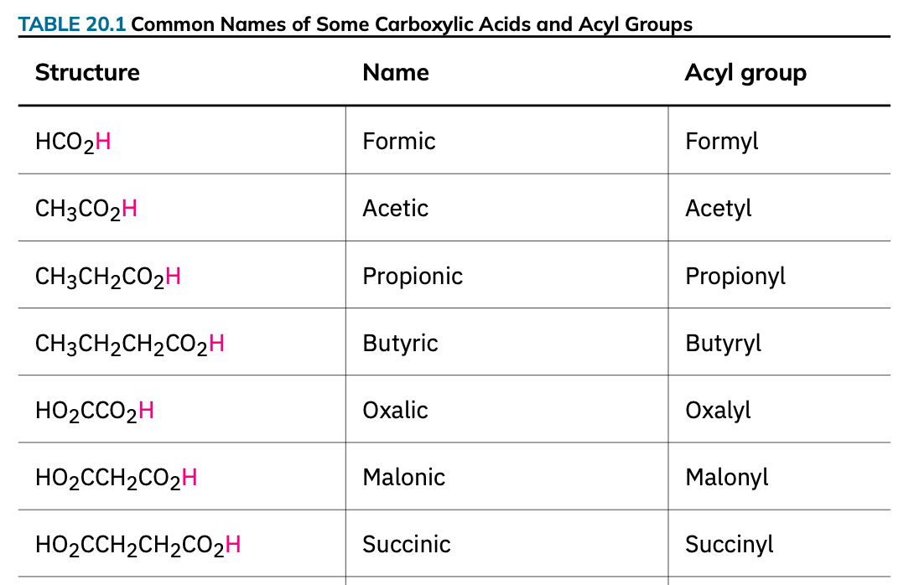

Slide 8
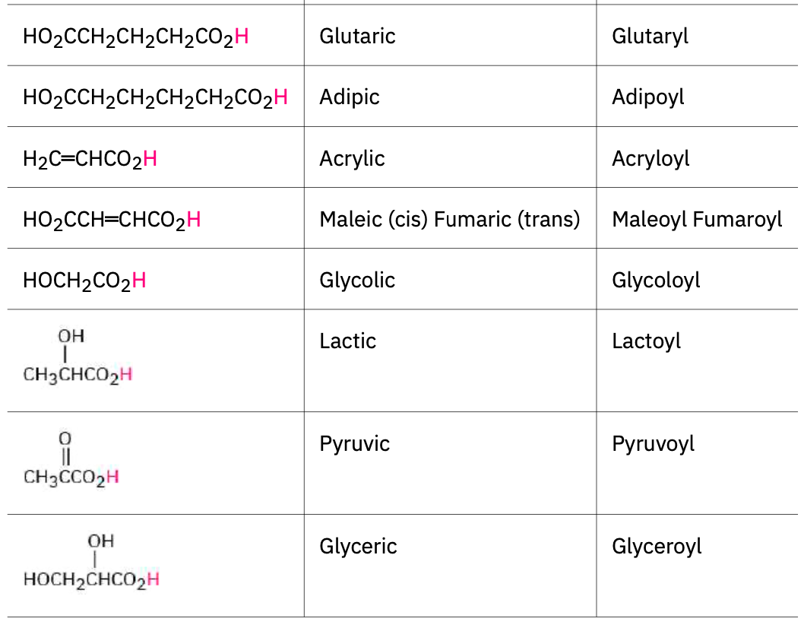

Slide 9
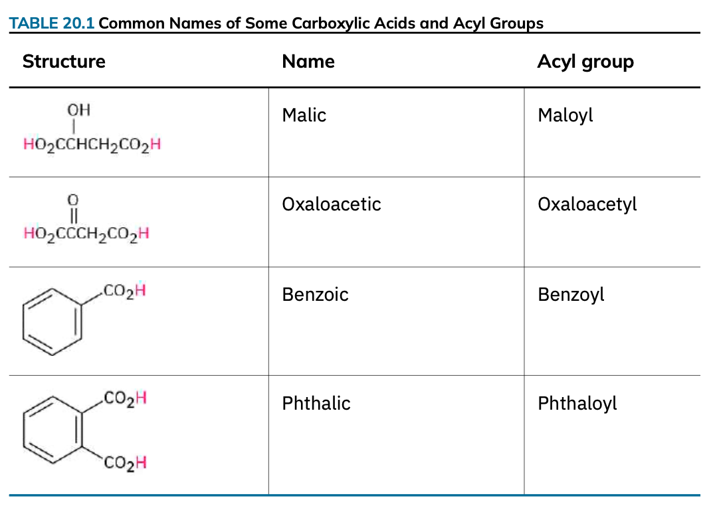

Slide 10
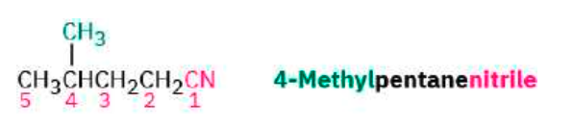
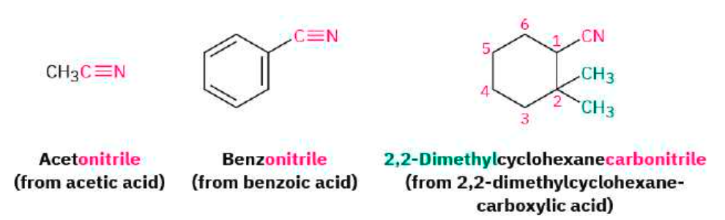
Nitriles, RC≡N
Compounds containing the -C≡N functional group are called Nitrile and can undergo some chemistry similar to that of carboxylic acids. Simple open-chain nitriles are named by adding -nitrile as a suffix to the alkane name, with the nitrile carbon numbered C1.

Slide 11
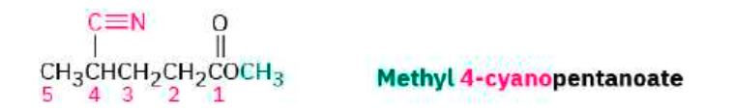
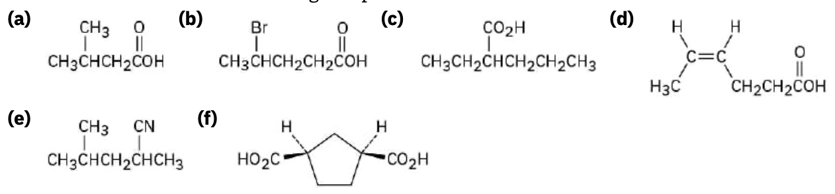
If another carboxylic acid derivative is present in the same molecule, the prefix cyano- is used for the group.
PROBLEM 20-1 Give IUPAC names for the following compounds:
PROBLEM 20-2 Draw structures corresponding to the following IUPAC names:
(a) 2,3-Dimethylhexanoic acid (b) 4-Methylpentanoic acid
(c) trans-1,2-Cyclobutanedicarboxylic acid (d) o-Hydroxybenzoic acid
(e) (9Z,12Z)-9,12-Octadecadienoic acid (f) 2-Pentenenitrile

Slide 12
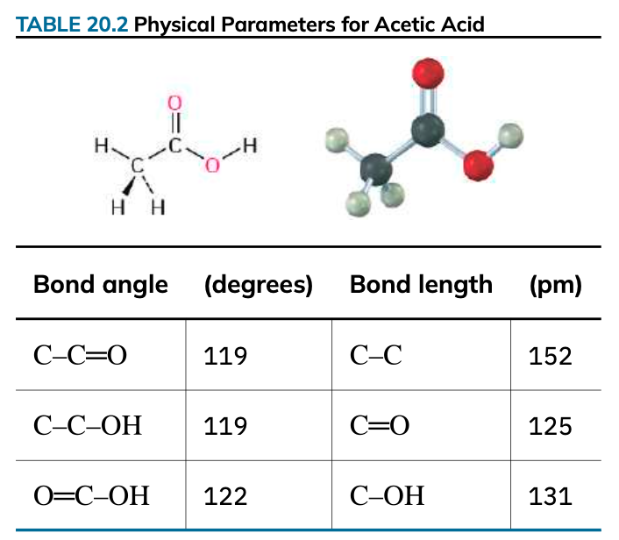
20.2 Structure and Properties of Carboxylic Acids
Carboxylic acids are similar in some respects to both ketones and alcohols. Like ketones, the carboxyl carbon is sp²-hybridized, and carboxylic acid groups are therefore planar with and approximately 120° (TABLE 20.2).

Slide 13
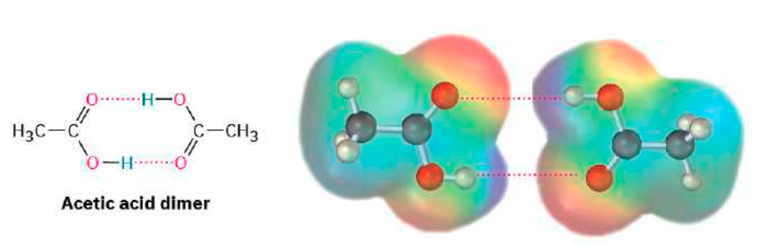
Like alcohols, carboxylic acids are strongly associated because of hydrogen-bonding. Most carboxylic acids exist as cyclic dimers held together by two hydrogen bonds. This strong hydrogen-bonding has a noticeable effect on boiling points, making carboxylic acids boil far less easily than their corresponding alcohols. Acetic acid, for instance, has a boiling point of 117.9 °C, versus 78.3 °C for ethanol, even though both compounds have two carbons.

Slide 14
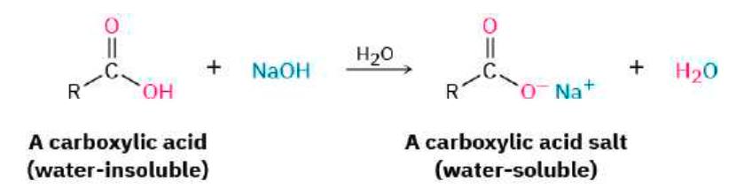
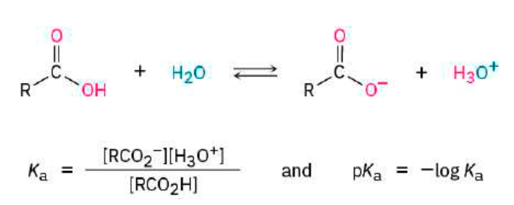
The most obvious property of carboxylic acids is implied by their name: carboxylic acids are acidic.
Like other Brønsted–Lowry acids discussed in Section 2.7, carboxylic acids dissociate slightly in dilute aqueous solution to give H₃O⁺ and the corresponding carboxylate anions, RCO^{2–}. The extent of dissociation is given by an acidity constant, Ka.

Slide 15
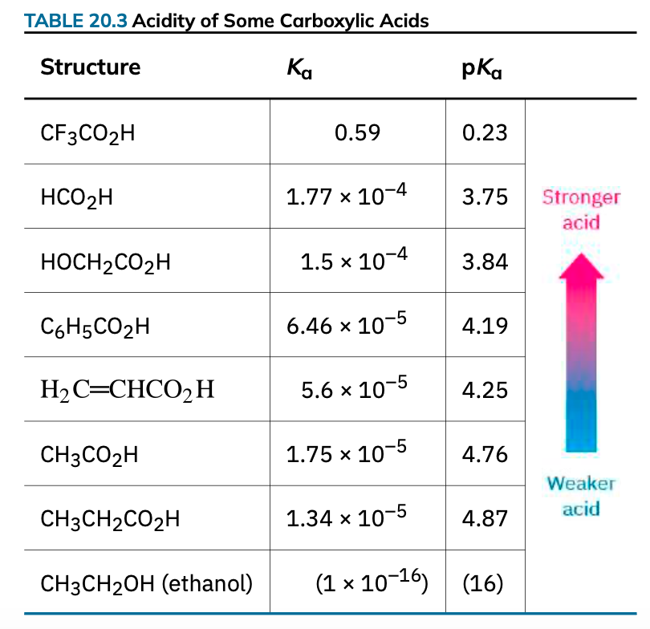

Slide 16
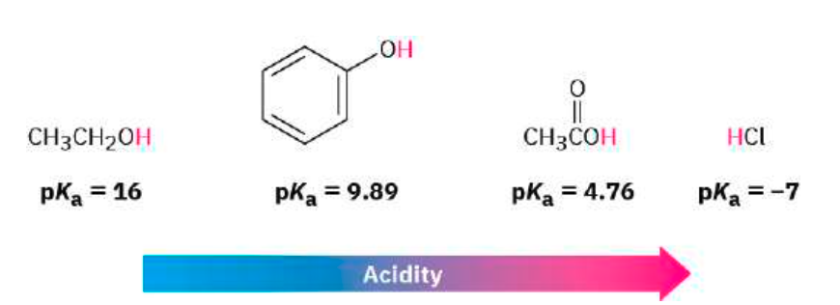
Although much weaker than mineral acids, carboxylic acids are nevertheless much stronger acids than alcohols and phenols. The Ka of ethanol, for example, is approximately 10^{–16}, making it a weaker acid than acetic acid by a factor of 10¹¹.
Why are carboxylic acids so much more acidic than alcohols, even though both contain –OH groups? An alcohol dissociates to give an alkoxide ion, in which the negative charge is localized on a single electronegative atom. A carboxylic acid, however, gives a carboxylate ion, in which the negative charge is delocalized over two equivalent oxygen atoms (FIGURE 20.2).

Slide 17
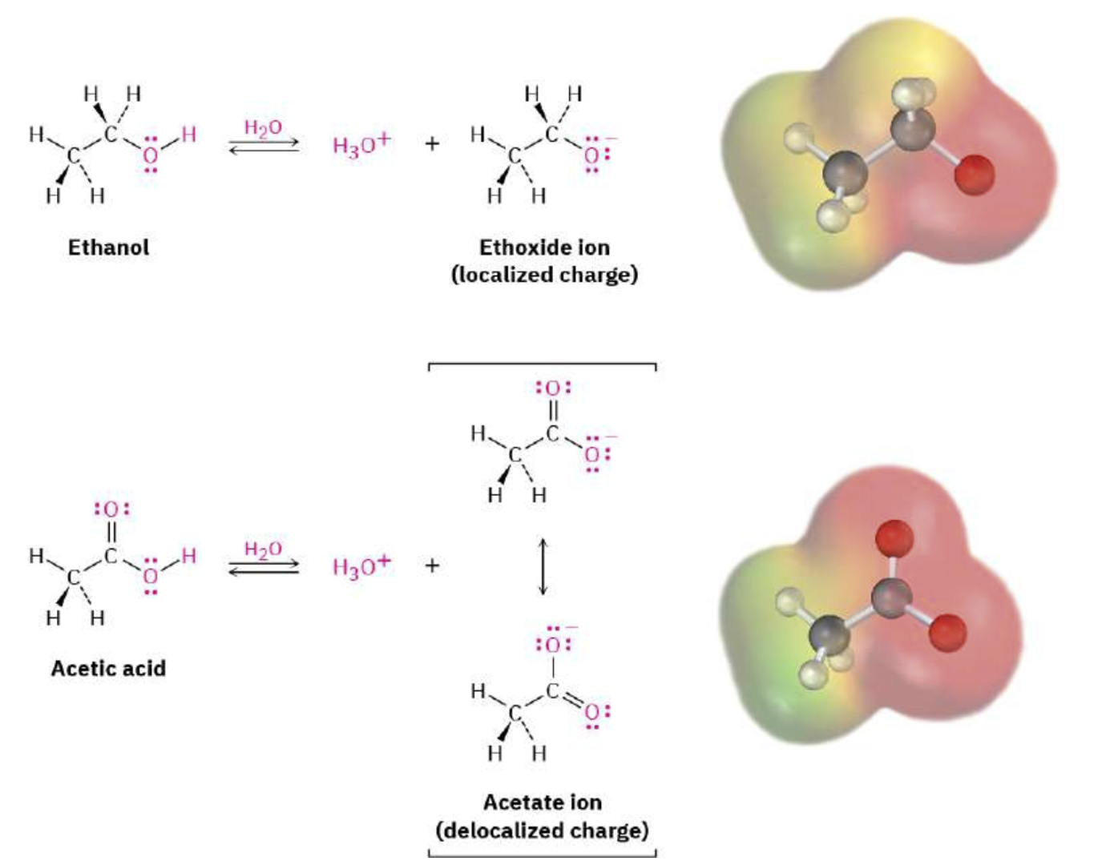
FIGURE 20.2 An alkoxide ion has its charge localized on one oxygen atom and is less stable, while a carboxylate ion has the charge spread equally over both oxygens and is therefore more stable.

Slide 18
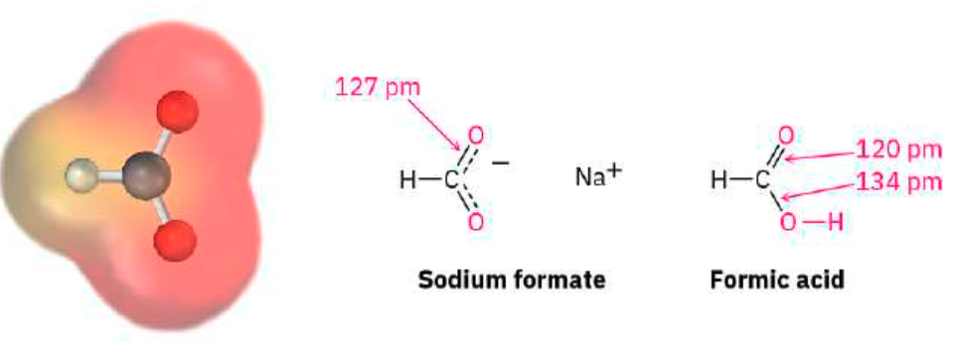
Experimental evidence for the equivalence of the two carboxylate oxygens comes from X-ray crystallographic studies on sodium formate. Both carbon–oxygen bonds are 127 pm in length, midway between the double bond (120 pm) and the C–O single bond (134 pm) of formic acid. An electrostatic potential map of the formate ion also shows how the negative charge (red) is spread equally over both oxygens.
PROBLEM 20-3 Assume you have a mixture of naphthalene and benzoic acid that you want to separate. How might you take advantage of the acidity of one component in the mixture to effect a separation?
PROBLEM 20-4
The Ka for dichloroacetic acid is 3.32 × 10–2. Approximately what percentage of the acid is dissociated in a 0.10 M aqueous solution?

Slide 19
20.3 Biological Acids and the Henderson–Hasselbalch Equation
In acidic solution, at low pH, a carboxylic acid is completely undissociated and exists entirely as RCOH. In basic solution, at high pH, a carboxylic acid is completely dissociated and exists entirely as RCO^{2–}.
Inside living cells, however, the pH is neither acidic nor basic but is instead buffered to a nearly neutral pH of 3.5–4.5 in humans, a value often referred to as physiological pH. In what form, then, do carboxylic acids exist inside cells?
The question is an important one for understanding the acid catalysts so often found in biological reactions.

Slide 20
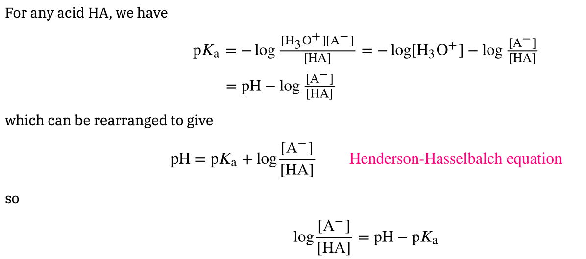
If the pKa value of a given acid and the pH of the medium are known, the percentages of dissociated and undissociated forms can be calculated using the Henderson–Hasselbalch equation.

Slide 21
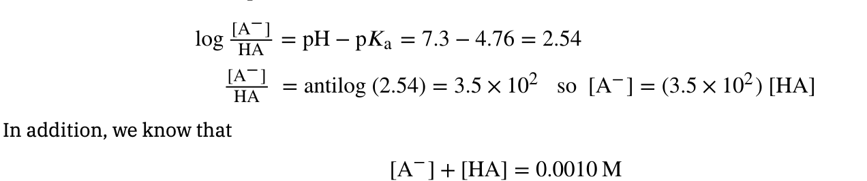
As an example of how to use the Henderson–Hasselbalch equation, let’s find out what species are present in a 0.0010 M solution of acetic acid at pH = 7.3. According to Table 20-3, the pKa of acetic acid is 4.76. From the Henderson–Hasselbalch equation, we have
Solving the two simultaneous equations gives [A–] = 0.0010 M and [HA] = 3 × 10^{–6} M. In other words, at a physiological pH of 7.3, essentially 100% of acetic acid molecules in a 0.0010 M solution are dissociated to the acetate ion.
PROBLEM 20-5 Calculate the percentages of dissociated and undissociated forms present in the following solutions:
0.0010 M glycolic acid (HOCH₂CO₂H; pKa = 3.83) at pH = 4.50
0.0020 M propanoic acid (pKa = 4.87) at pH = 5.30

Slide 22
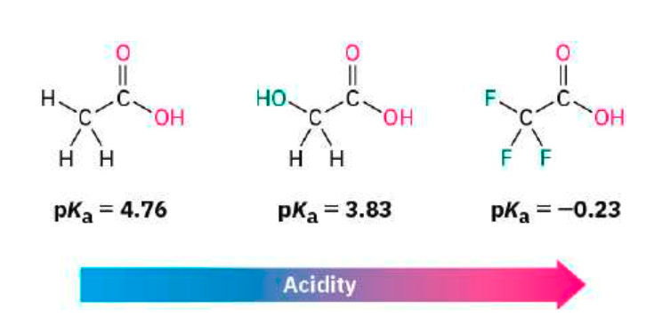
20.4 Substituent Effects on Acidity
Because the dissociation of a carboxylic acid is an equilibrium process, any factor that stabilizes the carboxylate anion relative to undissociated carboxylic acid will drive the equilibrium toward increased dissociation and result in increased acidity.

Slide 23
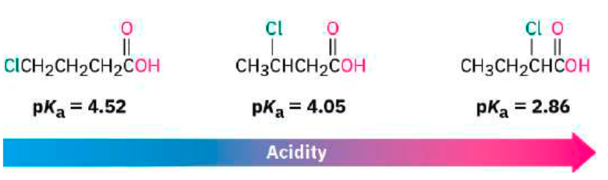
Because inductive effects operate through σ bonds and are dependent on distance, the effect of halogen substitution decreases as the substituent moves farther from the carboxyl. Thus, 2-chlorobutanoic acid has pKa = 2.86, 3-chlorobutanoic acid has pKa = 4.05, and 4-chlorobutanoic acid has pKa = 4.52, similar to that of butanoic acid itself.

Slide 24
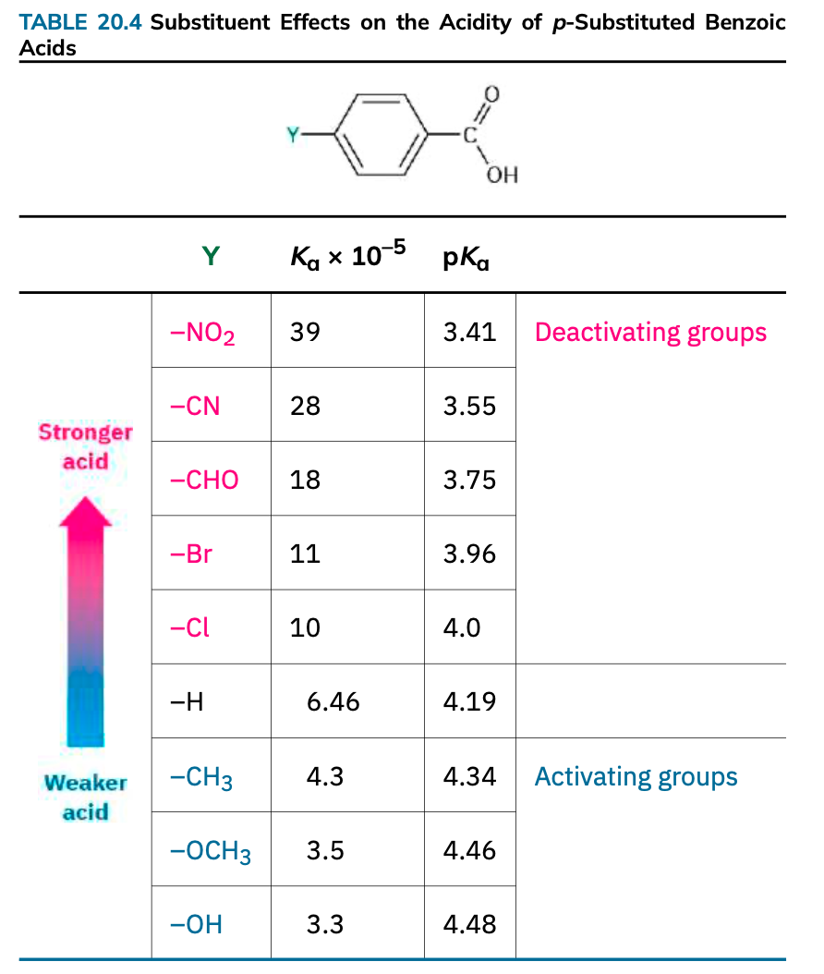
TABLE 20.4
Substituent Effects on the Acidity of p-Substituted Benzoic Acids

Slide 25
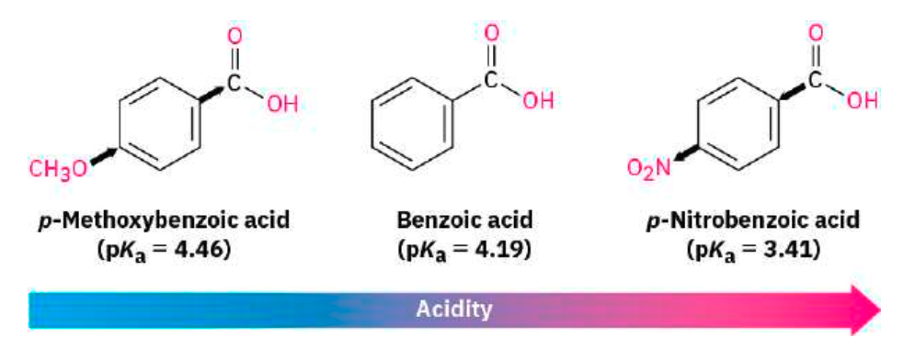
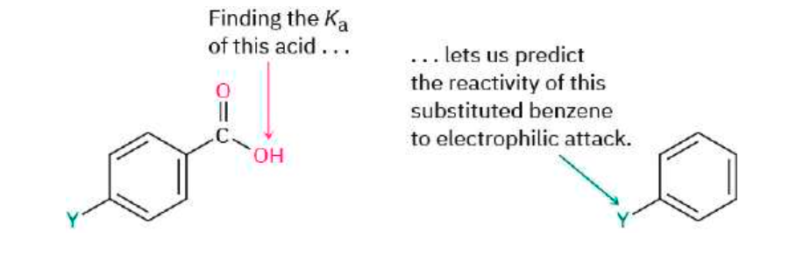
As TABLE 20.4 shows, an electron-donating (activating) group such as methoxy decreases acidity by destabilizing the carboxylate anion, and an electron-withdrawing (deactivating) group such as nitro increases acidity by stabilizing the carboxylate anion.

Slide 26
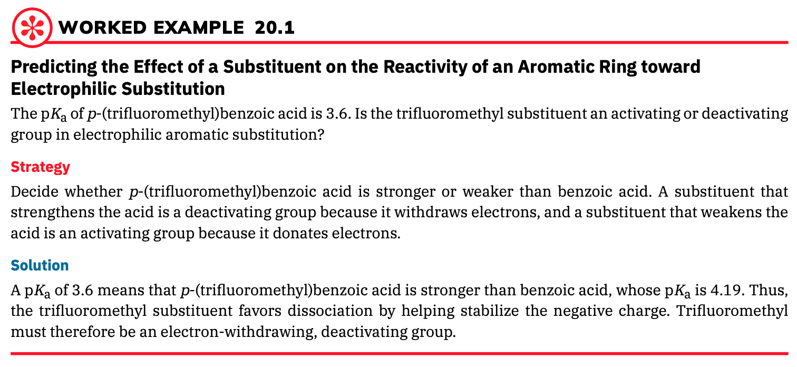

Slide 27

PROBLEM 20-6 Which would you expect to be a stronger acid,the lactic acid found in tired muscles or acetic acid? Explain.
PROBLEM 20-7 Dicarboxylic acids have two dissociation constants, one for the initial dissociation into a mono anion and one for the second dissociation into a dianion. For oxalic acid,HO₂C–CO₂H, the first ionization constant is pKa1 = 1.2 and the second ionization constant is pKa2 = 4.2. Why is the second carboxyl group far less acidic than the first?
PROBLEM 20-8 The pKa of p-cyclopropylbenzoic acid is 4.45. Is cyclopropyl benzene likely to be more reactive or less reactive than benzene toward electrophilic bromination? Explain.
PROBLEM 20-9 Rankt he following compounds in order of increasing acidity. Don’t look at a table of pKa data to help with your answer.
Benzoic acid, p-methylbenzoic acid, p-chlorobenzoic acid
Acid, acetic acid, p-Nitrobenzoic, benzoic acid

Slide 28
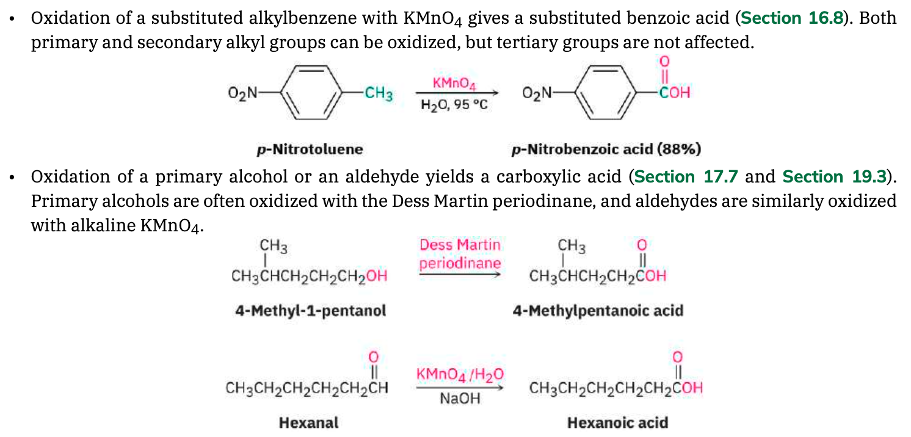
20.5 Preparing Carboxylic Acids

Slide 29
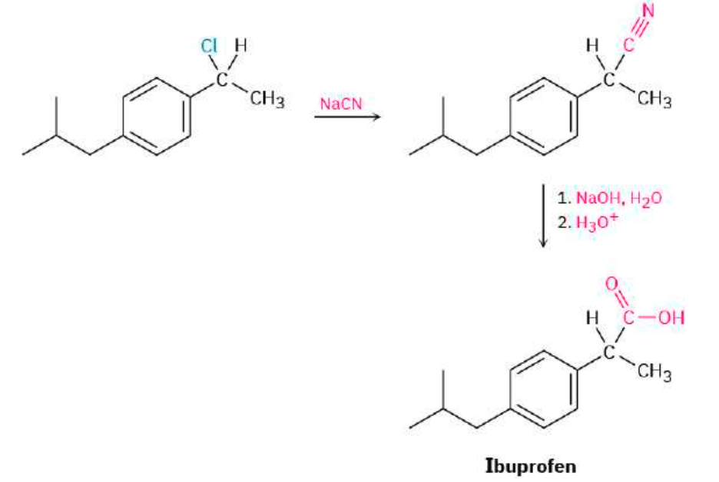
Hydrolysis of Nitriles

Slide 30
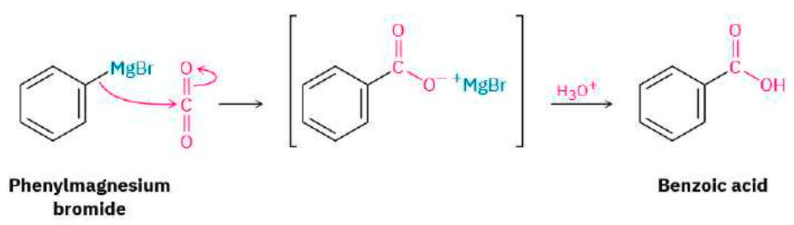
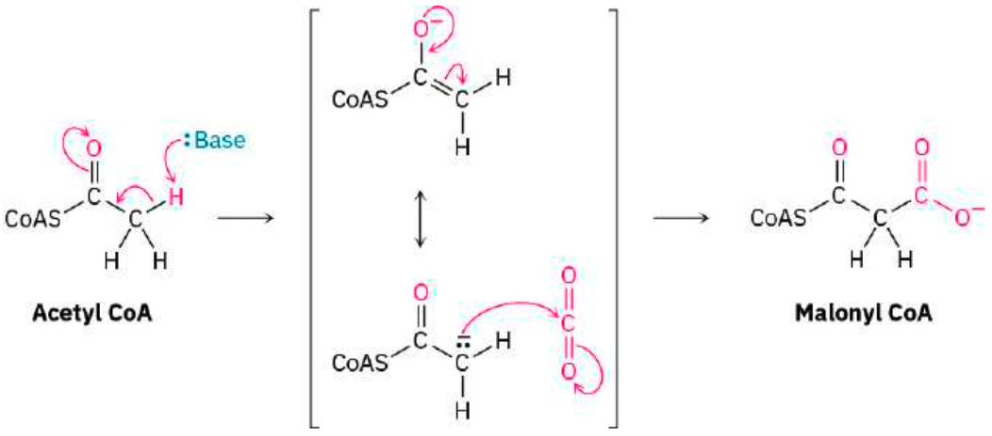
As noted previously, there are no Grignard reagents inside living cells, but there are other types of stabilized carbanions that are often carboxylated.

Slide 31
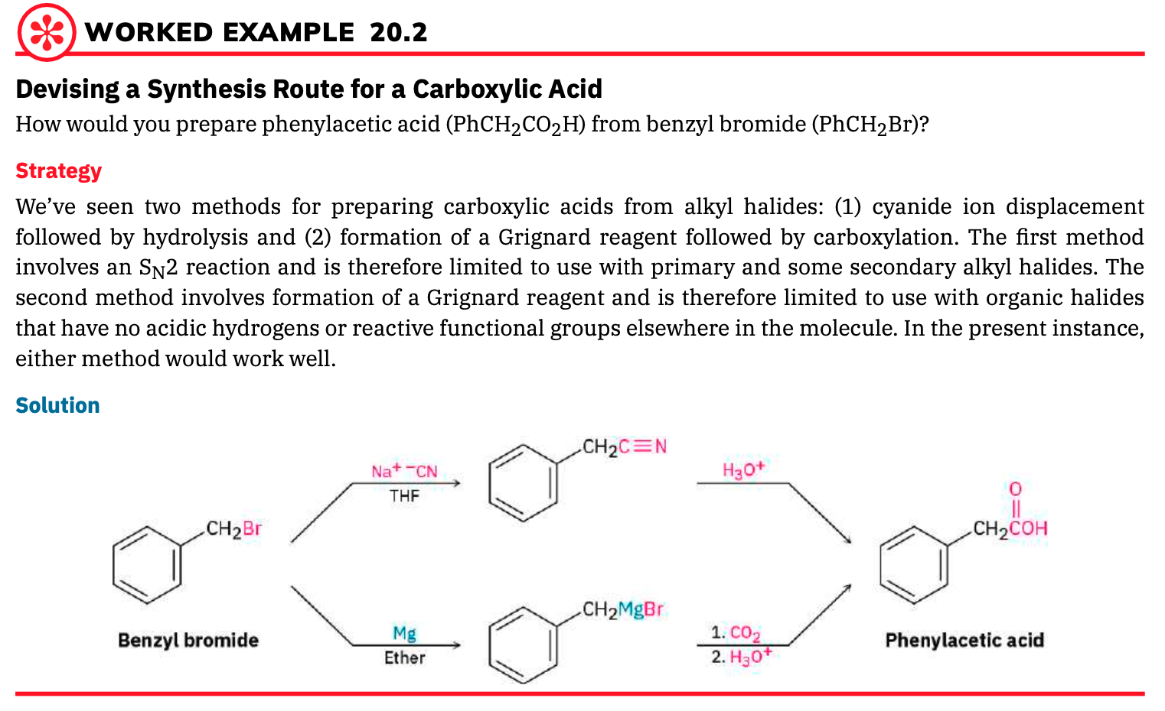
PROBLEM 20-10 How would you prepare the following carboxylic acids?
(a) (CH₃)₃CCO₂H from (CH₃)₃CCl (b) CH₃CH₂CH₂CO₂H from CH₃CH₂CH₂Br

Slide 32
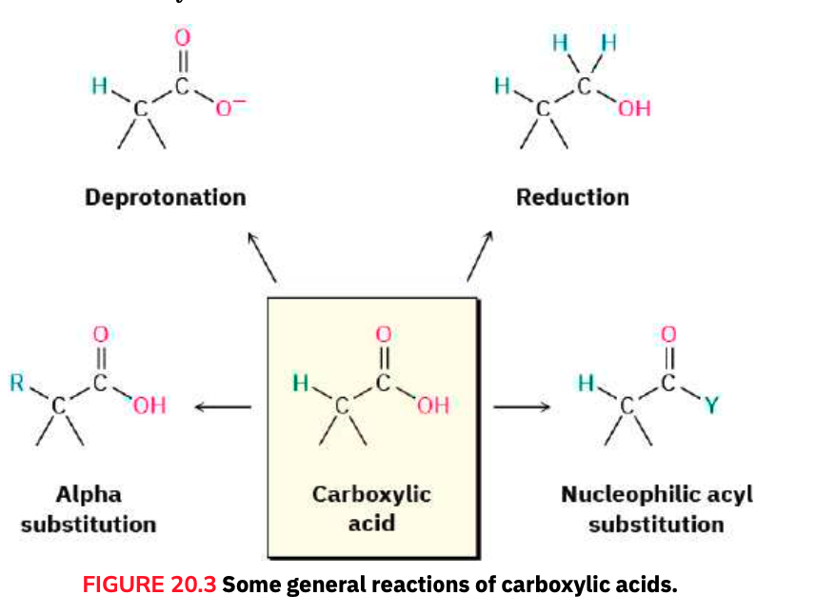
20.6 Reactions of Carboxylic Acids: An Overview

Slide 33
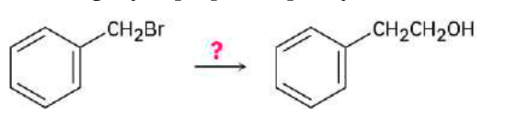
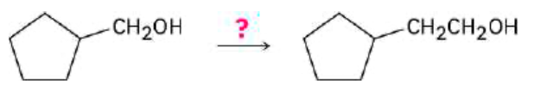
PROBLEM 20-11
How might you prepare 2-phenylethanol from benzyl bromide? More than one step is needed.
PROBLEM 20-12 How might you carry out the following transformation? More than one step is needed.

Slide 34
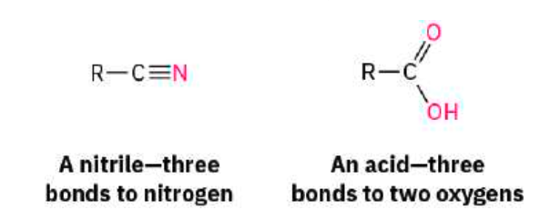
20.7 Chemistry of Nitriles
Nitriles are analogous to carboxylic acids in that both have a carbon atom with three bonds to an electronegative atom and both contain a π bond. Thus, some reactions of nitriles and carboxylic acids are similar. Both kinds of compounds are electrophiles, for instance, and both undergo nucleophilic addition reactions.

Slide 35
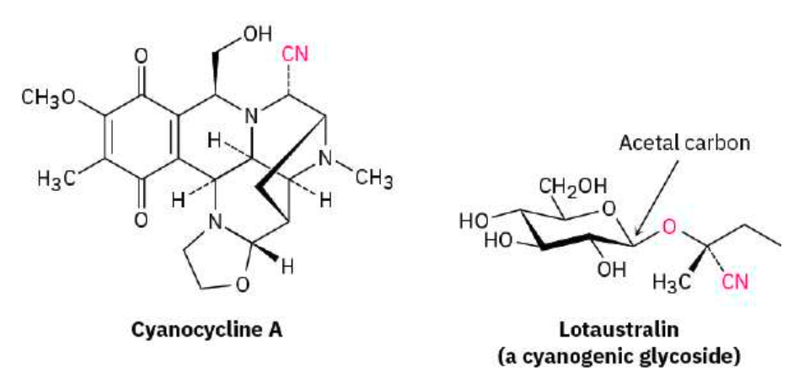
isolated from the bacterium Streptomyces lavendulae and was found to have both antimicrobial and antitumor activity.
to protect the plant by poisoning any animal foolish enough to eat it. Lotaustralin from the cassava plant is an example.

Slide 36
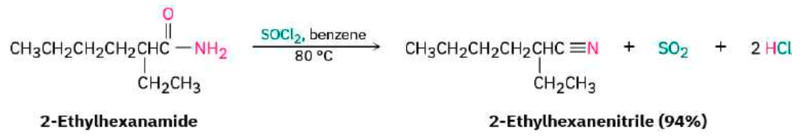
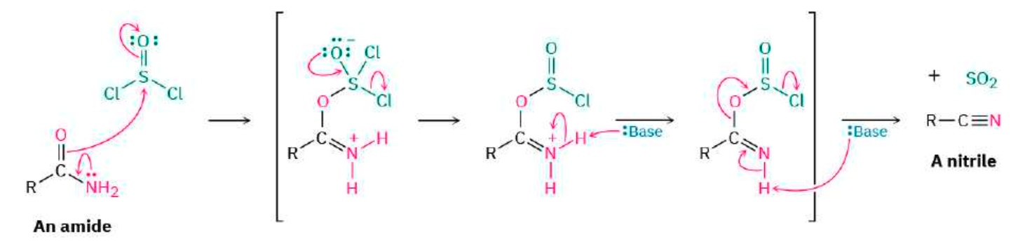
Preparation of Nitriles

Slide 37
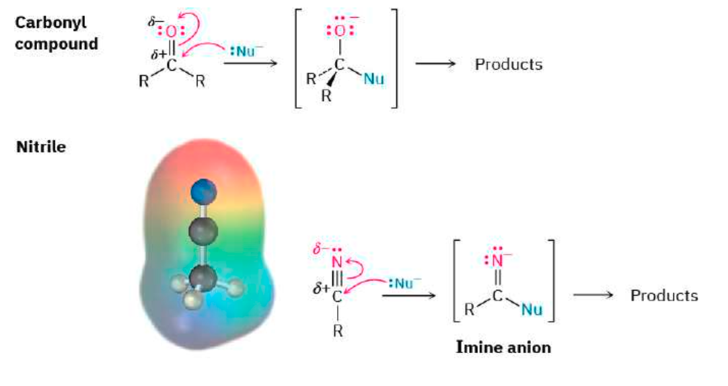
Reactions of Nitriles

Slide 38
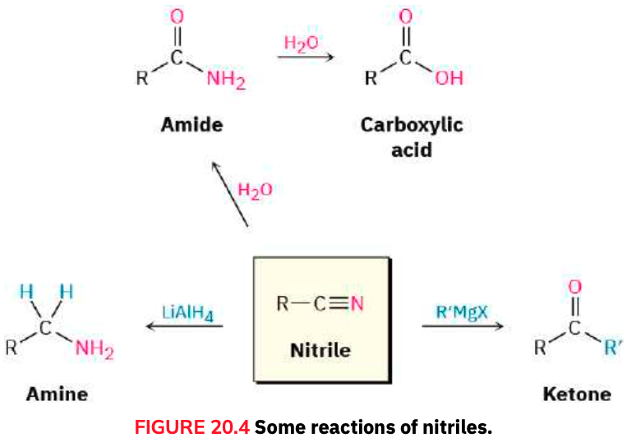
Some general reactions of nitriles

Slide 39
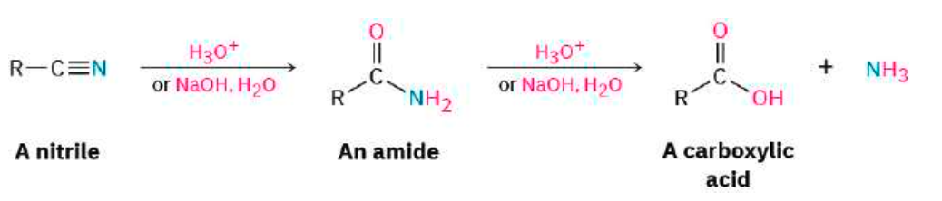
Hydrolysis: Conversion of Nitriles into Carboxylic Acids
Among the most useful reactions of nitriles is their hydrolysis to yield first an amide and then a carboxylic acid plus ammonia or an amine. The reaction occurs in either basic or acidic aqueous solution:
As shown in FIGURE 20.5, base-catalyzed nitrile hydrolysis involves nucleophilic addition of hydroxide ion to the polar C≡N bond to give an imine anion in a process similar to the nucleophilic addition to a polar C=O bond to give an alkoxide anion. Protonation then gives a hydroxy imine, which tautomerizes (Section 9.4) to an amide in a step similar to the tautomerization of an enol to a ketone. Further hydrolysis gives a carboxylate ion.

Slide 40
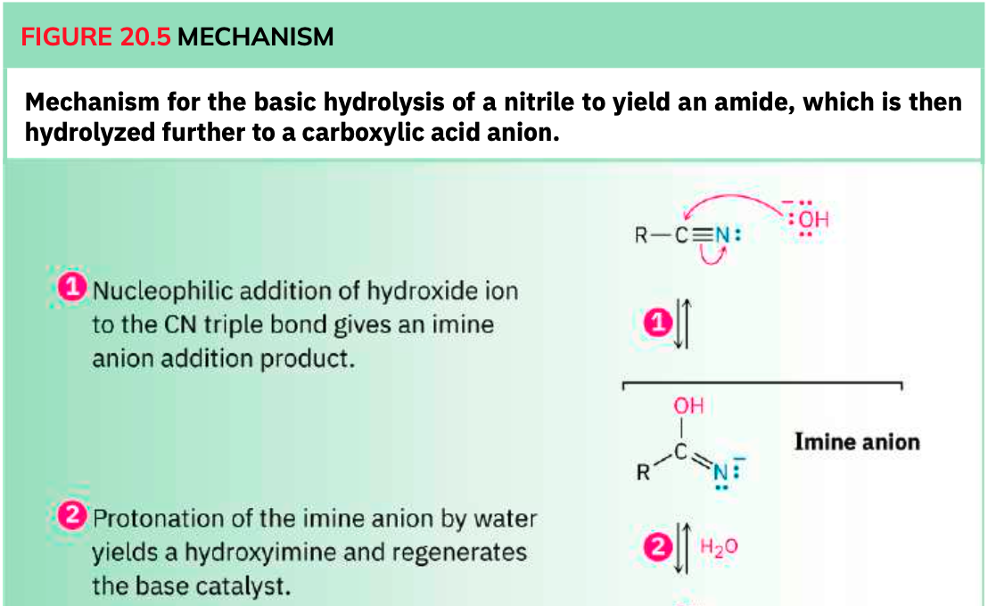

Slide 41
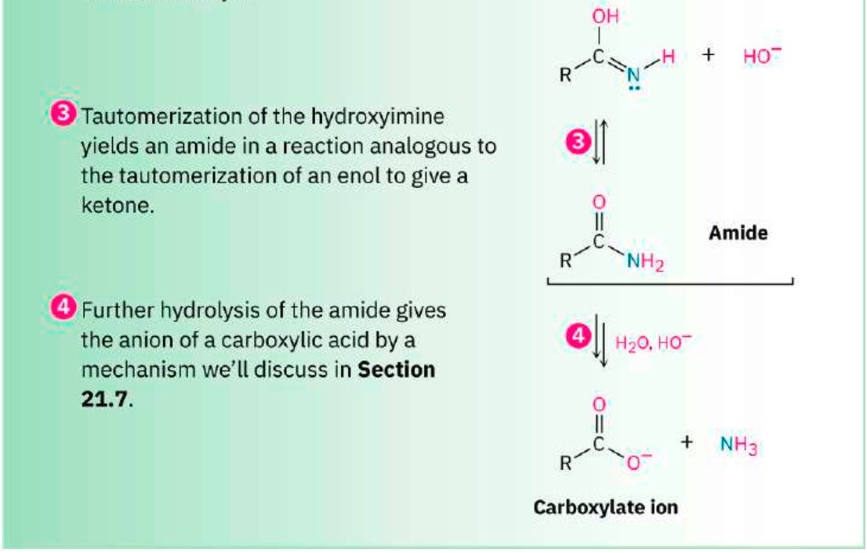

Slide 42
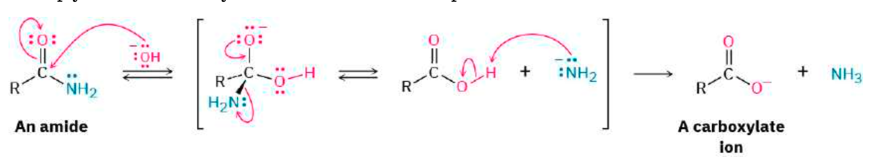
The further hydrolysis of the amide intermediate takes place by a nucleophilic addition of hydroxide ion to the amide carbonyl group, which yields a tetrahedral alkoxide ion. Expulsion of amide ion, NH2−, as leaving group gives the carboxylate ion, thereby driving the reaction toward the products. Subsequent acidification in a separate step yields the carboxylic acid. We’ll look at this process in more detail in Section 21.7.

Slide 43
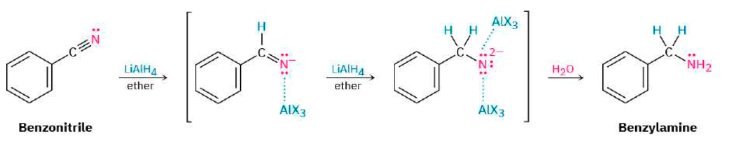
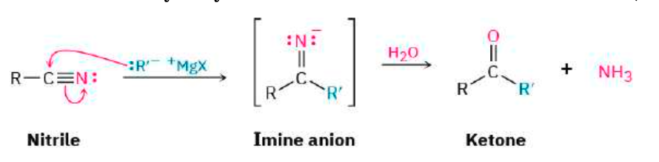
Reduction: Conversion of Nitriles into Amines
Reaction of Nitriles with Grignard Reagents

Slide 44
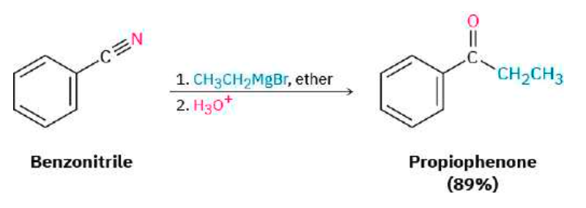
This reaction is similar to the reduction of a nitrile to an amine, except that only one nucleophilic addition occurs rather than two and the attacking nucleophile is a carbanion (R:–) rather than a hydride ion. For example:

Slide 45


Slide 46

PROBLEM 20-13
How would you prepare the following carbonyl compounds from a nitrile?
PROBLEM 20-14
How would you prepare 1-phenyl-2-butanone, C₆H₅CH₂COCH₂CH₃, from benzyl bromide, C₆H₅CH₂Br? More than one step is needed.

Slide 47

20.8 Spectroscopy of Carboxylic Acids and Nitriles
Infrared Spectroscopy

Slide 48
Nitriles show an intense and easily recognizable bond absorption near 2250 cm–1 for saturated compounds and 2230 cm–1 for aromatic and conjugated molecules. Few other functional groups absorb in this region, so IR spectroscopy is highly diagnostic for nitriles.
PROBLEM 20-15 Cyclopentane carboxylic acid and 4-hydroxy cyclo hexanone have the same formula (C₆H₁₀O₂), and both contain an –OH and a C═O group. How could you distinguish between them using IR spectroscopy?

Slide 49

Nuclear Magnetic Resonance Spectroscopy
Carboxyl carbon atoms absorb in the range 165 to 185 δ in the ¹³C NMR spectrum, with aromatic and α,β-unsaturated acids near the upfield end of the range (∼165 δ) and saturated aliphatic acids near the downfield end (∼185 δ). Nitrile carbons absorb in the range 115 to 130 δ.

Slide 50

PROBLEM 20-16 How could you distinguish between the isomers cyclopentanecarboxylic acid and 4-hydroxycyclohexanone by 1H and 13C NMR spectroscopy? (See Problem 20-15.)

Slide 51



FIGURE 20.8 In addition to the hazards of weather, participants in early polar expeditions often suffered from scurvy, caused by a dietary vitamin C deficiency

Slide 52


