Slide 1

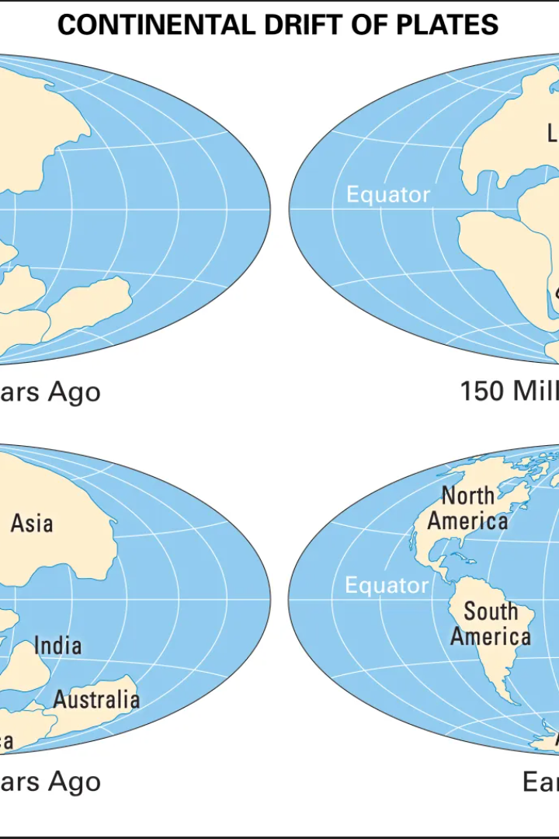
Earth's Crustal Deformation and Tectonics:
A short and simple explanation of deformation of the earth's crust, its types and how this is related to plate tectonics and the movement of the plates.
Kelompok 7:
Wulan Syah Hidayatullah
Marifatus soleha

Slide 2
Definition of Crusal Deformation and Tectonics
Deformation is the change in position, shape and size of matter (Kuang, 1996). Working loads or heavy forces accompanied by the influence of the gravity of a surrounding material in a certain time interval affect the geometric shape of the material.
Deformation
Plate Tectonics
The definition of deformation can be interpreted as a change in position or movement of a point on an object in absolute or relative terms.
Plate tectonics is a cycle of rocks on earth that occurs on a geologic time scale
The movement of tectonic plates on earth is classified into three types of movement boundaries, namely: convergent, divergent and transform.

Slide 3
Factors Controlling the Occurrence of Deformation
The factors that control deformation are:
1. At low temperatures and pressures fracture will occur faster, at high temperatures and pressures bending or even melting will occur.
2. The speed of movement caused by the applied force; fast movement can cause fracture, while slow movement can cause bending, depending on the material concerned and other circumstances.
3. Material properties, which can be more brittle or more pliable

Slide 4
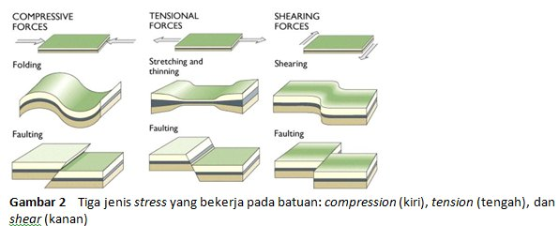
e
The stages of deformation are as follows:
Elastic Deformation
Ductile Deformasi
Facture Deformasi
Temporary deformation is deformation of rocks that is temporary or not permanent. This temporary deformation occurs if the stress does not exceed the elastic limit of the rock.
Ductile deformation is the stage of deformation after the elastic limit is exceeded and the change in shape and volume of the rock does not return.
Fracture deformation is the stage of deformation that occurs after the limit or limit of elastic deformation and ductile deformation is exceeded.
There are 3 forces acting on a surface of unity area, namely:
Compression
Extension
Shear

Slide 5
The Process of Deformation of the Earth's Crust
Deformation of the earth's crust occurs due to geological activity, such as tension and strain in the earth's crust.
1
Tension
Pressure that acts on the earth's crust and causes deformation.
Strain
2
Shifting and separation of rocks beneath the earth's surface resulting in deformation.
3
Plate Tectonics
The movement of tectonic plates is the main cause of deformation of the earth's crust and the formation of geological structures.

Slide 6
Relationship between Earth's Crust Deformation and Plate Tectonics
Plate tectonics is the study of the movement and interactions between the plates that form the Earth's crust and how these interactions influence the Earth's topography and geological activity. Deformation of the earth's crust is one of its manifestations.
Divergent Boundaries
Convergent Boundaries
Transformation Limits
The appearance of cracks and thickening of the earth's crust due to the separation of two plates that are moving away from each other.
The meeting between two tectonic plates that are moving closer together causes the formation of mountains, islands and ocean trenches.
The point of horizontal movement between two tectonic plates. Often triggers earthquakes.

Slide 7
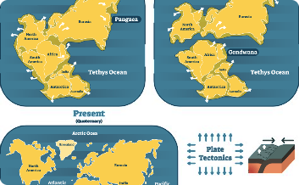
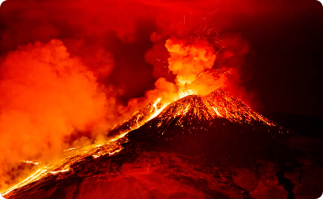

Plate Tectonics and Plate Movement
Tectonic plates move together following three main patterns, namely divergent, convergent and transformation, which causes the formation of various geological forms and geological phenomena on the face of the Earth.
Continental Drift
Volcanic Eruption
Tsunami
Plate tectonics can also trigger volcanic eruptions. As a result of the reaction between magma in the volcanic body with ground water and steam, it produces a very powerful eruption.
The consequences of tectonic plate movements that occur on the seabed can trigger the movement of sea masses and trigger tsunamis.
Plate tectonics causes giant movements throughout the Earth's crust, moving land and spreading oceans, and forming new mountains and faults.

Slide 8
Evidence of Plate Tectonics
What is the evidence for plate tectonics? Read the following explanation:
Movement of types of bones on land
There are rocks that are evenly distributed on the face of the Earth
Earthquakes and volcanoes occur
Meteorite showers and the presence of traces of ancient life in different environmental origins
1
Haruki Rintaro
"We saw similar patterns in rocks and geological formations located hundreds of kilometers from each other."
Carl Sagan
2
"The Earth's plates are like a bird's wings. When he lifts them, he continues to raise those wings throughout his life."
3
Stephany Spencer
"Plate tectonics explains everything from earthquakes to volcanoes and the geological structure of the Earth. It's one big idea that connects it all."

Slide 9


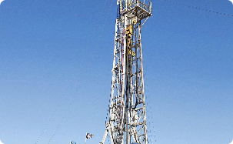
The Impact of Earth's Crustal Deformation and Tectonics on Human Life
How does deformation of the earth's crust and tectonics affect human life? These are examples of its impact:
Changes in the living environment can force humans to adapt.
The development of hot spring bathing places, the accuracy of determining the location of springs, as well as the placement of other public buildings such as roads and skyscrapers.
The formation of springs and kidney basins makes it easier to distribute clean water around the city/community.
The emergence of natural disasters such as volcanic eruptions, earthquakes, subsidence and sea earthquakes which require planning, monitoring and preparedness from the authorities.
Renewable energy
Development
Natural resources
Plate tectonics has great potential to support the development of unlimited micro energy in the body, such as waterfall energy (hydrothermal), natural gas, or to create electrical units.
Due to the nature of shifts in the depths of the earth, subduction of tectonic plates is known to cause uplift of basalt mountains, sedimentary deposits, fault effects, and so on. In this case, development can be carried out on the hills and mountains that are formed.
The deposition of petroleum and natural gas originates from the synthesis of organic materials that have taken place over many years. In the same time range, tectonic plates can move to compress and supply crude oil on the seabed.

