Slide 1
Evaluation of Physics Learning
Here is where our presentation begins

Slide 2



Our team
Annisa Putri Arifa
Candra Julian Pratama
Dinda Tara Cahyani
2213022014
2213022019
2213022005
2213022024
2213022005
Okta Irmanita
Uswatun Hasanah

Slide 3
Material Discussion
Activity 2
Activity 1
the purpose of the function & usefulness of the evaluation of learning physics
Understanding of learning evaluation
Activity 3
Activity 4
physics learning evaluation measurement
physics learning evaluation evaluation
Activity 5
evaluation of physics learning

Slide 4
01
Understanding
Of learning Evaluation

Slide 5
Evaluation of physics learning
Don't forget
...
evaluation learning is a processin planning, acquiringand provide informationvery necessary to makevarious decision alternativesdesigning a systemlearning.
.

Slide 6
02
the purpose of the function & usefulness of the evaluation of learning physics
FISIKA

Slide 7
the purpose of the function & usefulness of the
Evaluation of learning physics
Don't forget
...
The purpose of the evaluation of the learning itselfis to get datathe evidence will showstudent success to achievecurricular goals. apart from that, evaluation as wellcan be used by educators and supervisorseducation in measuring or assessingteaching effectiveness, learning activities,and teaching methods used..
Don't forget
...

Slide 8
Evaluation function in learning
01
Proceed & develop
02
Program Success
03
NecessityBK
04
Curriculum Development and Improvement
how advanced &To knowdevelopment of studentslevel of successafter doing the activityteaching programmestudy over a period of time
to determine the level of success of teaching programs
Various evaluation resultsstudents usestudent successas a source of informationand learning programs,or data for BK servers
Evaluation is also used forassess the content and also the subject matterthat is in the curriculum

Slide 9
03
Measurement
physics learning evaluation

Slide 10
Measurement
Measurement is measuring somethingor can be interpreted as giving a number toobject being measured so as to describecharacteristics of the object. Education measurementcompetency-based classification based on observationfor the work or abilities of learners withusing one standard..

Slide 11
Measurement
Competency-based educational measurement
Measurements can use test & non-test
Education measurement is usually quantitative
Testing is part of the measurement followed by assessment activities
NOTE: Quantitative results are in the form of NUMBERS, while Qualitative results are NOT NUMBERS (in the form of good, adequate, poor predicates/statements)
35%

Slide 12

Measuring Instrument
In measurement terms there are two things, namely "measuring instrument" and "what is being measured". The measuring instrument is in the form of an instrument (test/non-test). Test instruments are used to measure cognitive and psychomotor abilities, while non-test instruments are used to measure affective abilities.

Slide 13
04
Evaluation
Physics learning evalution

Slide 14

Evaluation
Assessment is a series of activitiesto acquire, analyze, andInterpreting data about processes andstudent learning outcomessystematically andcontinuous so it becomesdeep meaningful informationdecision-making.'

Slide 15

Don't forget
...
Learning success of students inachieve competency standardsdetermined., At the subject level, competencies to be achieved in the form of Competency Standards (SK), subject swhich is further described in Basic Competency (KD), for level educational units, competencies that must beachieved by students is Standard Graduate Competency (SKL)

Slide 16
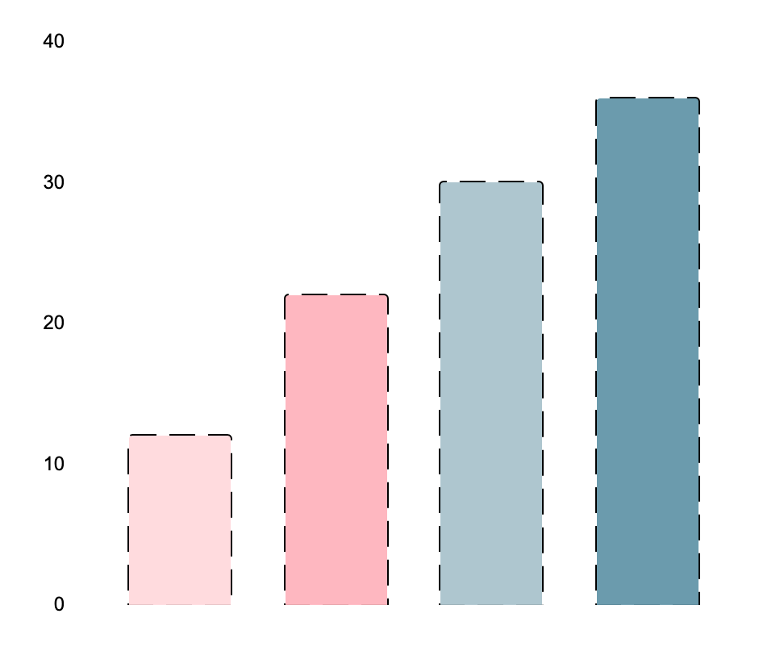
05
Evaluation
of physics learning

Slide 17
Evaluation
Don't forget
...
In conducting the evaluation there arejudgment to determine the value of aquite a few programscontains a subjective element. Evaluationrequire measurement data andinformation on the results of the assessment that hasmany dimensions, such as ability,creativity, attitudes, interests, skills,etc. therefore, toolsThe measurements used also varydepending on the type of data you wantobtained
Don't forget
...

Slide 18
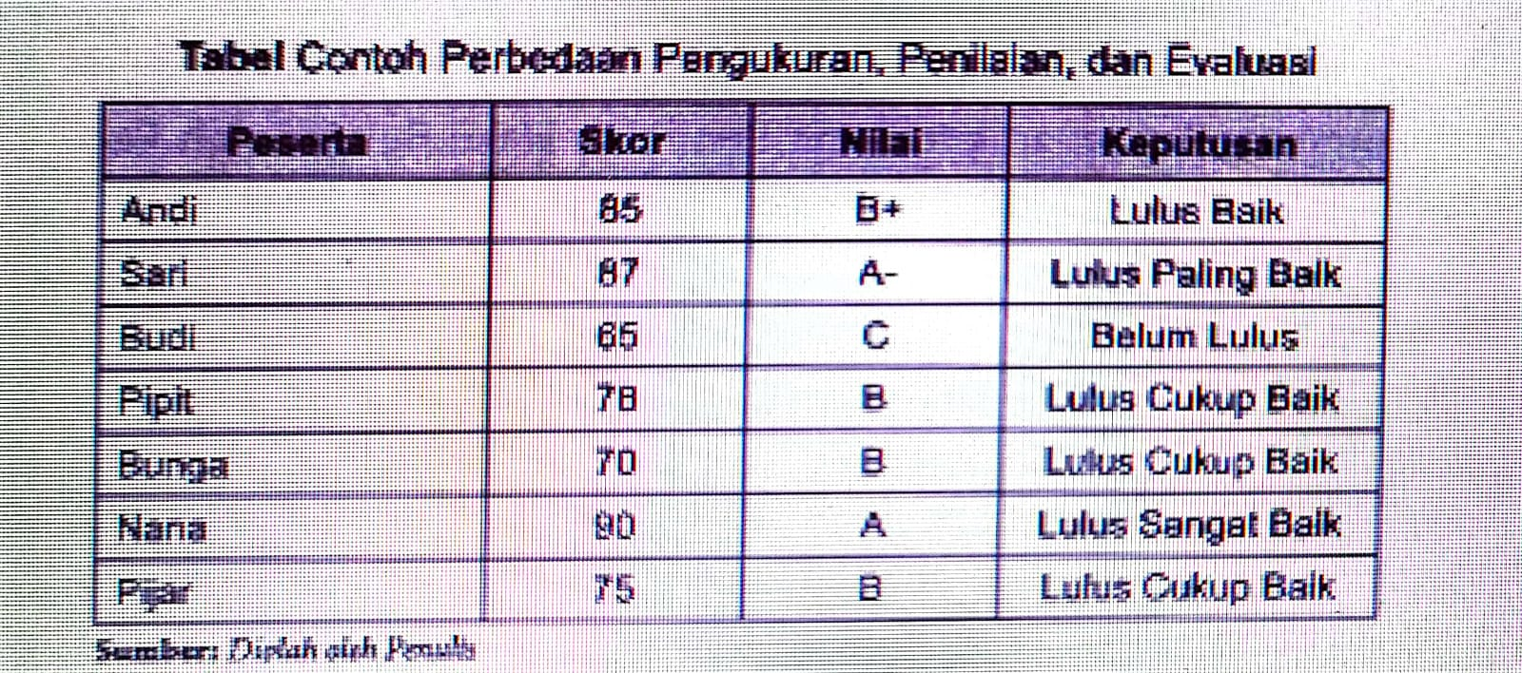
Measurement, Assessment, &Evaluation
Measurement, assessment, and evaluation are hierarchical activities.That is, the three activities are related to the learning processTeaching cannot be separated from one another, as well as in its implementationmust be completed sequentially.Table of Examples of Differences in Measurement, Registration, and Evaluation

Slide 19
Thank you

