Slide 1
ENDOMEMBRANE SYSTEM
PENDIDIKAN BIOLOGI
UNIVERSITAS LAMPUNG

Slide 2
Metionin (AUG)-
Leusin (CUA)
Alanin (GCU)
Asparagin (GAC)

Slide 3
Kompetensi yang diharapkan setelah mempelajari bab ini yaitu:
Menjelaskan struktur retikulum endoplasma, dan kompleks Golgi beserta komponen penyusunnya.
Menjelaskan proses biosintesis protein, glikosilasi, fosfolipid dan kolesterol
Menganalisis proses detoksifikasi.
Membuat kesimpulan materi pembelajaran sesuai dengan informasi yang di-peroleh dengan predikat “sangat baik”.
Mempresentasikan hasil kerja (LKM) dengan predikat “Cakap.

Slide 4
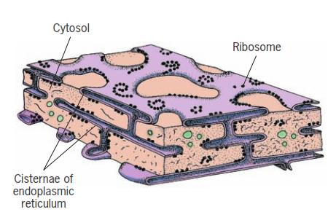
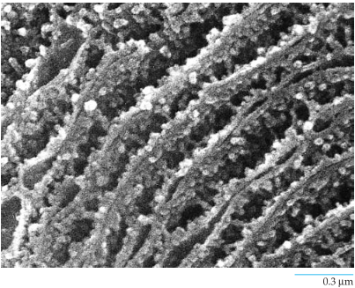
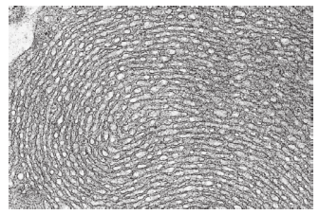
Struktur RE

Slide 5
(Campbell, 2010)

Slide 6
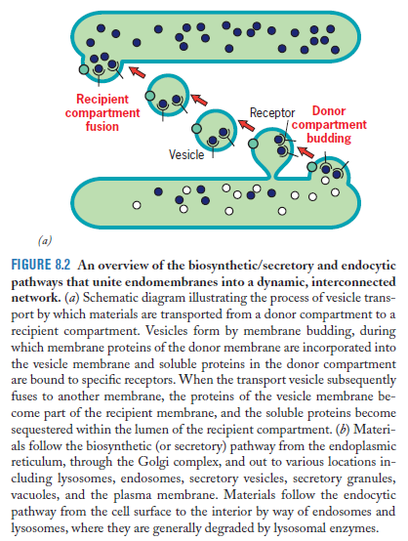
(Karp, 2010)

Slide 7
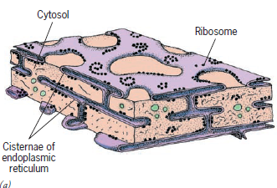
ENDOPLASMIC RETICULUM
(Campbell, 2010)
SER
Synthesis steroid - endocrine
Detoxification – cytochrome p450
Sequestering Ca²⁺
RER, synthesis:
Protein
Secretory, lysosome, vacuola
Newly protein
Membrane
Glycosylation
(Karp, 2010)

Slide 8
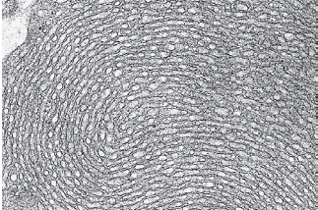
(Karp, 2010)

Slide 9
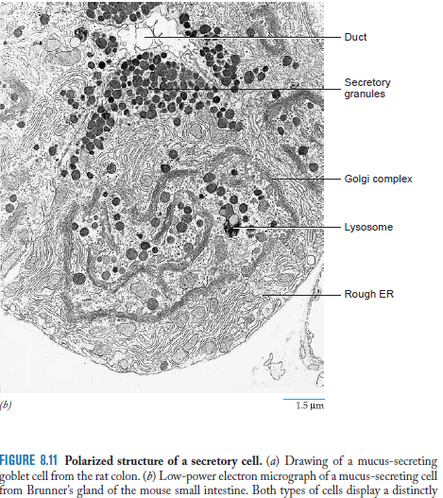
RER pancreas > SER
SER epithelial > RER
SER testes & ovary >
SER glycogen to glucose
(Karp, 2010)

Slide 10
ENDOPLASMIC RETICULUM
Syn secretory protein: 1.binds 2.bring 3.release 4.translocate
Syn integral membrane protein
(Karp, 2010)

Slide 11
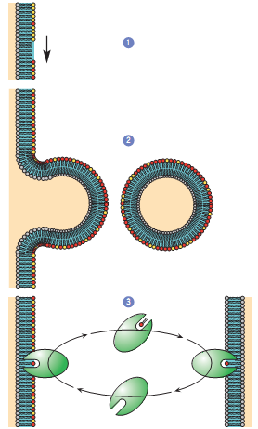
1.Modify enzym
2.Phos diff bud
3.Phos removed

Slide 12
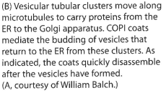
(Alberts, 2008)

Slide 13
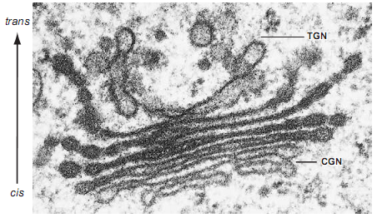
GOLGI COMPLEX
Aparatus = badan = kompleks
Sisternae
Diktiosom

Slide 14
GOLGI COMPLEX

Slide 17
LYSOSOMES
Enzyme: Phosphatase, nuclease, hydrolase, protease
Primer & seconder
Heterophagy
Autophagy

Slide 18
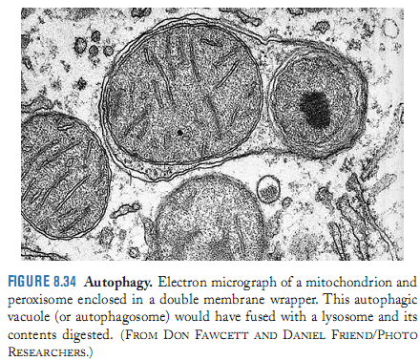
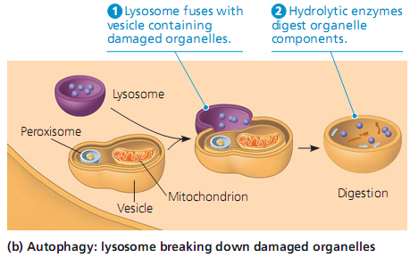

Slide 19
VACUOLES

Slide 20
VACUOLES
90 % volume plant cells
Stored: ions, sugars, amino acids, proteins, polysaccharides, toxic, pigment, weapon (cyanide)
Tonoplast: pump ions
Water enter by osmosis
Interceluler digestion hydrolase

Slide 21
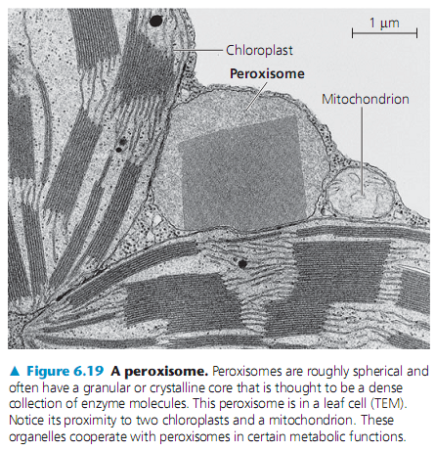
PEROXISOMES
Enzyme produce H₂O₂
Break fatty acid
Convert H₂O₂ to water
In liver: detoxify alcohol
Glyoxysomes plant seeds: fatty acid to sugar

Slide 23
METABOLISME
The totality of an organism’s chemical reactions
A metabolic pathway begins with specific molecule, altered, resulting product
Catabolic : release energy, complex -> simple
Anabolic : simple -> complex

Slide 24
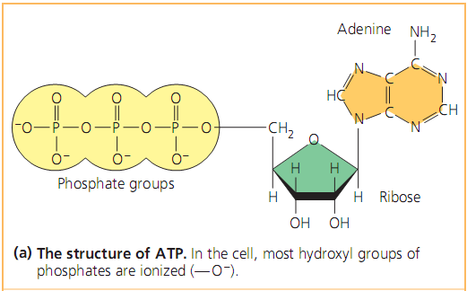
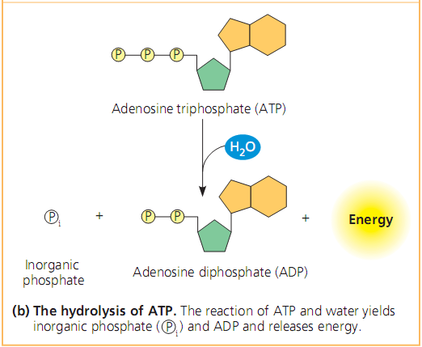

Slide 29
MITOKONDRIA

Slide 30
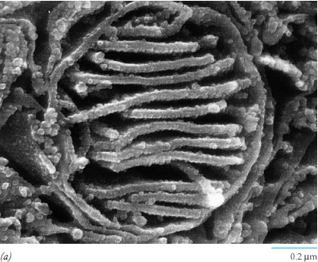

Slide 31
MITOKONDRIA

Slide 33
RESPIRASI SELULER
Catabolic pathway
Organic c + Oxygen -> Carbondioxide + Water + Energy
Redox Reactions : Oxidation & Reduction
NAD (nicotinamide adenin dinucleotide)
FAD (flavin adenin dinucleotide)
Stages:
1. Glycolysis
2. Pyruvate oxidation & citric acid cycle
3. Oxidative phosphorylation (e-transport & chemiosmosis

Slide 39
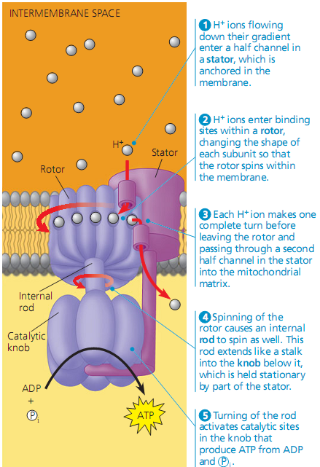

Slide 43
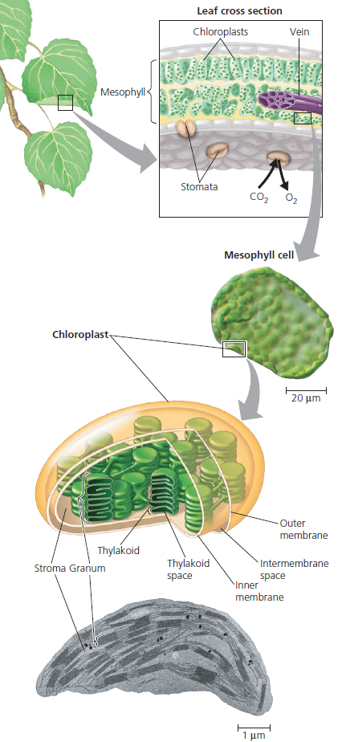
FOTOSINTESIS
Autotrof
Fotoautotrof
Kloroplas

Slide 44
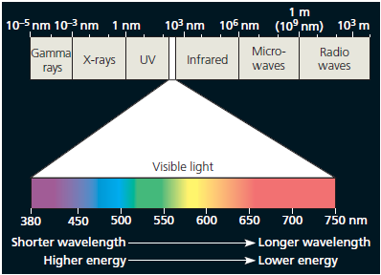

Slide 45
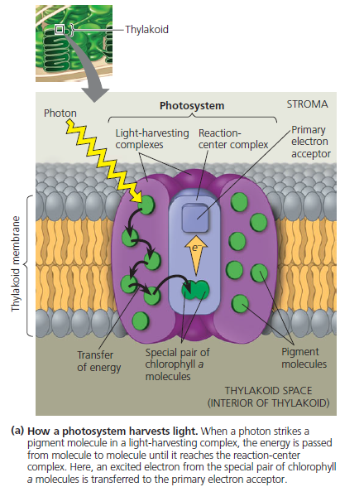

Slide 46
FII serap cahaya
e⁻ oleh akseptor
Enzim ekstraksi air
e⁻ dari FII ke FI
Fotofosforilasi
FI serap cahaya
Rantai trasnfer e
NADPH

Slide 48
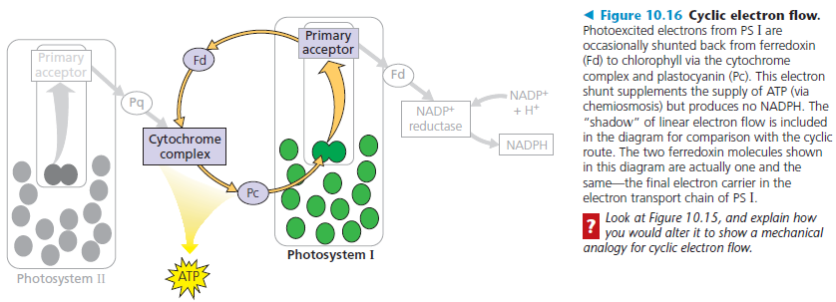

Slide 54
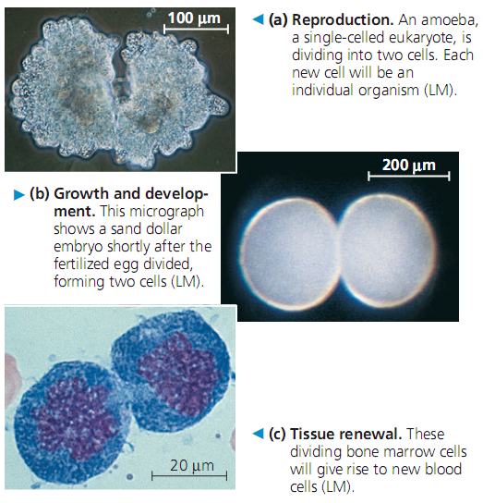
SIKLUS SEL
Omnis cellula e cellula
Mekanika pembelahan sel

