Slide 1
Microbial
Physiology
Achmad Arifiyanto

Slide 2
Bioremediation
Definition
Types
Benefits
Microbial agents

Slide 3
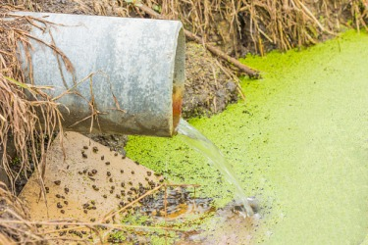
Definition
The use of either naturally occurring or deliberately introduced microorganisms or other forms of life to consume and break down environmental pollutants, in order to clean up a polluted site.
Use of living organism to transform, destroy or immobilize contaminant

Slide 4
Types
Bioremediation
Ex situ
Biopile
Windrow
In situ
Bioreactor
Land farming

Slide 5
Types
Bioremediation
Ex situ
Biopile
Windrow
In situ
Bioreactor
Land farming

Slide 6
Types

Slide 7
Types

Slide 8
Types

Slide 9
Types

Slide 10
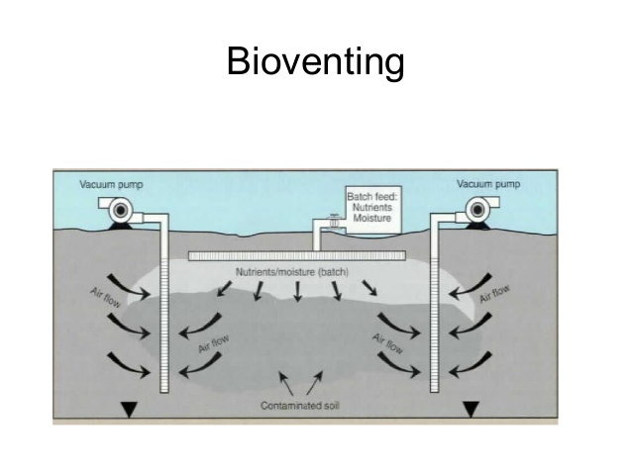
Types

Slide 11
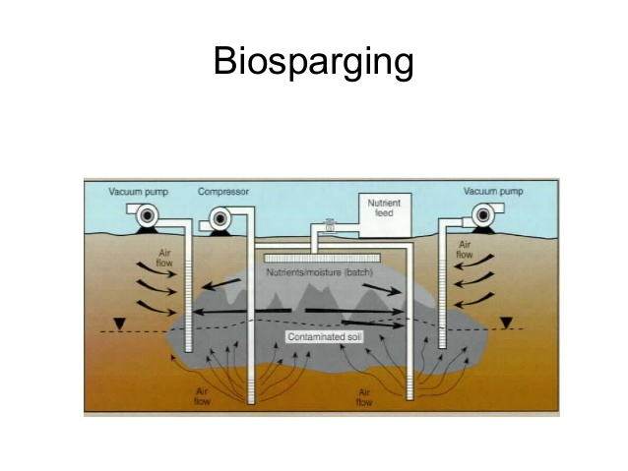
Types

Slide 12
Types

Slide 13
Feasibility

Slide 14
Microbes

Slide 15
Environmental factors

Slide 16
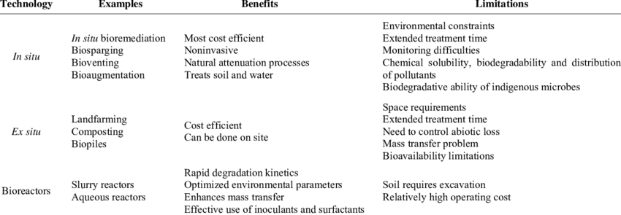
Overview

Slide 17
Plants

Slide 18
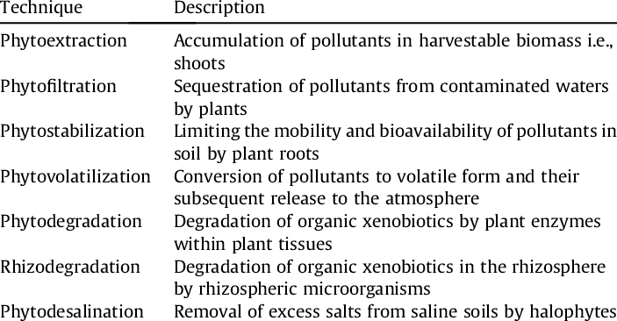
Phytoremediations

Slide 19
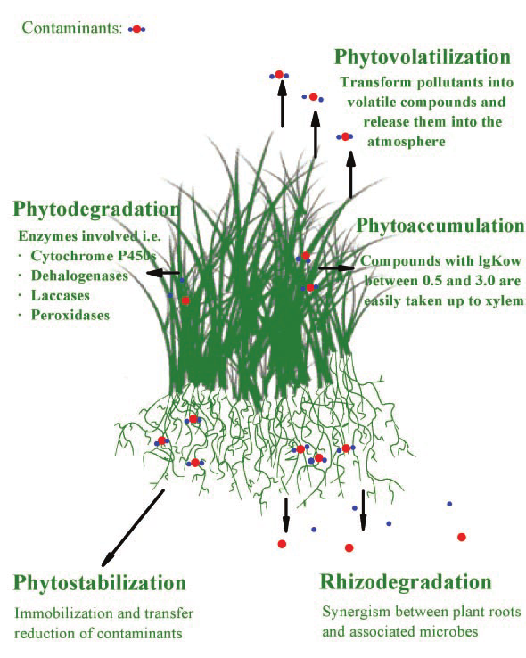
Phytoremediations

Slide 20
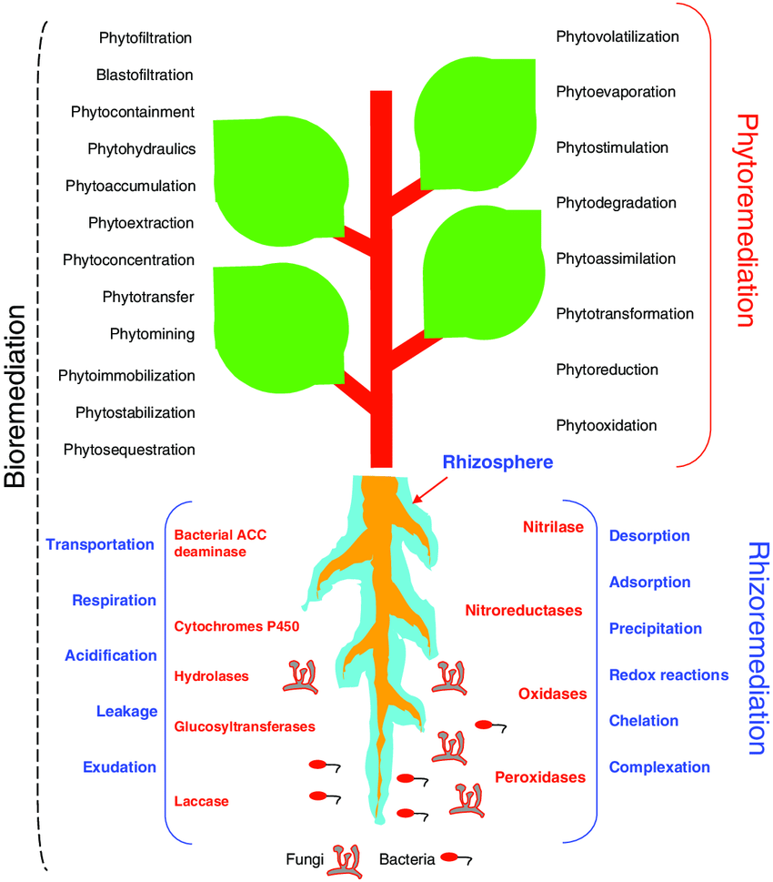
Phytoremediations

Slide 21
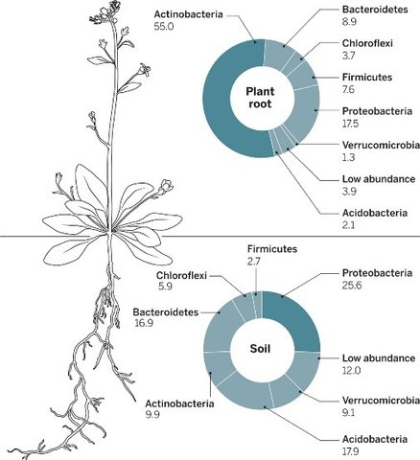
Phytoremediations

Slide 22
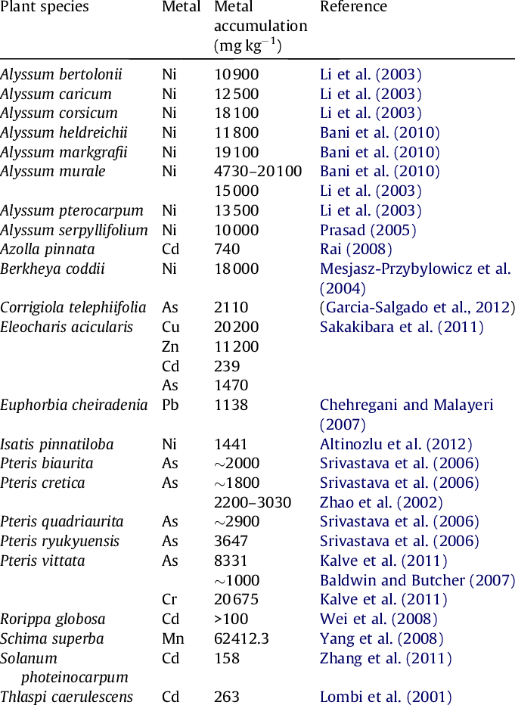
Phytoremediations

Slide 23
Steps

Slide 24
Analysis
Organism
Pollutant
Bioremediation
Microbes
Biomonitoring
Amdal

Slide 25
Apa pengertian dari bioremidiasi
Kapan bioremidiasi ex situ dan in situ ditetapkan sebagai sebuah pilihan remidiasi
Bagaimana proses bioremidiasi terkait erat dengan faktor pertumbuhan
Jelaskan perbedaan jenis jenis bioremdiasi
Mengapa bioremdiasi tidak dapat dipisahkan dari tinjauan peran mikroba dalam mendekontaminasi polutan

