Slide 1
Nucleic Acids
In the 1860s, Swiss chemist Friedrich Miescher discovered that cell nuclei contained acids not found elsewhere. He called these nucleic acids.
By 1900, biochemists had established that nucleic acids all contained:
4 nitrogenous bases,
a five-carbon sugar, and
molecules of phosphoric acid.

Slide 2
Nucleotides
Any nucleic acid it seemed could be built up from units that each contained
one molecule of one of the bases
one molecule of the 5-carbon sugar
one molecule of phosphoric acid.
These building block units were called nucleotides.

Slide 3
Polynucleotides
A complete molecule of a nucleic acid was a collection of nucleotides, or a polynucleotide for short.
But how they are assembled was a major question.
At right is a model suggested by Alexander Todd in 1951.

Slide 4
The 5-carbon sugars
Any polynucleotide contains only one kind of sugar.
The sugars found in nucleic acids are unusual in that they have 5 carbon atoms in each molecule.
The usual is 6 carbon atoms.

Slide 5
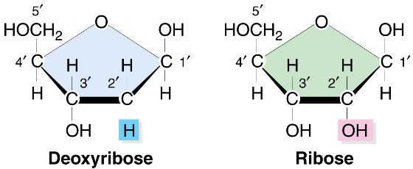
The 5-carbon sugars, 2
There are two basic 5-carbon sugars in nucleic acids:
ribose and de-oxyribose.
Note that de-oxyribose has one less oxygen atom than ribose, hence the name.

Slide 6
The two nucleic acids
Therefore, there are 2 kinds of nucleic acids
RNA – ribonucleic acid
Composed of nucleotides, each having one of four nitrogenous bases, a molecule of phosphoric acid and a molecule of ribose.
DNA – deoxyribonucleic acid
Composed of nucleotides, each having one of four nitrogenous bases, a molecule of phosphoric acid and a molecule of deoxyribose.
In the late 1920s, it was discovered that DNA is found almost exclusively in the chromosomes, while RNA was actually mostly outside the nucleus, in the cytoplasm of the cell.

Slide 7
The nitrogenous bases
DNA has four possible bases
2 are purines
Adenine
Guanine
2 are pyrimidines
Cytosine
Thymine
RNA is similar but in place of Thymine it has a different pyrimidine, Uracil.

Slide 8
Mechanical Models
The construction toy approach to discovering the physical structure of a complex molecule.
Actual ball and stick constructions built to scale of a molecule under study, so as to get the angles and distances corresponding to physical theory.
An American innovation, derided as unscientific by most European scientists.

Slide 9
Linus Pauling and Mechanical Models
Linus Pauling at the California Institute of Technology was the leader in this work.
His book The Nature of the Chemical Bond was the standard text in the field.
In 1951, Pauling discovered the basic structure of many protein molecules (polypeptides) by building such 3-dimensional models.

Slide 10
Alpha-helix model.
One of Pauling’s major discoveries was the alpha-helix structure of many proteins.
So called because, he learned, the molecular chain continually crossed over on itself, making the shape of the Greek letter alpha, α, and then twisted into the coil shape of a helix.

Slide 11
Chargaff’s Rules
One of the interesting discoveries, coming right out of standard chemical research methods concerned the makeup of DNA.
In DNA samples, the relative amounts of sugar, phosphates, and bases was constant.
Every nucleotide had one of each.
But there were 4 different bases, and their amounts varied widely.

Slide 12
Chargaff’s Rules, 2
Erwin Chargaff, a chemist at Columbia University in New York discovered in 1950 that:
The amount of guanine = the amount of cytosine
The amount of thymine = the amount of adenine.
These are called Chargaff’s rules.
Erwin Chargaff

Slide 13
The Gene: Protein or Nucleic Acid?
In 1944, Oswald Avery fed DNA from donor bacteria to recipient bacteria.
Some of the recipients then began to function like the donor bacteria.
Therefore Avery concluded that the DNA had transmitted hereditable information.

Slide 14
The Gene: Protein or Nucleic Acid?, 2
In 1952, Martha Chase and Alfred Hershey (of the Phage Group) did more experiments and showed that only the DNA of a phage had infected a bacterial host, with similar results.
DNA was therefore much more strongly indicated as the likely carrier of the genes.

Slide 15
Crystallography – X-Ray Diffraction
W. L. Bragg
W. H. Bragg
W. H. Bragg and W. L. Bragg, father and son, invented the discipline of crystallography in 1912.
They used it to study the structure of many simpler crystallized structures.

Slide 16
Crystallography – X-Ray Diffraction, 2
Britain was the center of crystallography in the twentieth century.
W. L. Bragg, the son, was the head of the Medical Research Division of the Cavendish Laboratories at Cambridge in the 1950s, which was one of the main research centres in crystallography

Slide 17
Crystallography – X-Ray Diffraction, 3
Another was King’s College at the University of London.
At King’s, the head crystallographer was Rosalind Franklin, who was studying the structure of DNA using x-ray diffraction.

Slide 18
James D. Watson
1928 –
Born in Chicago, took a biology degree from the University of Chicago at age 19.
Did his graduate studies at Indiana University under Salvador Luria, one of the original Phage Group.
Watson completed his Ph.D. in 1950 at age 22.
Luria admitted him to the select Phage Group.
James Watson
Watson & Luria

Slide 19
Gen, kromosom,DNA
DNA
DNA terdiri dari
gula pentosa, basa nitrogen dan fosfat

Slide 20
Basa
Dua macam basa
Purin
Adenine A DNA RNA
Guanine G DNA RNA
Pyrimidines
Cytosine C DNA RNA
Thymine T DNA
Uracil U RNA

Slide 21
Struktur nukleotida
Nukleotida terdiri dari:
Gula pentosa
Yaitu gula dengan 5 karbon
Pada DNA gula ini adalah deoksiribosa.
Pada RNA gula berupa gula ribosa.

Slide 22
The 5-carbon sugars, 2
There are two basic 5-carbon sugars in nucleic acids:
ribose and de-oxyribose.
Note that de-oxyribose has one less oxygen atom than ribose, hence the name.

Slide 23
Sebuah group fosfat
Fosfat ini menghubungkan gula pada satu nukleotida ke fosfat pada nukleotida berikutnya untuk membentuk polinukleotida

Slide 24
Basa nitrogen
DNA :
Timin (T)
Adenine (A)
Sitosin (C)
Guanin (G)
RNA :
Urasil (U)
Adenin (A)
Sitosin (C)
Guanin (G)

Slide 25
Perpasangan basa

Slide 26
PENEMUAN STRUKTUR DNA
Hasil penelitian Chargaff, 1950

Slide 27
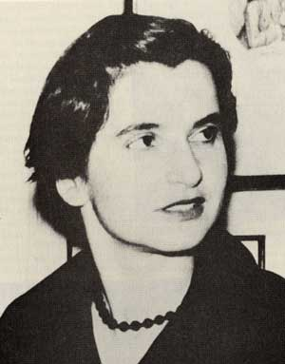
KRISTAL DNA
Difraksi sinar X kristal DNA, Rosalind Franklin 1953

Slide 28
Ikatan hidrogen
H
H
O
H
H
C
H
N
H
Timin
C
C
N
C
C
C
Adenin
H
C
N
H
N
C
N
C
N
O
C
N
H
H
H
N
H
Sitosin
C
C
N
H
O
C
H
C
N
C
C
Guanin
C
H
N
N
N
C
O
C
N
N
H
H

Slide 29
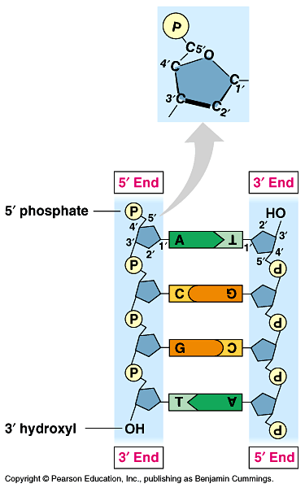

Slide 30
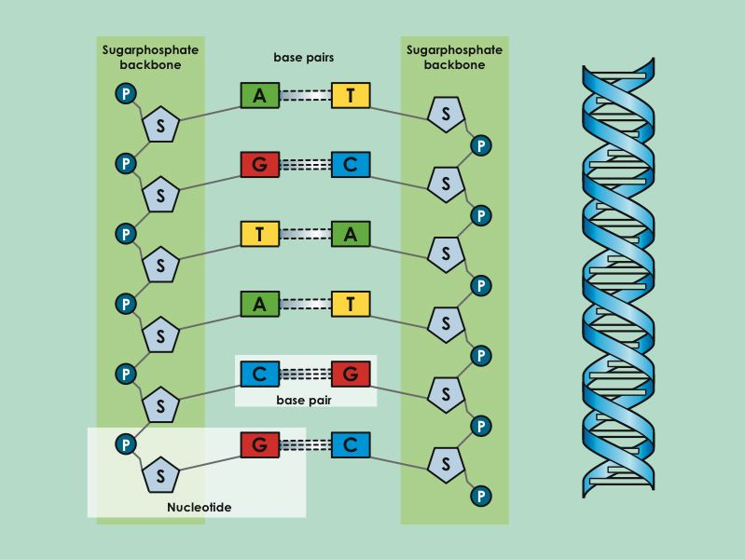

Slide 31
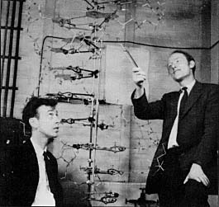

Slide 32
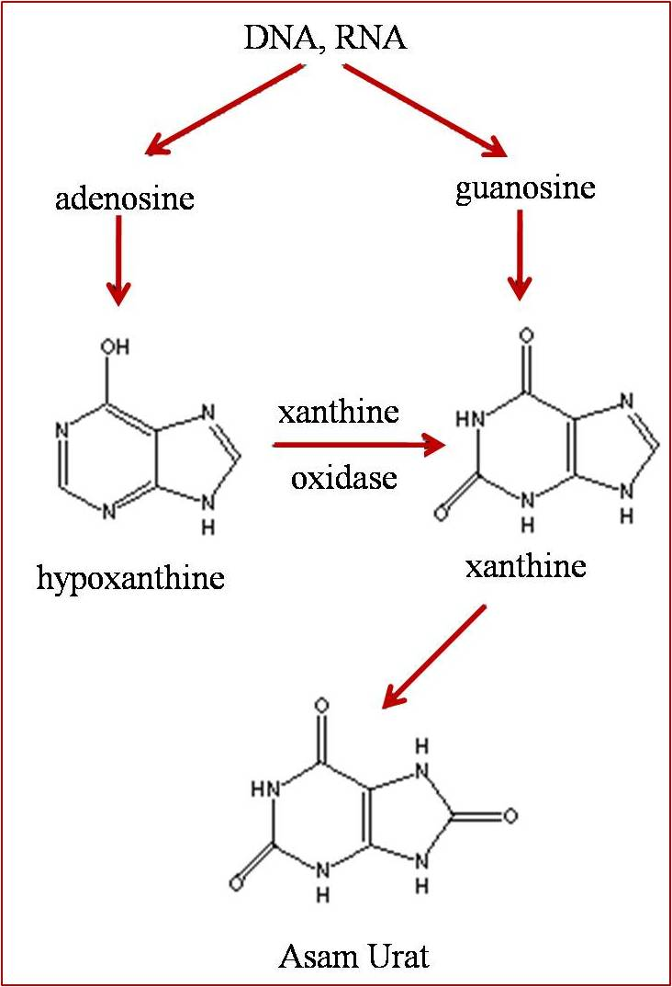
METABOLISME ASAM URAT
Penderita asam urat

Slide 33
REPLIKASI DNA
Replikasi DNA terjadi secara semikonservatif
Hal ini menyebabkan DNA baru membawa informasi yang persis sama dengan DNA induk/cetakan

Slide 34
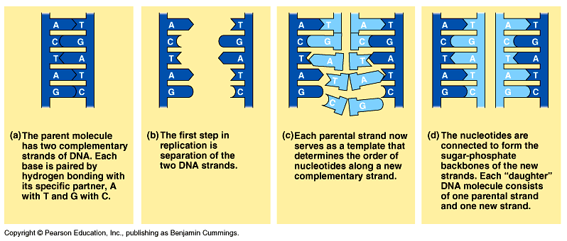

Slide 35
Replikasi
Replikasi DNA pada cetakan 3’ – 5’ terjadi seutas demi seutas dengan arah 5’ – 3’ Replikasi berjalan meninggalkan replication fork.
Utas-utas pendek tersebut dihubungkan oleh enzim ligase DNA.
Terdapat utas DNA yang disintesis secara kontinu disebut utas utama atau leading strand.
Sedangkan utas DNA baru yang disintesis pendek-pendek seutas-demi seutas disebut utas lambat atau lagging strand.

Slide 36
Replikasi DNA melibatkan :
Polimerase DNA : enzim yang berfungsi mempolimerisasi nukleotida-nukleotida
Ligase DNA : enzim yang berperan menyambung DNA utas lagging
Primase RNA : enzim yang digunakan untuk memulai polimerisasi RNA pada lagging strand
Helikase DNA : enzim yang berfungsi membuka jalinan DNA double heliks
Single strand DNA-binding protein : menstabilkan DNA induk yang terbuka

Slide 37
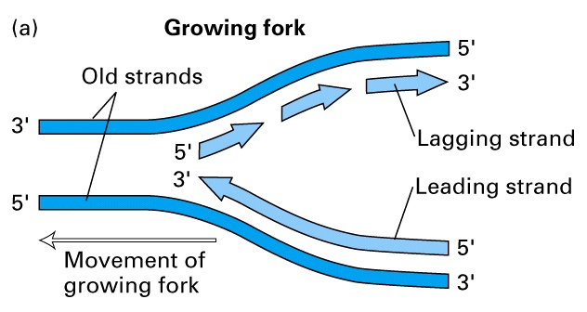
Garpu replikasi/Growing Fork
Leading strand: sintesis DNA terjadi secara kontinu
Lagging strand: sintesis DNA terjadi melalui pembentukan utas-utas pendek

Slide 38
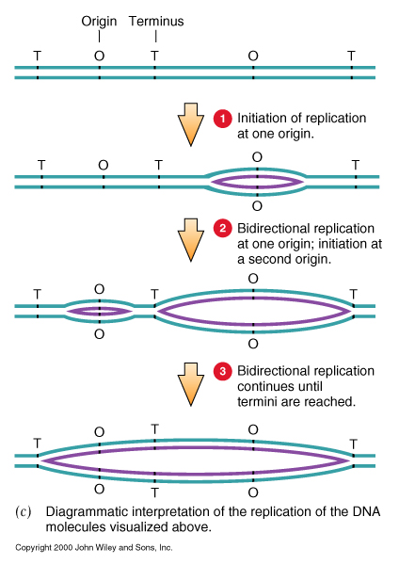
Origin meng-inisiasi replikasi DNA pada waktu yang berbeda

Slide 39
Replikasi dimulai dari tempat-tempat spesifik, yang menyebabkan kedua utas DNA induk berpisah dan membentuk gelembung replikasi
Pada eukariota, terdapat ratusan atau bahkan ribuan origin of replication di sepanjang molekul DNA.
Gelembung replikasi terentang secara lateral dan replikasi terjadi ke dua arah
Selanjutnya gelembung replikasi akan bertemu, dan sintesis DNA anak selesai

Slide 40
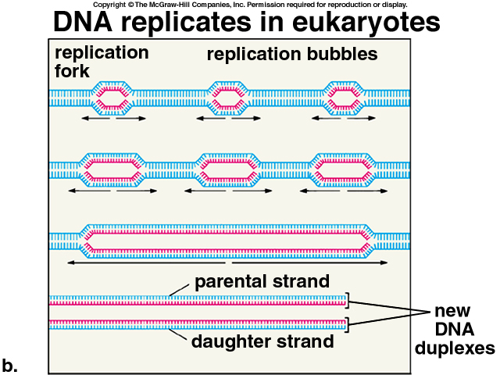

Slide 41
