Slide 1
Protozoa
Microbiological Approach
Achmad Arifiyanto M.Si
Jurusan Biologi
Fakultas Matematika dan Ilmu Pengetahuan Alam
Universitas Lampung

Slide 2
Introduction
What are algae definition according to you?
How were they gain their nutrition?
Why do we should learn this topic ?
How do algae can provide benefit to us?

Slide 3
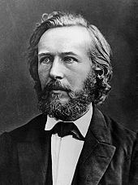
Open mind
History
In the year 1866 by Ernst Haeckel
Animal-like protozoans, i.e., heterotrophic/parasitic motile eukaryotes;
Plantlike protophyta or algae, i.e., autotrophic unicellular eukaryotes;
Fungus-like saprophytes, i.e., unicellular eukaryotic decomposers with extracellular digestion and spore production.
In the year 1866 by Ernst Haeckel
Protozoa

Slide 4
Objective
The simplest definition of a protist is exclusive: a eukaryote that is neither an animal nor a plant or a fungus
Protist is a polyphyletic (paraphyletic) assembly; an artificial collection of diverse organisms
It’s only limited human knowledge to give name
Protoza

Slide 5
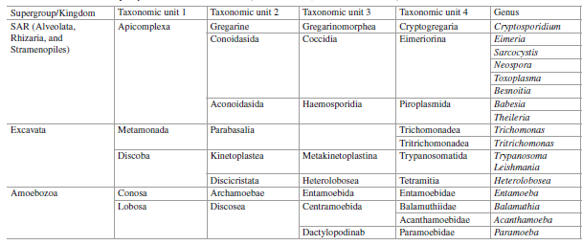
Classification

Slide 6
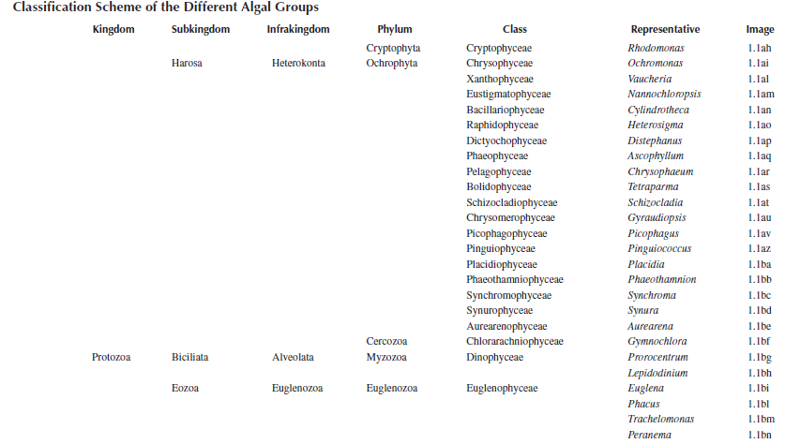
Classification

Slide 7
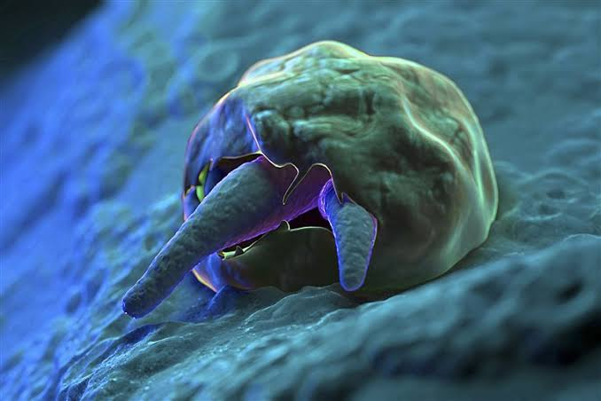
Shapes diversity
Cryptosporidium sp.

Slide 8
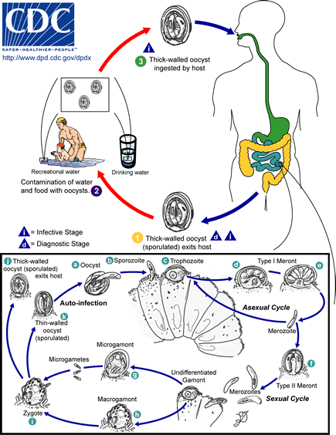

Slide 9
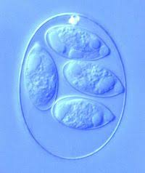
Shapes diversity
Eimeria sp.

Slide 10
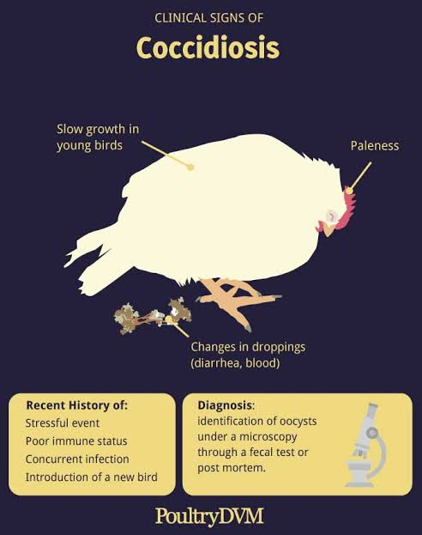
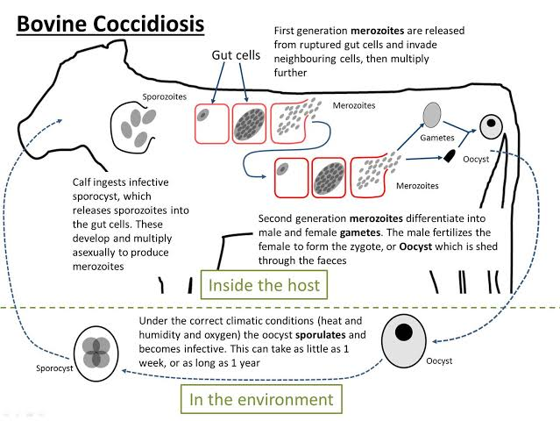

Slide 11
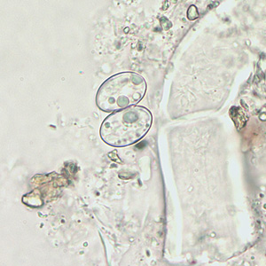
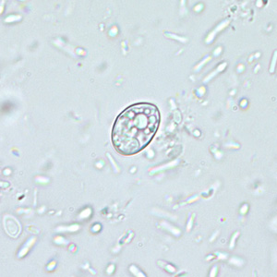
Shapes diversity
Sarcocystis sp.

Slide 12
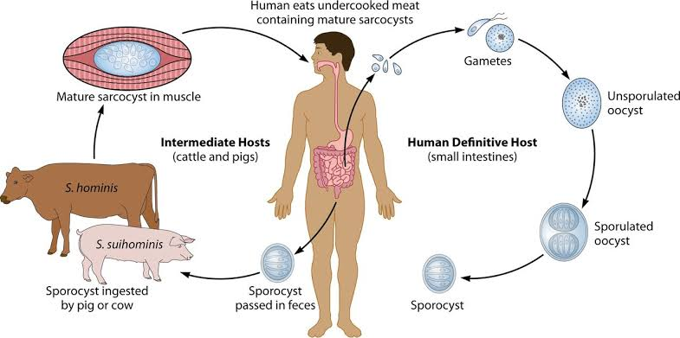
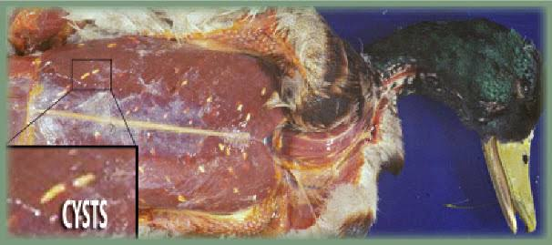

Slide 13
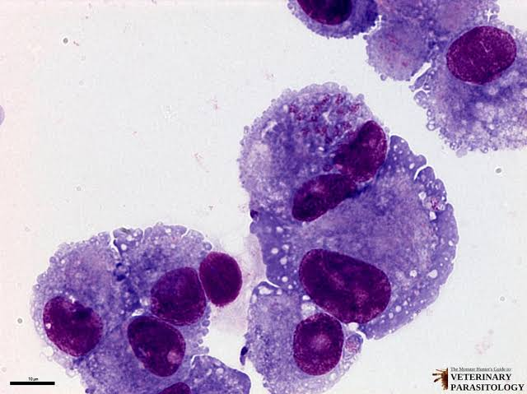
Shapes diversity
Neurospora sp.

Slide 14
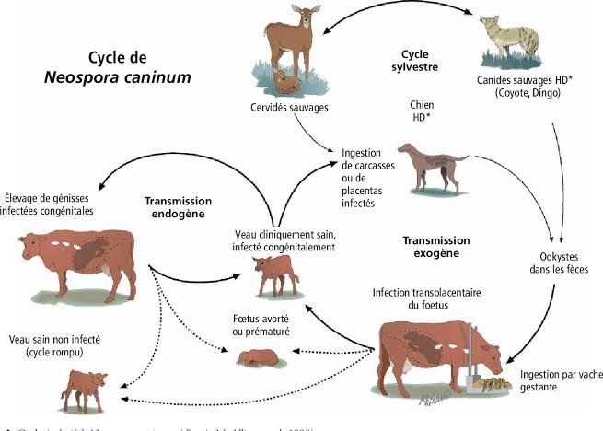

Slide 15
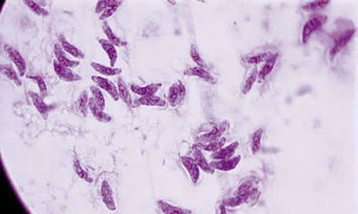
Shapes diversity
Toxoplasma sp.

Slide 16
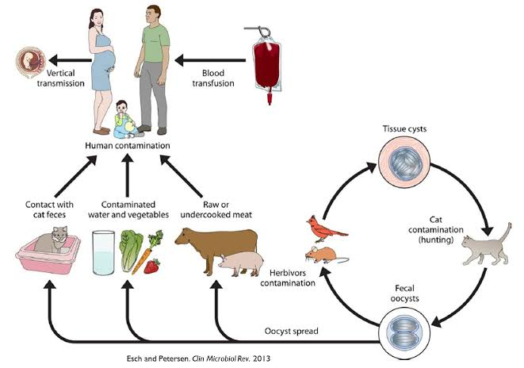

Slide 17
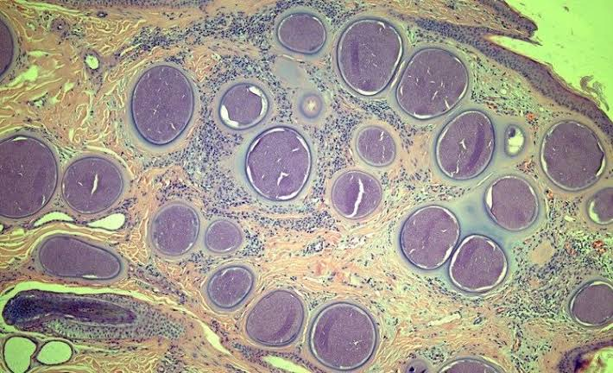
Shapes diversity
Besnoitia sp.

Slide 18
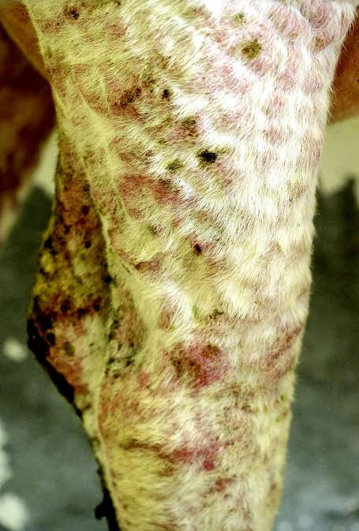
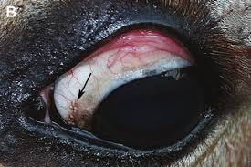

Slide 19
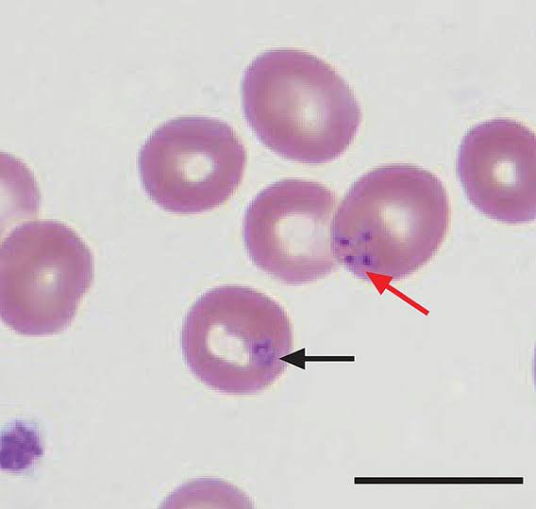
Shapes diversity
Babesia sp.

Slide 20
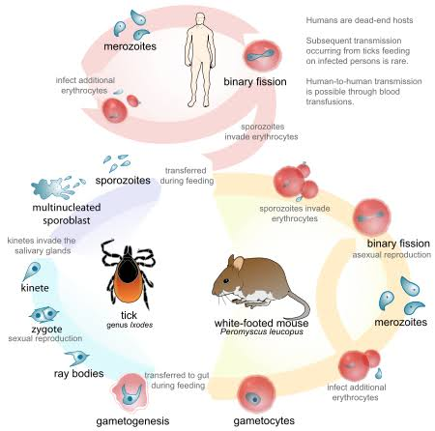
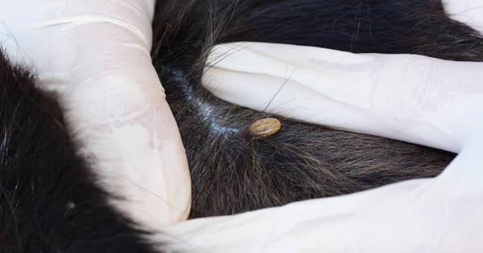

Slide 21
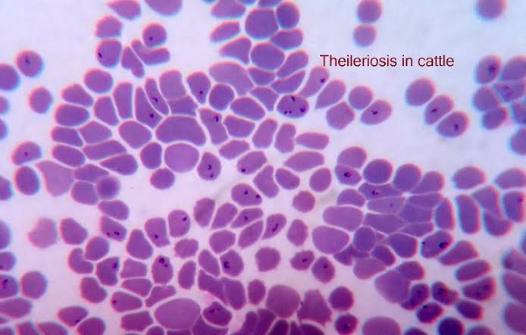
Shapes diversity
Theileria sp.

Slide 22
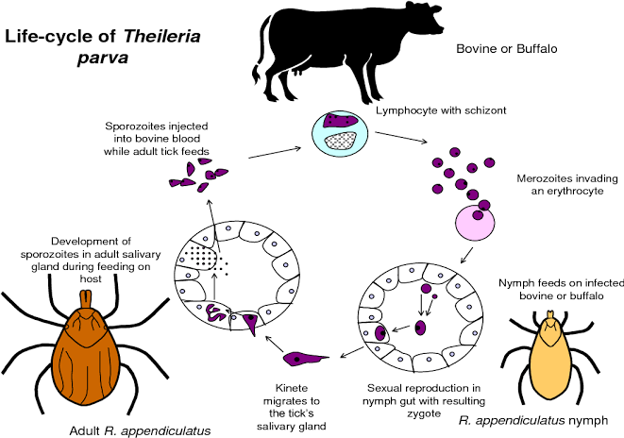

Slide 23
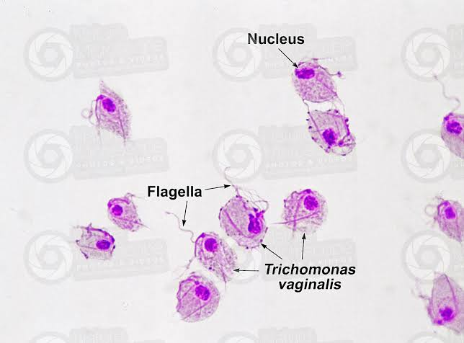
Shapes diversity
Trichomonas sp.

Slide 24
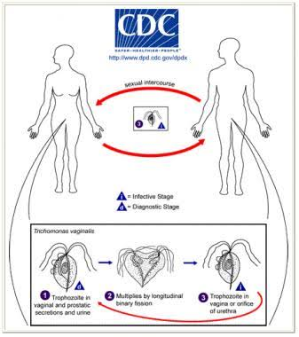

Slide 25
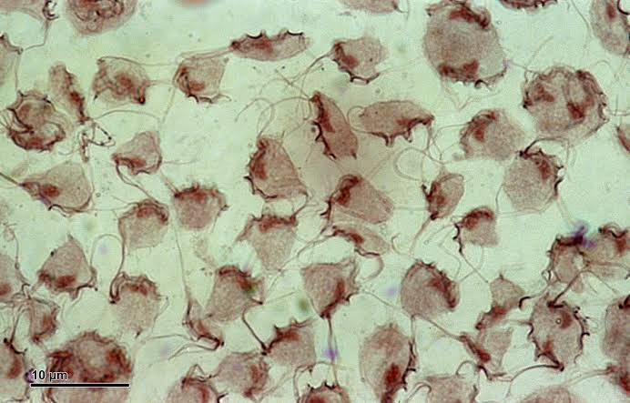
Shapes diversity
Tritrichomonas sp.

Slide 26
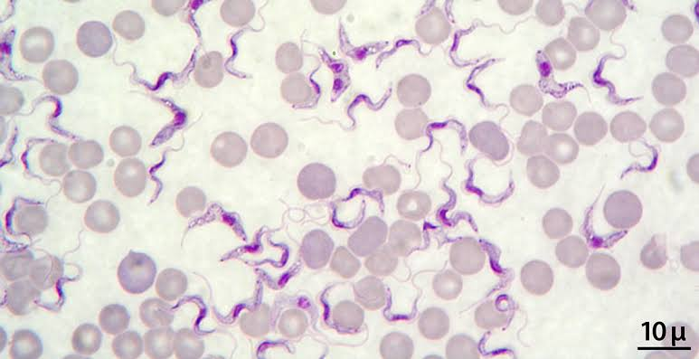
Shapes diversity
Trypanosoma sp.

Slide 27
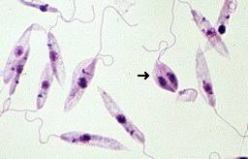
Shapes diversity
Leishmania sp.

Slide 28
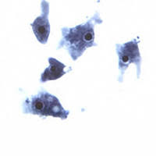
Shapes diversity
Heterolobosea sp.

Slide 29
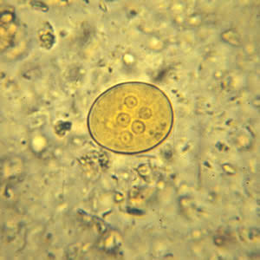
Shapes diversity
Heterolobosea sp.

Slide 30
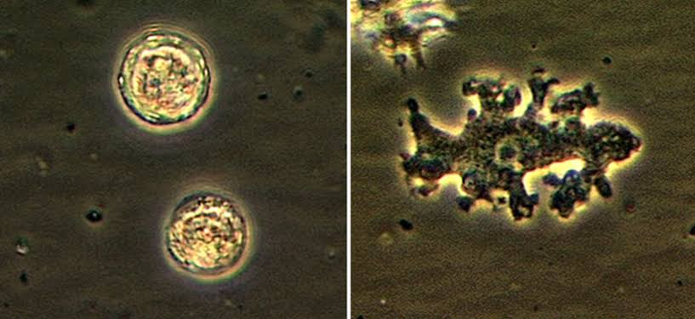
Shapes diversity
Balamuthia sp.

Slide 31
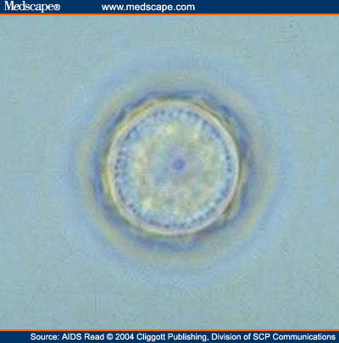
Shapes diversity
Acanthamoeba sp.

Slide 32
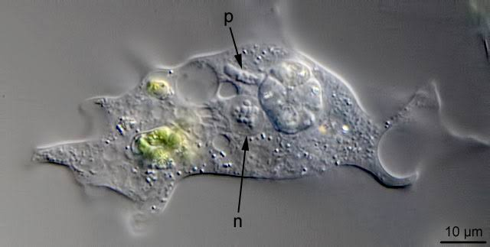
Shapes diversity
Paramoeba sp.

Slide 33
References

Slide 34
Tugas

Slide 35
Vielen Dank für ihre Aufmerksamkeit

