Slide 1
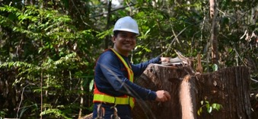
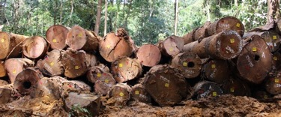
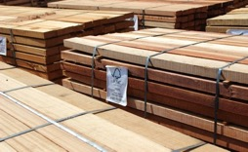
Overview of Forest Certification in the Forest Products Industry:
Revolution journey of Certified Forest Products
Wahyu Hidayat, Ph.D.
Department of Forestry, University of Lampung, Indonesia
Lead Auditor of FSC® Forest Management and Chain-of-Custody Certification, Lead Auditor of California Air Resources Board ATCM 93120 Wood Composites Certification, Lead Auditor of Environmental Protection Agency 40 CFR Part 770 Wood Composites Certification

Slide 2
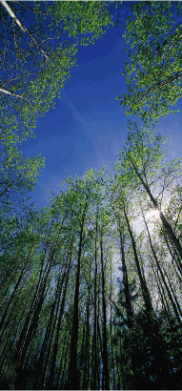
Who is the Forest Stewardship Council (FSC)?
The FSC is an international certification and labeling system that guarantees that paper and wood products carrying the FSC label come from an environmentally and socially responsible source.
The FSC’s mission is to promote the environmentally appropriate, socially beneficial and economically viable management of the
world's forests through standards development and certification
Notes:
The Forest Stewardship Council (FSC) FSC is an international certification and labeling system that guarantees that the forest products you purchase come from responsibly managed forests and verified recycled sources.
2

Slide 3
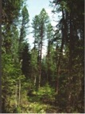
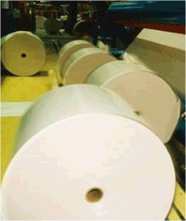
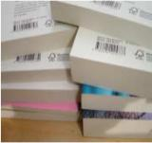
Who is the Forest Stewardship Council?
Voluntary, market based tool for forest conservation.
Tracking of products from forest to shelf.
Forest management
certification
Chain of Custody
certification
The FSC label
Notes:
The FSC was founded in 1993 as a voluntary and market-based mechanism for ensuring that the world’s forests are managed in an environmentally responsible, socially acceptable and economically viable manner.
Under FSC certification, forestry companies are independently audited to meet the FSC’s strict forest management standards. Beyond the forest, all producers along the supply chain must be chain of custody certified. At every stage of manufacturing or distribution, the fibre going into a product is tracked and identified. The FSC system not only makes certain that wood fibre used in a product is from a sustainable source, but it ensures that claims regarding the recycled content of products are verifiable. In an unbroken chain of commitment from forest to consumer, the FSC label carries the promise that a product comes from a forest friendly source.

Slide 4
10 Guiding Principles
Compliance with Laws and FSC Principles
Tenure and Use Rights and Responsibilities
Indigenous Peoples' Rights
Community Relations and Worker's Rights
Benefits from the Forest
Environmental Impact
Management Plan
Monitoring and Assessment
Maintenance of High Conservation Value Forests
Plantations
Notes:
All forests certified to FSC’s standards must meet the FSC’s ten principles of forest management, and undergo third-party audits. The audit process can take several years as public meetings and consultations take place to ensure that local communities, First Nations and stakeholders have a say in forest management practices. In addition to the initial certification audit, every year auditors return to the field to make certain that the forest management practices are being implemented according to established plans and requirements.
In Canada there are four regional standards for forest management that are based upon these 10 principles:
National Boreal Standard (accredited August 2004)
Maritimes Standard (accredited December 1999, under revision)
BC Standard (accredited November 2005)
Great Lakes-St. Lawrence, Laurentian Standard (currently under development)
The FSC’s transparency, focus on a participatory consultation process, independent monitoring, supply chain tracking and strong management standards are some of the reasons why it is the only forest certification system supported by groups such as the World Wildlife Fund Canada, Greenpeace, Sierra Club of Canada, and the National Aboriginal Forestry Association.

Slide 5
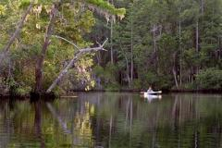
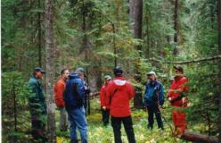
What does it mean for forests?
Waterways are protected;
Wildlife habitat and species are protected;
High conservation value forests are preserved;
Forest management practices are monitored annually;
Genetically modified trees are not used;
Local people are involved in forest mgmt.;
The rights of Indigenous Peoples are respected.
Notes:
FSC forest management certification has many benefits that can be seen on the ground in the forests themselves. Here are a few examples.

Slide 6
What is FSC Certification?
Forest certification is a market-based, non-regulatory forest conservation tool designed to recognize and promote environmentally-responsible forestry and sustainability of forest resources through the verification of forest management practices and product labeling.
By certifying forest lands to FSC standards and tracking all wood fiber coming out of these certified forests, final products like paper, furniture, lumber and so forth can be labeled, recognized and demanded by consumers who want to support sustainable forest management.
Notes:
6

Slide 7
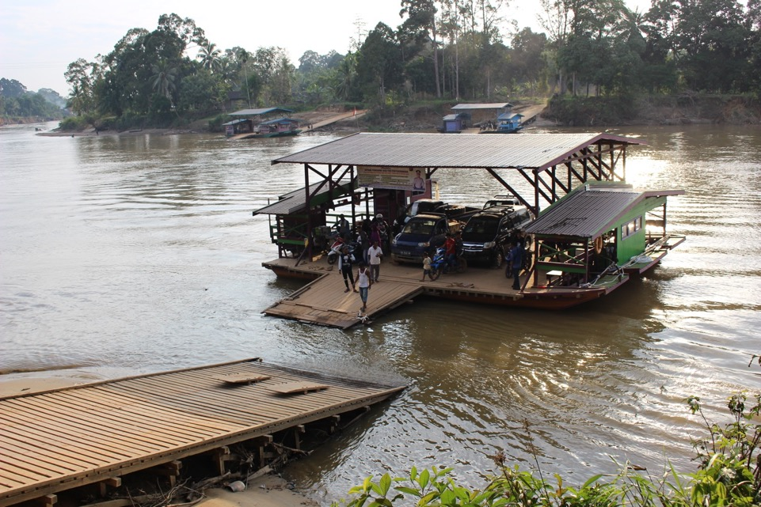

Slide 8
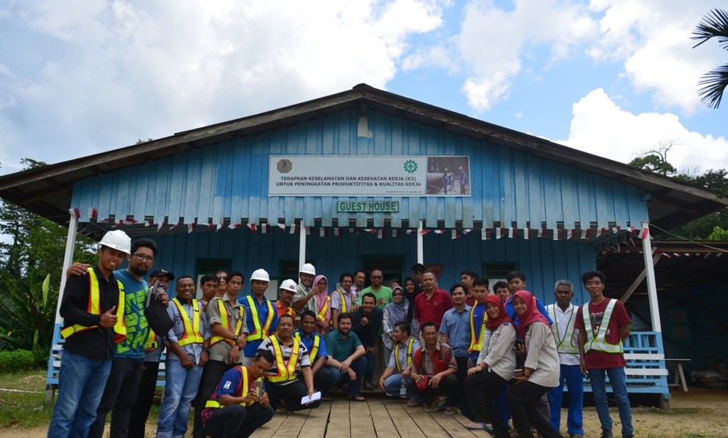

Slide 9
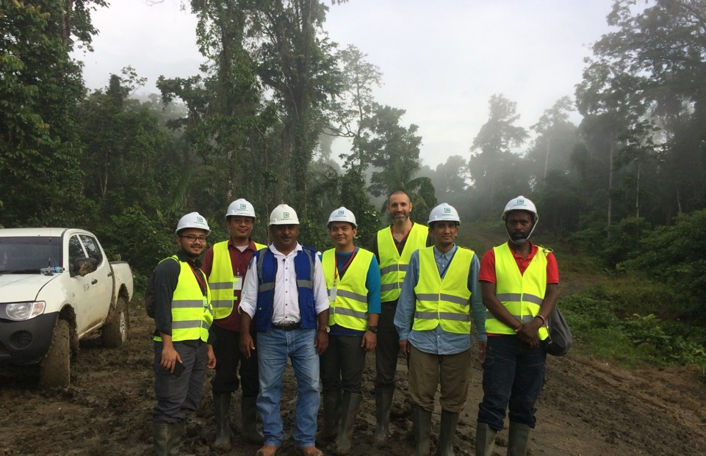

Slide 10
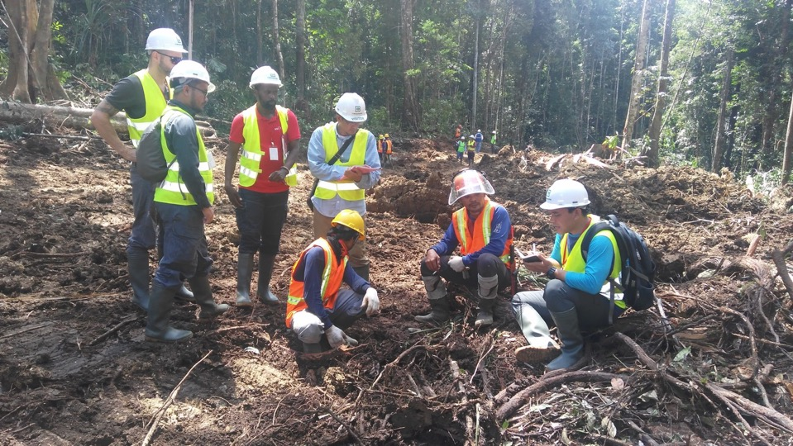

Slide 11
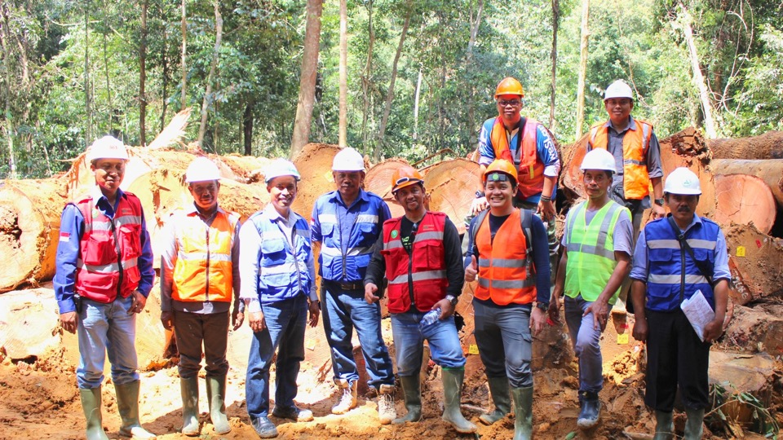

Slide 12
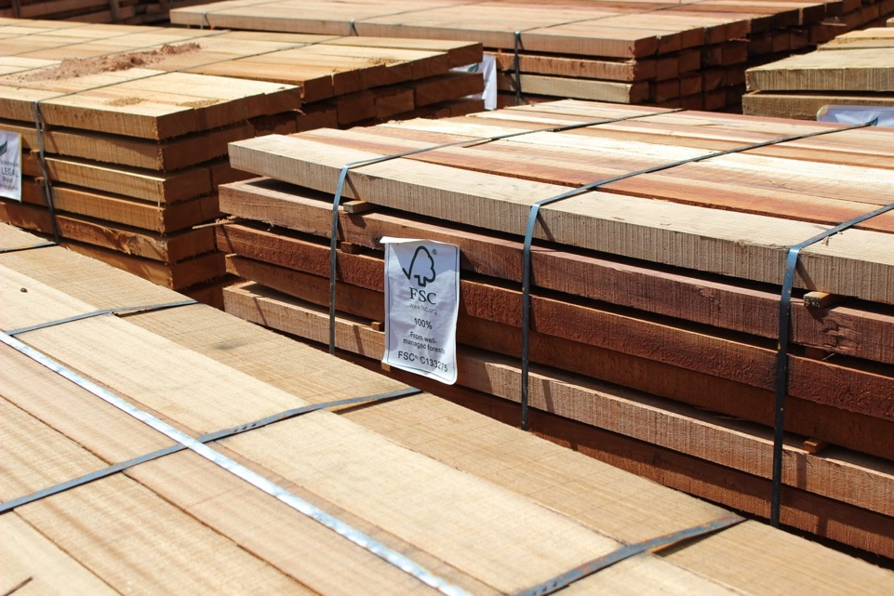

Slide 13
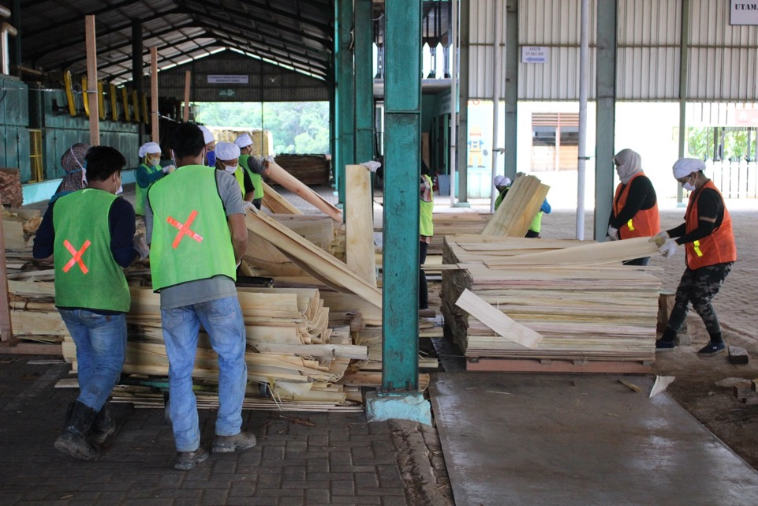

Slide 14
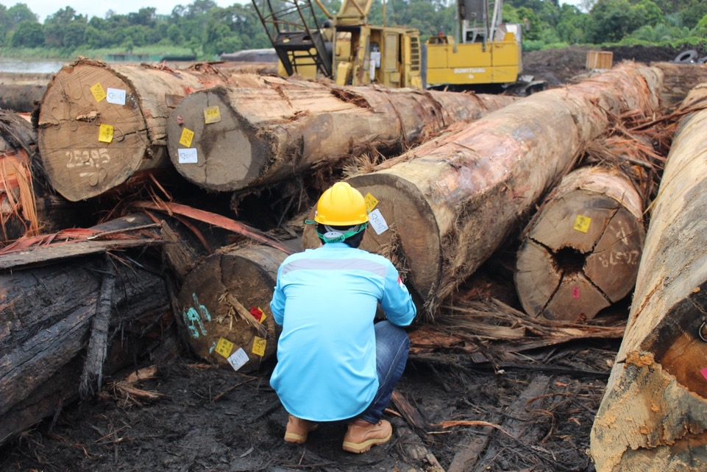

Slide 15
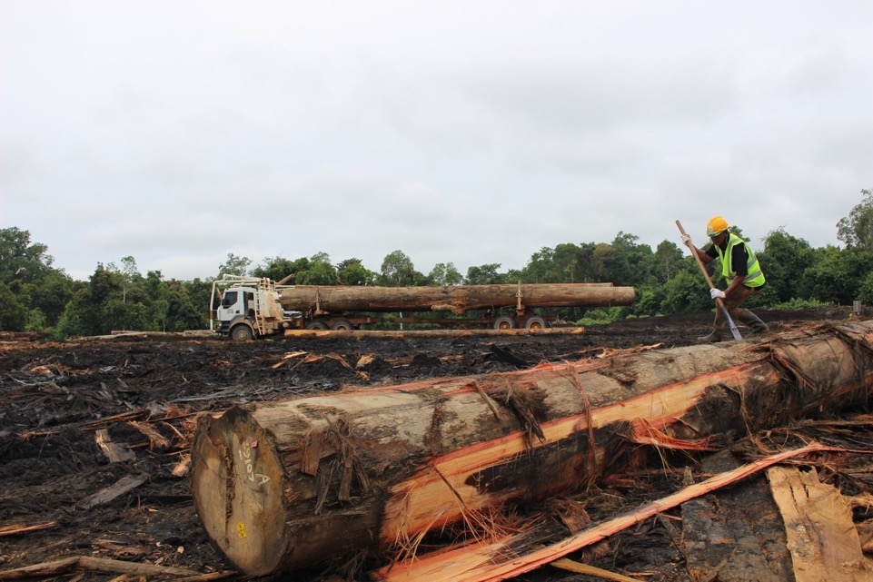

Slide 17
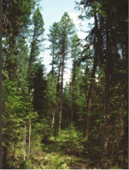
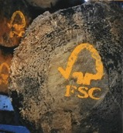
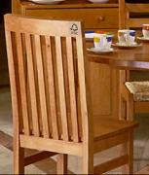
How Does FSC Certification Work?
It is a voluntary, market based tool for forest conservation.
It tracks products from forest to shelf.
Responsibly produced forest products are identified with the FSC logo.
1. Forest Management
certification
2. Chain of Custody
certification
3. Product Labeling
Notes:
There are two types of FSC certification, those for forests (called Forest Management certification) and those for manufacturers, distributors and traders (called Chain of Custody certification).
Once a forest is FSC-certified, all the wood coming from this forest can then be tracked through manufacturing and processing so that when a final wood or paper product carries the FSC logo, it can be guaranteed to have come from a responsible wood source. This means that all manufacturers, processors, distributors and traders within a supply chain must become Chain of Custody certified, so that FSC fibre can be tracked and the label used to identify FSC-certified products.
17

Slide 18
FSC Today

Slide 19
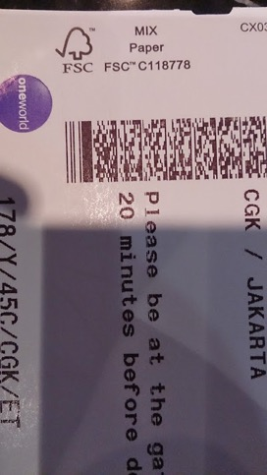
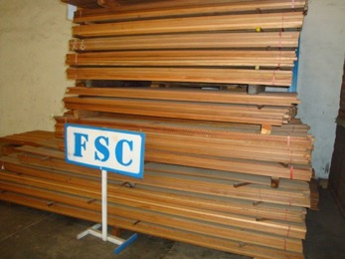
FSC certified product

Slide 20
Opportunities
Clean energy
Biomass
Fashion

Slide 21
Revolution journey of FSC certified products

Slide 22
Revolution journey of FSC certified products

Slide 23
Consumer vs Producer in Asia
Consumer
Japan
South Korea
Producer
Indonesia
Malaysia
Vietnam
China
Thailand

Slide 24
Main driver of biomass market in Asia
China
Guiding opinions on Establishing Renewable Energy Portfolio Standards in 2013
South Korea
Renewable Portfolio Standards in 2012
Japan
2009 Basic Act for The Promotion of Biomass Utilization

Slide 25
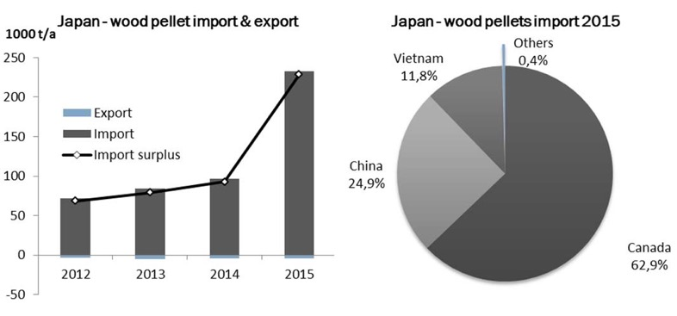
Wood pellet consumption in Japan
Source: IEA Bioenergy Task 40 June 2017

Slide 26
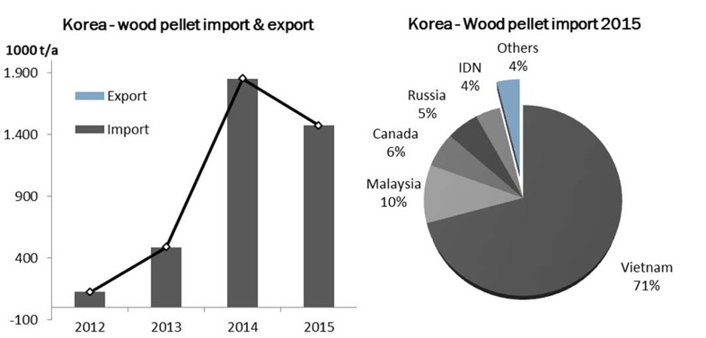
Wood pellet consumption in South Korea
Source: IEA Bioenergy Task 40 June 2017

Slide 27
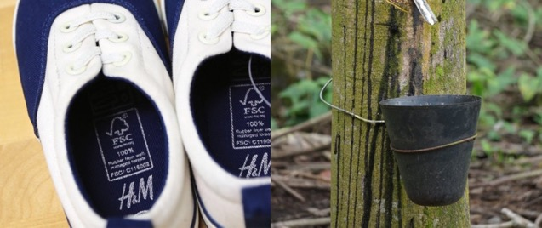
Revolution journey of FSC certified products
Source: FSC

Slide 28
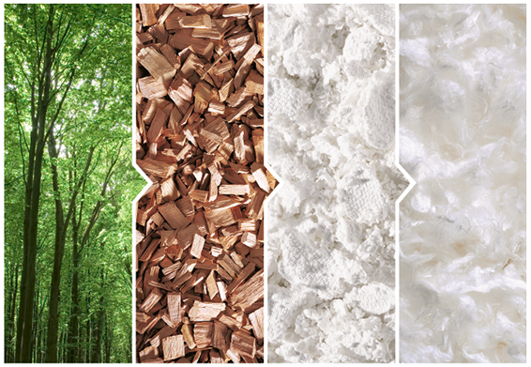
Revolution journey of FSC certified products

Slide 29
Challenges
Plantation after 1994
Capacity building for SLIMF
Land tenure dispute
Business scale

