Slide 1
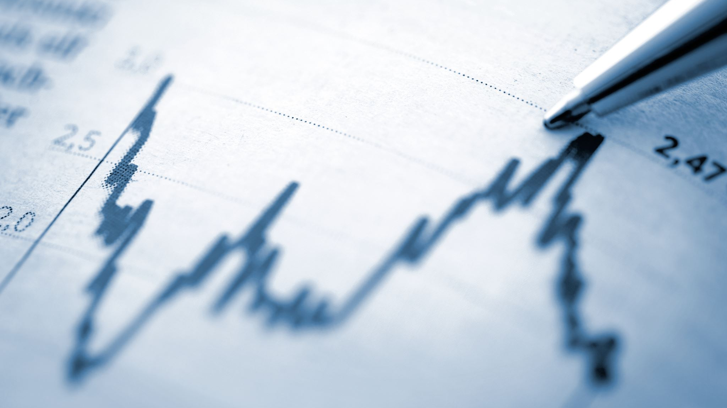
CAPITAL MARKET FUNCTIONS AND The OBJECTIVES
Presented by: Nurul Husna, S.E., M.S.M.

Slide 2
CAPITAL MARKET DEFINITION
According UU No 8/1995
Activities related to public offerings and securities trading of public companies related to issued securities, as well as institutions & professions related to securities

Slide 3
Suad Husnan
The market for various long-term financial instruments (securities) that can be traded in the form of debt/own equity issued by the government/private sector

Slide 4
3. The capital market is a market for various long-term financial instruments that can be traded, both debt securities (bonds), equities (stocks), mutual funds, derivative instruments and other instruments. The capital market is a means of funding for companies and other institutions (eg the government), and as a means for investing activities.

Slide 5
In a narrow sense:
- An organized place where securities are traded (Stock Exchange)
STOCK EXCHANGE:
Meetings of sellers and buyers of securities either directly or indirectly.
Maintain Continuity

Slide 6
Concretely:Bringing together those who offer and need long-term assets (stock, bonds, etc.)
stock Exchange
Indonesia stock Exchane

Slide 7
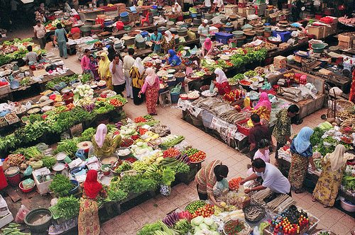
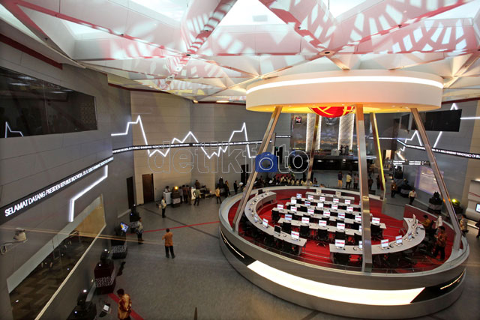
Capital Market vs Traditional Market
Vs
What is the difference ???
2

Slide 8
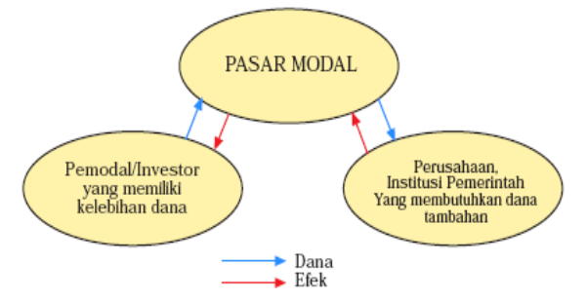

Slide 9
REASON FOR CAPITAL MARKET
Performing Economic & Financial Functions.
Capital Market Provides fund facilities from lenders to borrowers.
Lender : Return
Borrower : Fast investment
Become an alternative to raising funds other than bankingLimited debt opportunities (Manage Debt to equity ratio)
Allows issuing Bonds (debt securities) or shares (signs of ownership)

Slide 10
Investment Alternatives for Investors
Change portfolio combinations quickly
No need big funds
Liquidity
According to risk preferences

