Slide 1
DIFERENSIAL IMPLISIT
Oleh
AMIR SUPRIYANTO
FISIKA-FMIPA-UNILA

Slide 2
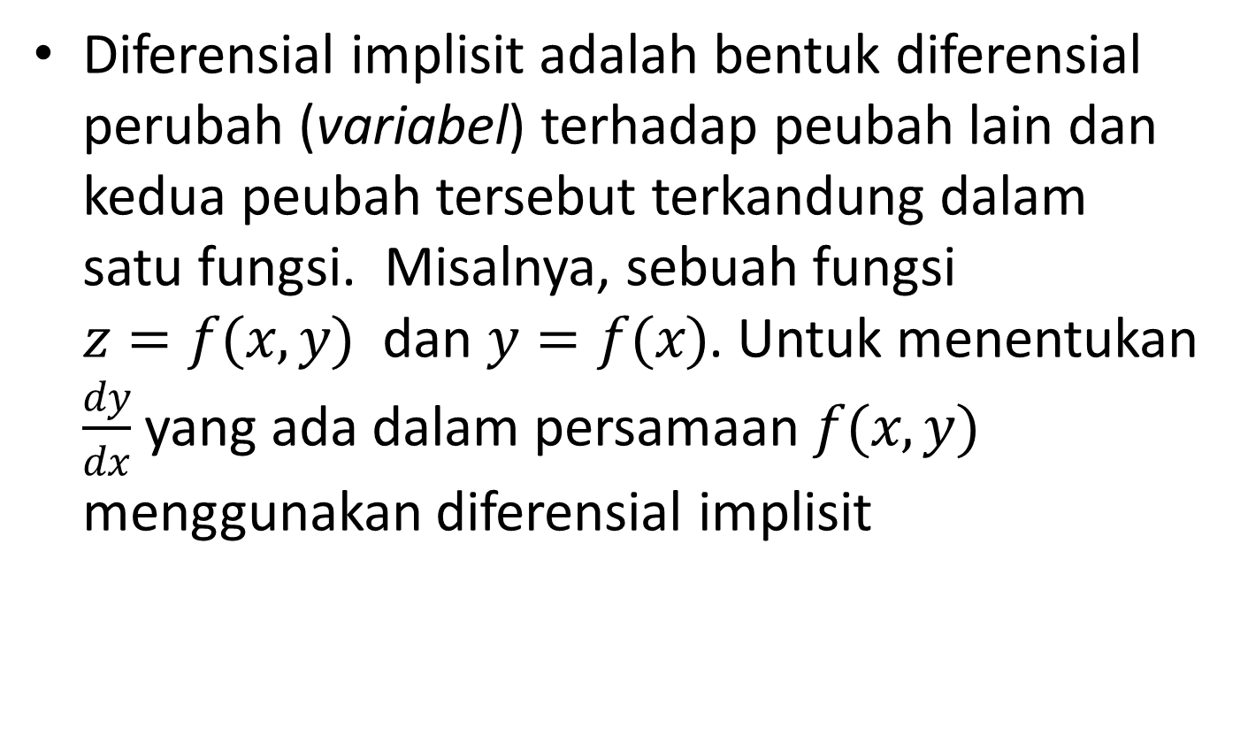
Diferensial implisit adalah bentuk diferensial perubah (variabel) terhadap peubah lain dan kedua peubah tersebut terkandung dalam satu fungsi. Misalnya, sebuah fungsi $z=f(x,y)$ dan $y=f(x)$. Untuk menentukan $\frac{dy}{dx}$ yang ada dalam persamaan$f(x,y)$ menggunakan diferensial implisit

Slide 3

Contoh:
Terdapat fungsi: $x^{3}−3y^{2}+xy+21=0$. Tentukan:
$\frac{dy}{dx}$;
$\frac{d^{2}y}{dx^{2}}$;
Berapa nilai $\frac{dy}{dx}$ dan $\frac{d^{2}y}{dx^{2}}$ di titk (1,2)

Slide 4
Penyelesaian:
$3x^{2}−6y\frac{dy}{dx}+y+x\frac{dy}{dx}=0$
$$3x^{2}+y=6y\frac{dy}{dx}−x\frac{dy}{dx}=\left(6y−x\right)\frac{dy}{dx}$$
Diperoleh $\frac{dy}{dx}=\frac{3x^{2}+y}{6y−x}$

Slide 5
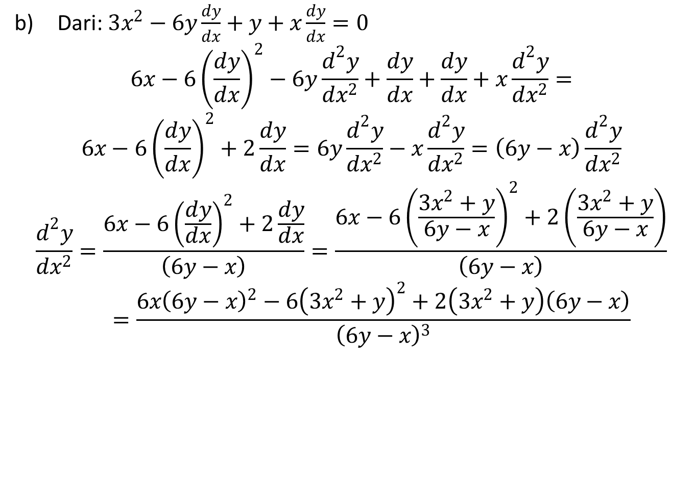
Dari: $3x^{2}−6y\frac{dy}{dx}+y+x\frac{dy}{dx}=0$
$$6x−6{\left(\frac{dy}{dx}\right)}^{2}−6y\frac{d^{2}y}{dx^{2}}+\frac{dy}{dx}+\frac{dy}{dx}+x\frac{d^{2}y}{dx^{2}}=$$
$$6x−6{\left(\frac{dy}{dx}\right)}^{2}+2\frac{dy}{dx}=6y\frac{d^{2}y}{dx^{2}}−x\frac{d^{2}y}{dx^{2}}=\left(6y−x\right)\frac{d^{2}y}{dx^{2}}$$
$$\frac{d^{2}y}{dx^{2}}=\frac{6x−6{\left(\frac{dy}{dx}\right)}^{2}+2\frac{dy}{dx}}{\left(6y−x\right)}=\frac{6x−6{\left(\frac{3x^{2}+y}{6y−x}\right)}^{2}+2\left(\frac{3x^{2}+y}{6y−x}\right)}{\left(6y−x\right)}=\frac{6x{\left(6y−x\right)}^{2}−6{\left(3x^{2}+y\right)}^{2}+2\left(3x^{2}+y\right)\left(6y−x\right)}{{\left(6y−x\right)}^{3}}$$

Slide 6
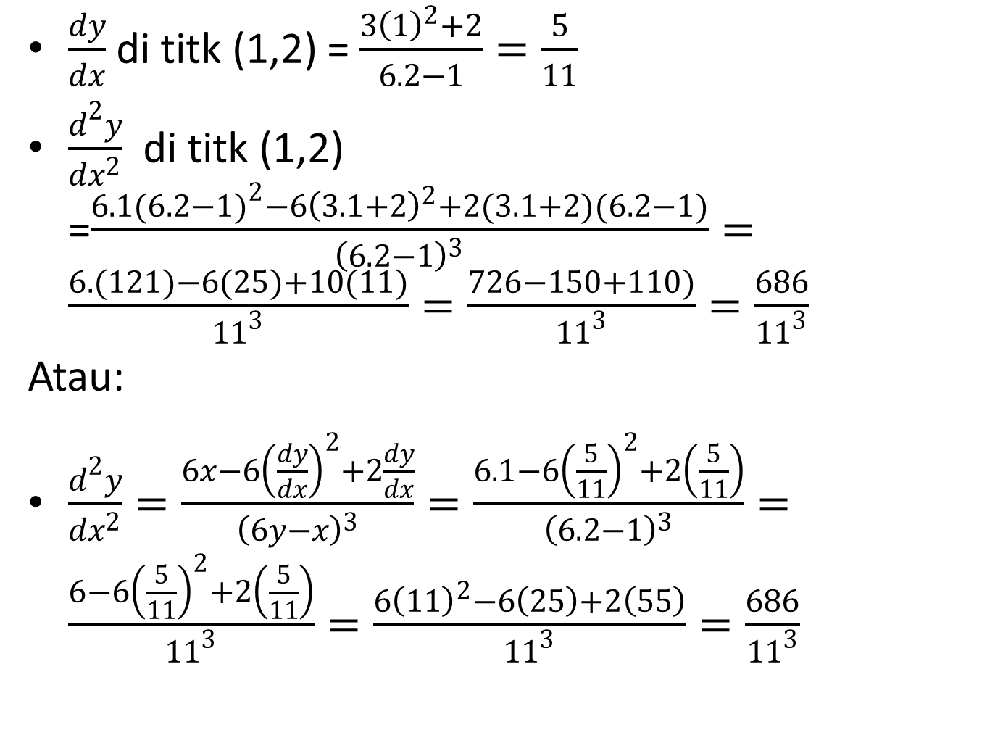
$\frac{dy}{dx}$ di titk (1,2) = $\frac{3{\left(1\right)}^{2}+2}{6.2−1}=\frac{5}{11}$
$\frac{d^{2}y}{dx^{2}}$ di titk (1,2) =$\frac{6.1{(6.2−1)}^{2}−6{\left(3.1+2\right)}^{2}+2(3.1+2)(6.2−1)}{{\left(6.2−1\right)}^{3}}=\frac{6. (121)−6(25)+10(11)}{{11}^{3}}=\frac{726−150+110)}{{11}^{3}}=\frac{686}{{11}^{3}}$
Atau:
$\frac{d^{2}y}{dx^{2}}=\frac{6x−6{\left(\frac{dy}{dx}\right)}^{2}+2\frac{dy}{dx}}{{\left(6y−x\right)}^{3}}=\frac{6.1−6{\left(\frac{5}{11}\right)}^{2}+2\left(\frac{5}{11}\right)}{{\left(6.2−1\right)}^{3}}=\frac{6−6{\left(\frac{5}{11}\right)}^{2}+2\left(\frac{5}{11}\right)}{{11}^{3}}=\frac{6{\left(11\right)}^{2}−6\left(25\right)+2\left(55\right)}{{11}^{3}}=\frac{686}{{11}^{3}}$

Slide 7
Dari persamaan garis lengkung $xy^{3}−yx^{3}=6$. Tentukan:
$\frac{dy}{dx}$; b) $\frac{d^{2}y}{dx^{2}}$ ; c) $\frac{dy}{dx}$ dan $\frac{d^{2}y}{dx^{2}}$ di titik (1,2);
d) slope dan persamaan garis singgung di titik (1,2)

Slide 8
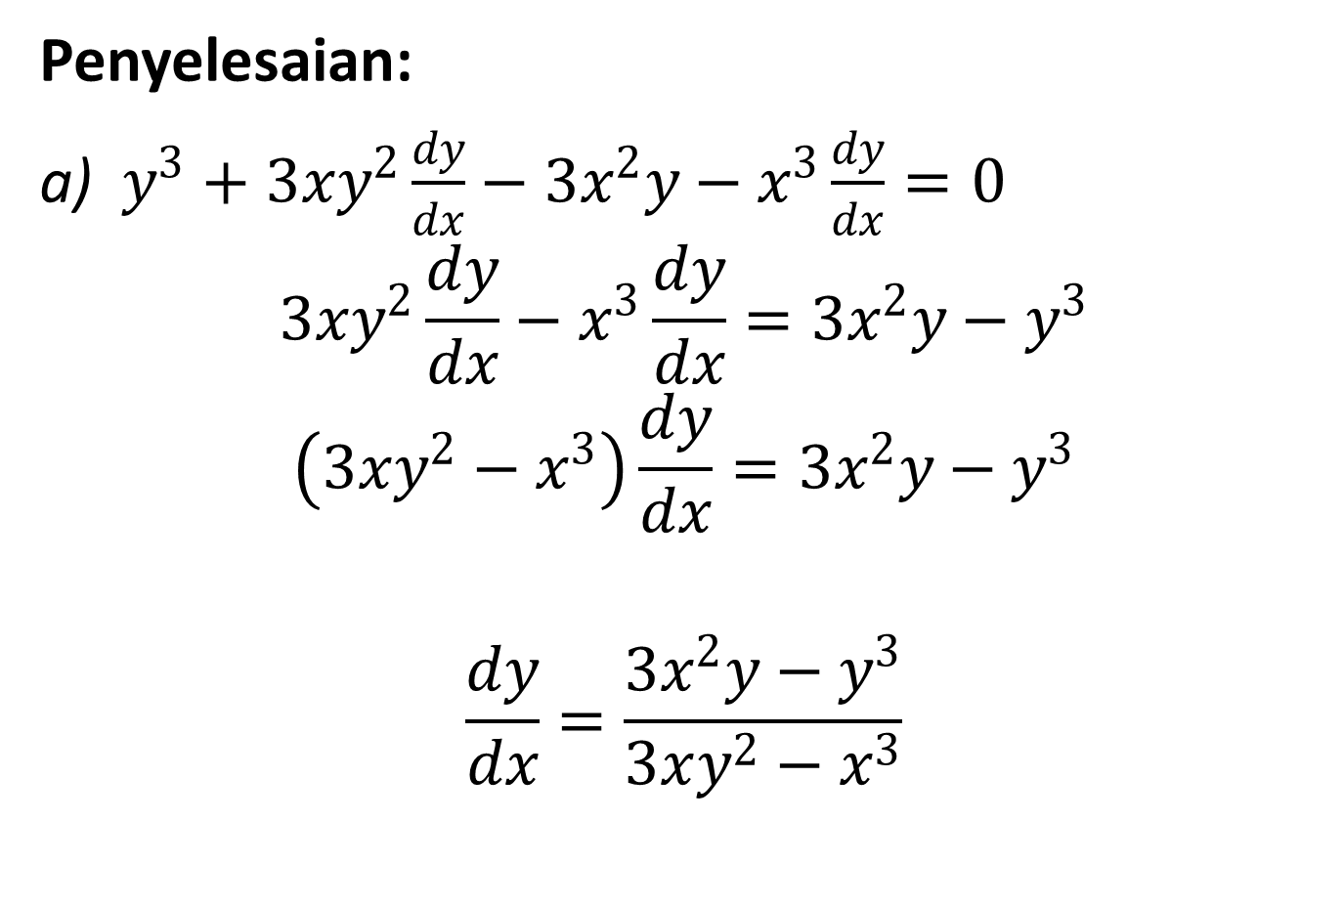
Penyelesaian:
$y^{3}+3xy^{2}\frac{dy}{dx}−3x^{2}y−x^{3}\frac{dy}{dx}=0$
$$3xy^{2}\frac{dy}{dx}−x^{3}\frac{dy}{dx}=3x^{2}y−y^{3}$$
$$\left(3xy^{2}−x^{3}\right)\frac{dy}{dx}=3x^{2}y−y^{3}$$
$$\frac{dy}{dx}=\frac{3x^{2}y−y^{3}}{3xy^{2}−x^{3}}$$

Slide 9
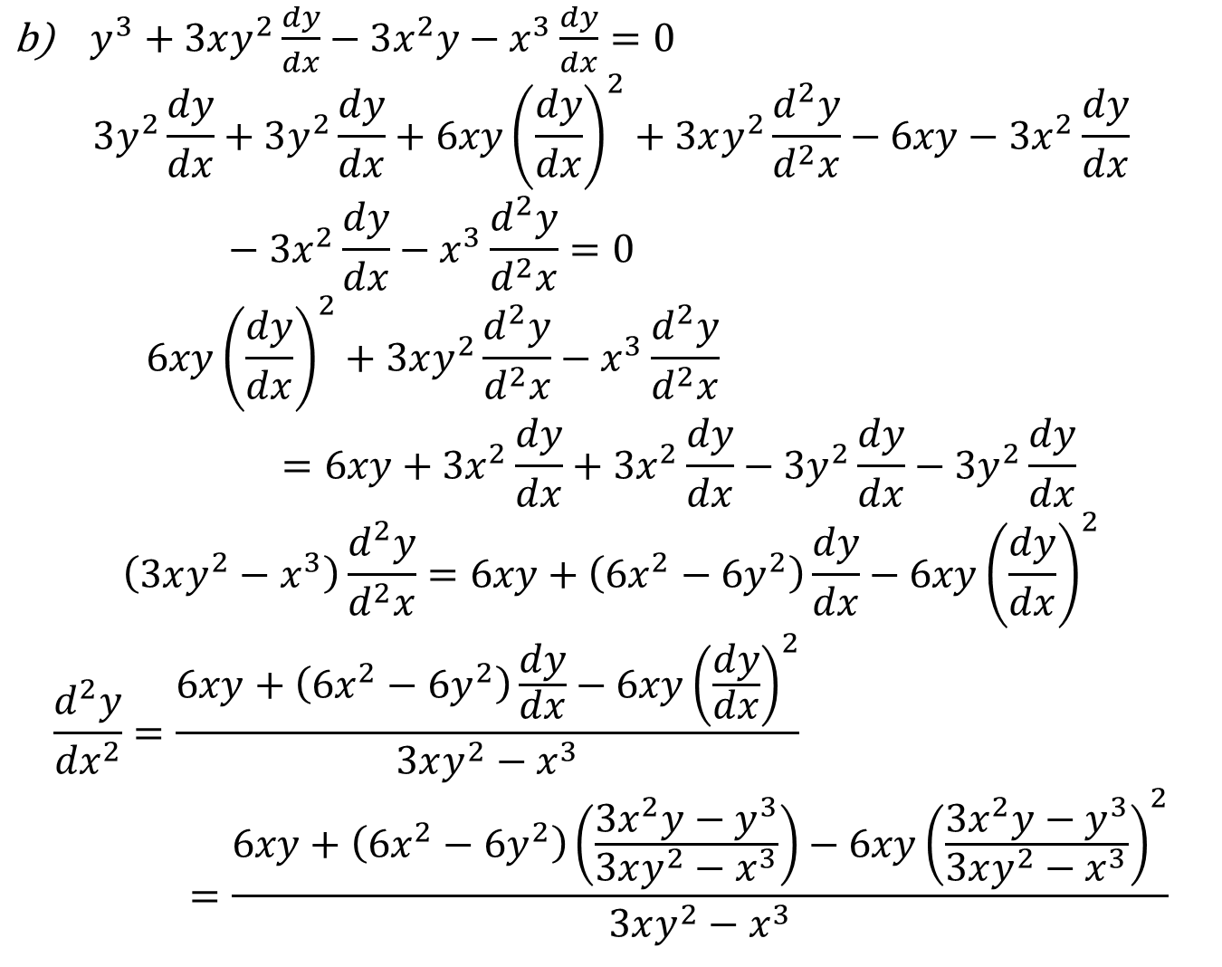
$y^{3}+3xy^{2}\frac{dy}{dx}−3x^{2}y−x^{3}\frac{dy}{dx}=0$
$$3y^{2}\frac{dy}{dx}+3y^{2}\frac{dy}{dx}+6xy{\left(\frac{dy}{dx}\right)}^{2}+3xy^{2}\frac{d^{2}y}{d^{2}x}−6xy−3x^{2}\frac{dy}{dx}−3x^{2}\frac{dy}{dx}−x^{3}\frac{d^{2}y}{d^{2}x}=0$$
$$6xy{\left(\frac{dy}{dx}\right)}^{2}+3xy^{2}\frac{d^{2}y}{d^{2}x}−x^{3}\frac{d^{2}y}{d^{2}x}=6xy+3x^{2}\frac{dy}{dx}+3x^{2}\frac{dy}{dx}−3y^{2}\frac{dy}{dx}−3y^{2}\frac{dy}{dx}$$
$$\left(3xy^{2}−x^{3}\right)\frac{d^{2}y}{d^{2}x}=6xy+\left(6x^{2}−6y^{2}\right)\frac{dy}{dx}−6xy{\left(\frac{dy}{dx}\right)}^{2}$$
$$\frac{d^{2}y}{{dx}^{2}}=\frac{6xy+\left(6x^{2}−6y^{2}\right)\frac{dy}{dx}−6xy{\left(\frac{dy}{dx}\right)}^{2}}{3xy^{2}−x^{3}}=\frac{6xy+\left(6x^{2}−6y^{2}\right)\left(\frac{3x^{2}y−y^{3}}{3xy^{2}−x^{3}}\right)−6xy{\left(\frac{3x^{2}y−y^{3}}{3xy^{2}−x^{3}}\right)}^{2}}{3xy^{2}−x^{3}}$$

Slide 10
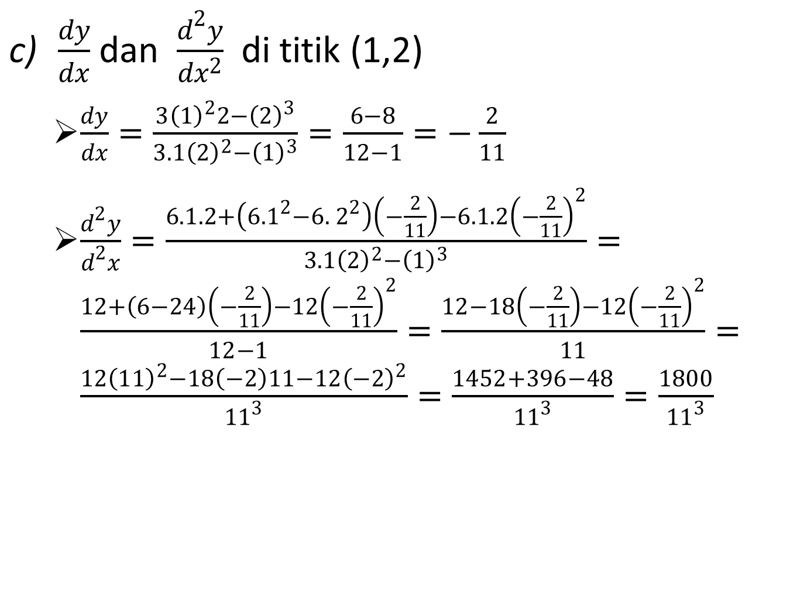
$\frac{dy}{dx}$ dan $\frac{d^{2}y}{dx^{2}}$ di titik (1,2)
$\frac{dy}{dx}=\frac{3{\left(1\right)}^{2}2−{\left(2\right)}^{3}}{3.1{\left(2\right)}^{2}−{\left(1\right)}^{3}}=\frac{6−8}{12−1}=−\frac{2}{11}$
$\frac{d^{2}y}{d^{2}x}=\frac{6.1.2+\left(6. 1^{2}−6.{ 2}^{2}\right)\left(−\frac{2}{11}\right)−6.1.2{\left(−\frac{2}{11}\right)}^{2}}{3.1{\left(2\right)}^{2}−{\left(1\right)}^{3}}=\frac{12+\left(6−24\right)\left(−\frac{2}{11}\right)−12{\left(−\frac{2}{11}\right)}^{2}}{12−1}=\frac{12−18\left(−\frac{2}{11}\right)−12{\left(−\frac{2}{11}\right)}^{2}}{11}=\frac{12{\left(11\right)}^{2}−18\left(−2\right)11−12{\left(−2\right)}^{2}}{{11}^{3}}=\frac{1452+396−48}{{11}^{3}}=\frac{1800}{{11}^{3}}$

Slide 11
slope dan persamaan garis singgung di titik (1,2)
slope =$\frac{dy}{dx}=−\frac{2}{11}$
persamaan garis singgung di titik (1,2)
$y−2=−\frac{2}{11}\left(x−1\right)$
atau
$11y−22=−2x+2$ atau $11y+2x=24$

